Slide 1
Computer Networks ChalkTalk
April 2013
Challita Youssef
cyoussef@cisco.com
Notes:
Customer Version

Slide 2
Agenda
Very high level overview on:
Cisco Career Certifications
Networking Project Lifecycle
Switching Architectures
Q&A

Slide 3
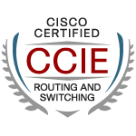
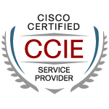
Who Am I?
LAU COE Graduate with High Distinction (Class of 2008)
2008: 6-month Internship at Cisco Headquarters (San Jose, CA)
2009-2010: Network Engineer with a Cisco Gold Partner: SP/Core routing team, mainly working on Routing, MPLS L2/L3 VPN, MPLS TE, BGP
2011-Present: Cisco - Data Center Networking (DCN) TAC (Brussels, Belgium)
Double CCIE #24153 (Routing&Switching, Service Provider)

Slide 4
Cisco Career Certifications
Networking Project Lifecycle
Switching Architectures

Slide 5
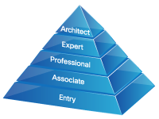
Cisco Career Certifications
Cisco is the leader in IT training and Certifications
Award-winning certification program
Great balance of speed, innovation and quality
Scalability, depth and breadth are built into the program to offer specializations in major networking areas: Security, Voice, Service Provider, Wireless, Data Center

Slide 6
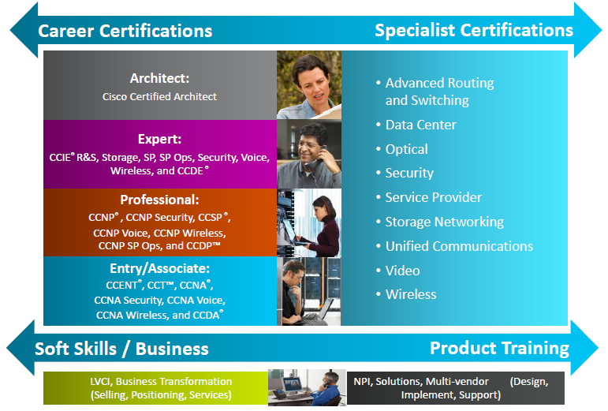
Certifications Portfolio

Slide 7
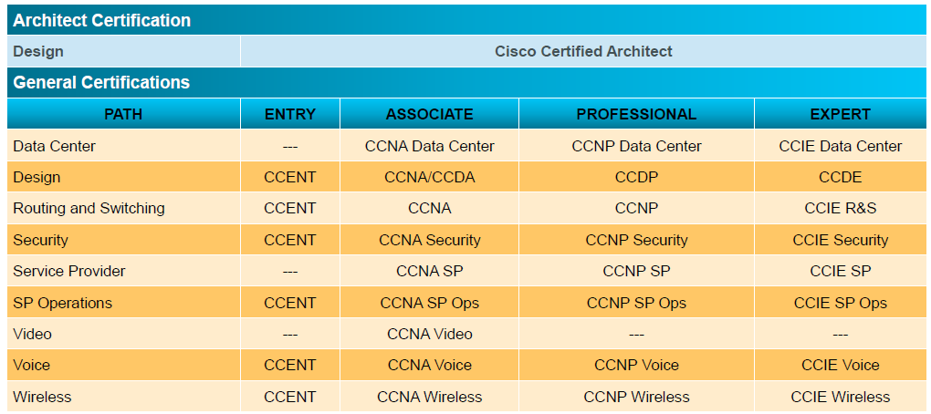
Certifications Portfolio

Slide 8
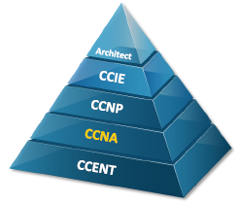
Cisco Certified Network Associate (CCNA)
Aligns to job roles such as:
–Network Technician
–Network Support or Systems Engineer
–Network Engineer
Validates ability to configure, implement, verify, and maintain a multisite enterprise network
Can implement a small switched and routed network and verify WAN links
Exams needed for certification:
–ICND1
–ICND2
No prerequisites

Slide 9
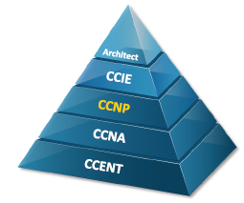
Cisco Certified Network Professional (CCNP)
Aligned to job roles such as:
–Network Technician
–Network Support or Systems Engineer
–Network Engineer
Validates ability to plan, implement, verify, and troubleshoot local and wide-area networks
Confirms advanced knowledge of security, voice, wireless, and video
Exams needed for certification:
–ROUTE
–SWITCH
–TSHOOT
CCNA is a prerequisite

Slide 10
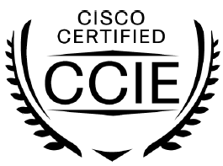
Cisco Certified Internetwork Expert (CCIE)
Most highly respected IT certification for more than 15 years
Hands-on lab differentiates the CCIE certification
More than 30,000 CCIE certified experts worldwide: less than 3% of all professionals who are certified by Cisco
Demonstrates strong commitment and investment in networking career, life-long learning, and dedication to remaining an active CCIE certified expert
Validates skills in job roles, including:
–Lead Network Engineer
–Designer
–Administrator

Slide 11
CCIE Certifications
CCIE Routing and Switching: Configure and troubleshoot complex converged networks
CCIE Security: Configure complex, end-to-end secure networks, troubleshoot environments, and anticipate and respond to network attacks
CCIE Service Provider: Configure and troubleshoot advanced technologies to support service provider networks
CCIE Service Provider Operations: Network management and operations of complex networks and network services
CCIE Voice: Configure complex, end-to-end telephony, as well as network, troubleshoot, and resolve VoIP-related problems
CCIE Wireless: Plan, design, implement, operate, and troubleshoot wireless network and mobility infrastructure
CCIE Data Centre: Plan, design, implement, operate, and troubleshoot data center networks

Slide 12
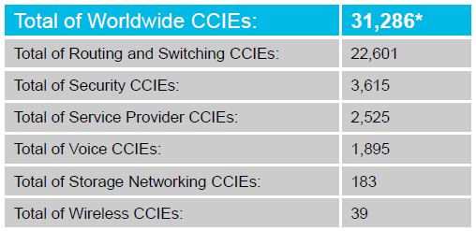
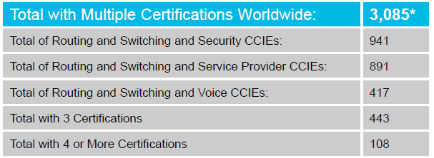
CCIE Information Worldwide
Many CCIEs Have Gone on to Pass the Certification Exams In Additional Tracks, Becoming a “Multiple CCIE.”
Below Are Selected Statistics on CCIEs Who Are Certified in More Than One Track:
* As per April 2012

Slide 13
Cisco Certified Architect (CCA)
The highest level of accreditation achievable in the Cisco Career Certification program
Recognizes the architectural expertise of network designers, and establishes formal validation of design and IT skills in Cisco technologies and infrastructure
Prerequisite to qualify for the program is a valid CCDE certification
Meet in-person with an exam committee, appointed by Cisco, to defend a proposed network

Slide 14
Cisco Specialist Certifications
Certifications that enhance and validate core knowledge for specific job roles, technologies, and products
Many certifications align to requirements for the Channel Partner Specialization program
Tracks include Advanced Routing and Switching, Data Center, IP Communications, Service Provider, Telepresence, VPN and Security, and Wireless LAN

Slide 15
Certification Process
Entry/Associate/Professional/Specialist certifications require passing one or more written (computer-based) exams
For Expert certifications, you must pass 2 exams:
2-hour written exam: similar to the above certs
Lab exam: This is what makes CCIE different. Full-day 8-hour hands-on lab exam tests the ability to configure and troubleshoot complex networks

Slide 16
Useful Links
Cisco Career Certifications Homepage:
http://www.cisco.com/web/learning/certifications/index.html
Cisco Learning Network
www.ciscolearningnetwork.com
Cisco Press
www.ciscopress.com
Cisco Support Community
https://supportforums.cisco.com

Slide 17
For more info:
CiscoLive Presentation:
BRKCRT-1610: Adding Value to your Career with Cisco Certifications
https://www.ciscolive365.com/connect/sessionDetail.ww?SESSION_ID=6575&backBtn=true
Registration on ciscolive365.com required (Free)

Slide 18
Cisco Career Certifications
Networking Project Lifecycle
Switching Architectures

Slide 19
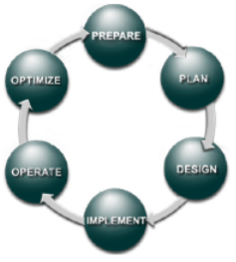
Network Lifecycle
A model called Cisco Lifecycle Services Approach
The network lifecycle has six distinct phases:
Prepare
Plan
Design
Implement
Operate
Optimize

Slide 20
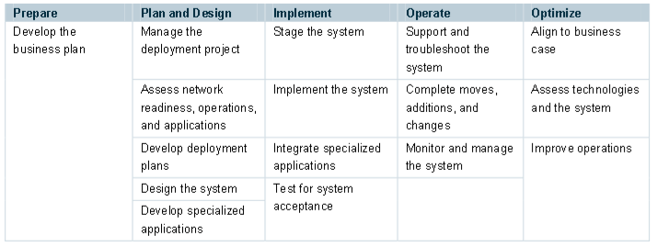
Simplified View

Slide 21
For more info:
More details in the following whitepaper:
http://www.cisco.com/warp/public/437/services/lifecycle/LifecycleServicesWhitePaper.pdf

Slide 22
Cisco Career Certifications
Networking Project Lifecycle
Switching Architectures

Slide 23
What is a switch fabric?
The Switch Fabric is a connection between multiple slots or ports in a switch
Fabric can be blocking or non-blocking:
1Gb
1Gb
1Gb
1Gb
5Gb
Switch
Fabric
5Gb
Switch
Fabric
1Gb
1Gb
1Gb
1Gb
1Gb
1Gb
Non Blocking
The sum of all inputs is
LESS THAN OR EQUAL TO
the capacity
of the switching fabric.
Better overall switching performance.
Blocking
The sum of all inputs is
GREATER THAN the capacity
of the switching fabric.
Less switching performance.

Slide 24
Switching Architectures
3 main switching models:
Shared Bus/Ring
Shared Memory
Crossbar

Slide 25
Shared Bus/Ring Switch Fabric
Typically oversubscribed architecture
Only one module/port can access the fabric at any given time
Buffering typically implemented at module level, not in fabric itself
Well-suited for multicast and broadcast traffic
Shared Bus Fabric
Shared Ring Fabric
Example of switches using a Shared Fabric Architecture:
Cisco Catalyst 3750 (ring)
Cisco Catalyst 6500 (bus)
Forwarding
Engine
Forwarding
Engine
Switching Module
Switching Module
Switching Module
Forwarding
Engine
Switching Module
Switching Module
Switching Module
Switching Module
Forwarding
Engine

Slide 26
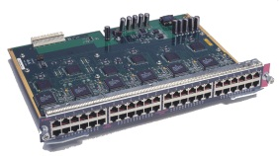
Shared Memory Fabric
Example of switches using a Shared Memory Architecture:
Cisco Catalyst 4500
Buffering internal to the switching fabric
Frames are stored in the shared memory pool as a forwarding decision is made
QoS functions – queuing, scheduling – are handled as frames leave the shared memory
Linecards typically are stub. Logic/intelligence is implemented on supervisor modules (centralized model)
Switch
Processor
(ASICs)
Frame
Shared
Buffer
Memory

Slide 27
Crossbar Architecture
Similar to Shared Memory Fabric in that every linecard has a dedicated, conflict-free path to the switching fabric (not a shared path)
Main differences:
Packets buffered on the linecards…not in shared memory
Signaling and scheduling more complex
Intelligence can be implemented on linecards
Forwarding
Engine
Switching Module
Example of switches using a Crossbar Fabric Architecture:
Cisco Catalyst 6500
Switching Module
Switching Module
Switching Module
Switching Module

Slide 28
For further reading
Cisco Catalyst 6500 Architecture White Paper
http://www.cisco.com/en/US/prod/collateral/switches/ps5718/ps708/prod_white_paper0900aecd80673385.html

Slide 29
Q & A

