Slide 1
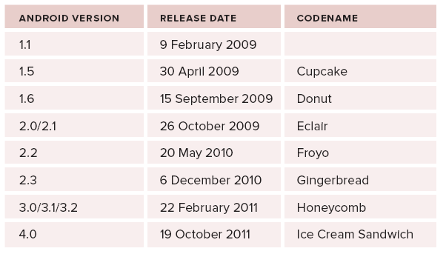
Android: versions
Note that:
Honeycomb (Android v3.0)
A tablet-only release
Jelly Bean (Android v4.1)
Released on July 09, 2012

Slide 2
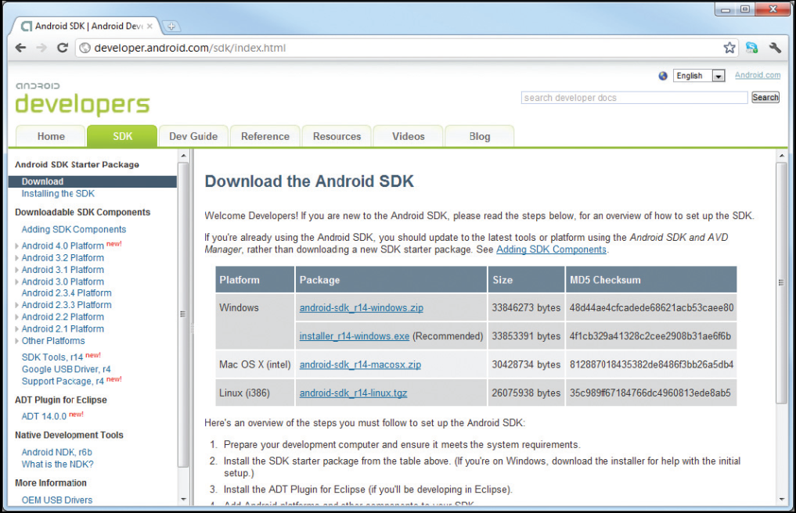
Applications
Android apps are
Written using the Java programming language
But executed via a custom VM called Dalvik
Executed in a separate process (its own security sandbox)
=> Application cannot access some parts of the system
Android SDK
Android APIs
Development tools
AVD Manager and emulator
Full documentation

Slide 3
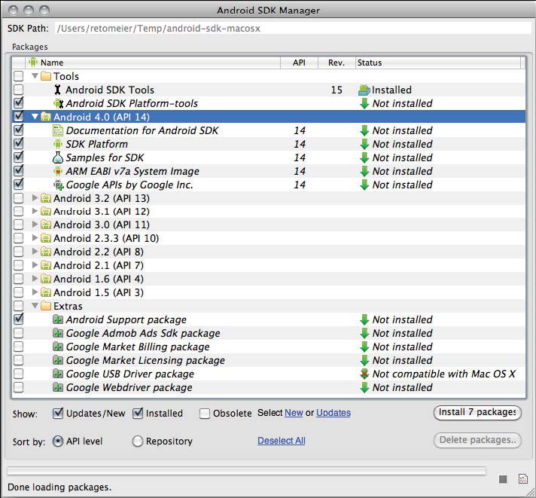
Setting Up the Development Environment
Collect the required tools:
The Android SDK starter package
http://developer.android.com/sdk/index.html

Slide 4
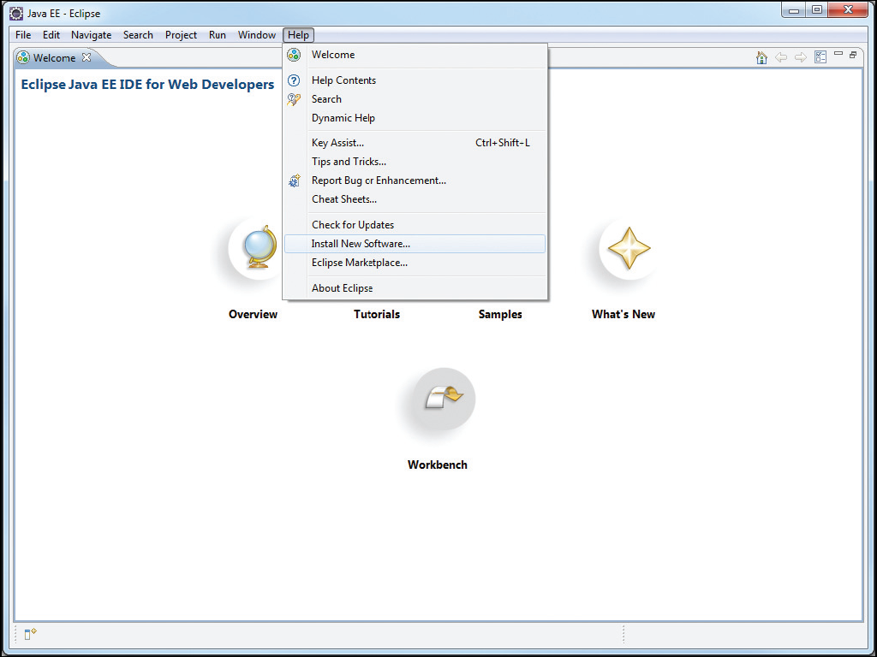
Setting Up the Development Environment (Continued)
Download the Eclipse IDE for Java EE developers
www.eclipse.org/downloads/
Install the android development tools plugin for Eclipse

Slide 5
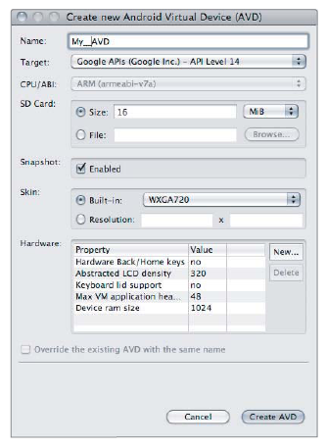
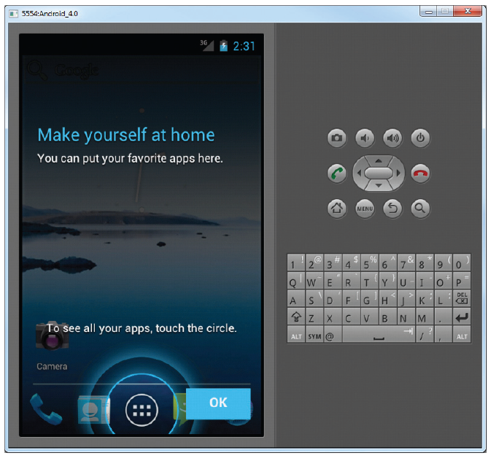
Setting Up the Development Environment (Continued)
Create an android virtual device

Slide 6
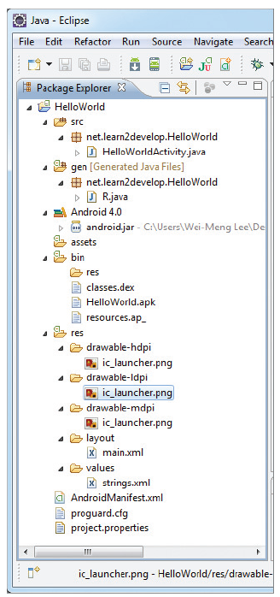
Anatomy of an Android Project
src folder
Project’s .java source files
gen
Holds the R.java compiler generated file
With references to all project resources
Library (Android 4.0/2.3.3)
Android.jar with all class libraries
assets
Assets used by app (text files, databases,…)
res
All resources used by app
AndroidManifest.xml
Permissions + other features

Slide 7
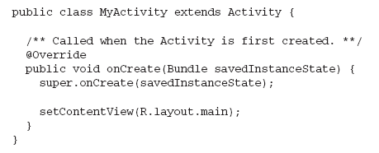
Dissecting First Program
Visual components
Are referred to as views
setContentView inflates a layout resource
Resources are stored in the res folder and includes
layout, values, and a series of Drawable subfolders

Slide 8
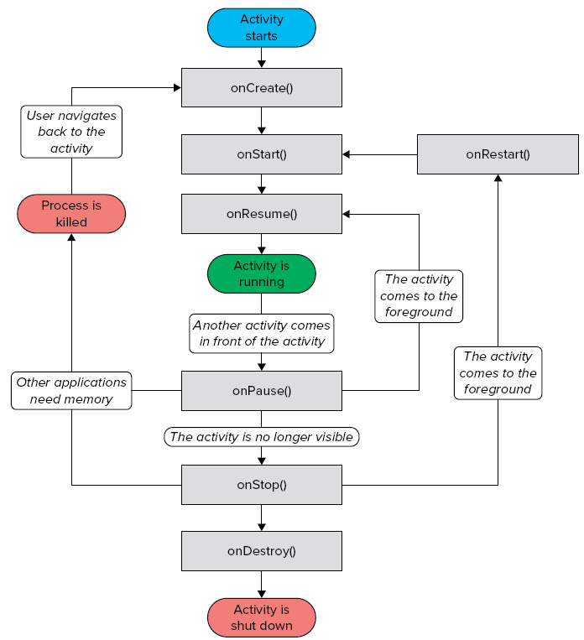
Android Activities
An application can have one or more activities, where
Each activity
Represents a screen that an app
present to its user
Extends the Activity class
Activity's event handlers
onCreate(): when first created
onStart(): when visible
onResume(): when interactive
onPause(): when paused
onStop(): when no longer visible
onDestroy(): prior to destruction
onSaveInstanceState(Bundle)

Slide 9
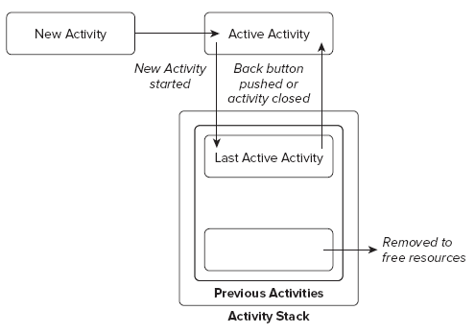
Activity States
The state of an activity depends on
Its position in the Activity stack
Activity states
Active
Activity at the top of the stack
Paused
Activity does not have focus
Stopped
Activity is not visible
Inactive
After an activity has been killed

Slide 10
Event Handlers to Monitor State Changes
Event handlers are defined to
Enable activities to react to state changes
Full lifetime:
Between onCreate and onDestroy
Visible lifetime:
Bound between onStart and onStop
Active lifetime
Starts with onResume and ends with onPause

Slide 11
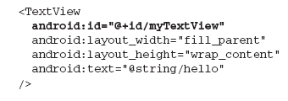
Layout resource

Slide 12
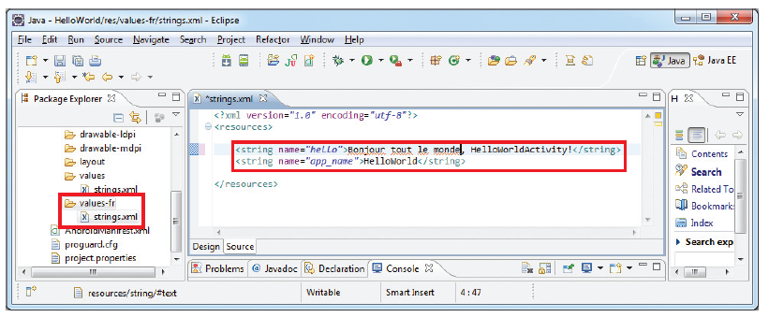
Externalizing resources

Slide 13
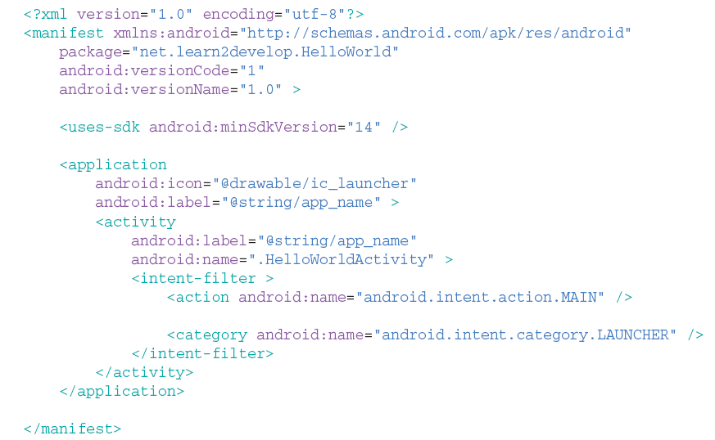
Introducing the Application Manifest File

Slide 14
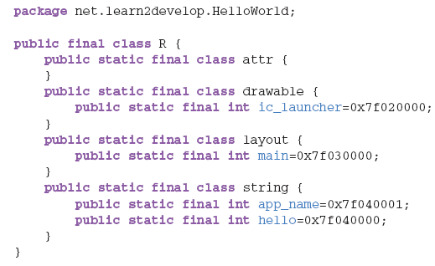
R.java File
To create an instance of the resource
Use the following helper method

Slide 15
Expanding your Experience: Let us Make a Toast!
Toast
Is a transient notification visible for a few seconds
Is perfect to inform users of events
Has a makeText method
Enabling you to create a standard Toast display window
Displaying a Toast:

Slide 16
Fundamentals of UI design
Visual components in Android
Derived from the android.view.View class
Referred to as views, controls, or widgets
Examples
TextView, EditText, ListView, Spinner, Button, ToggleButton,
CheckBox, RadioButton, VideoView, etc…
Multiple views
Grouped into ViewGroup (android.view.ViewGroup)
Examples
LinearLayout, RelativeLayout, AbsoluteLayout,
TableLayout, FrameLayout, ScrollView.

Slide 17
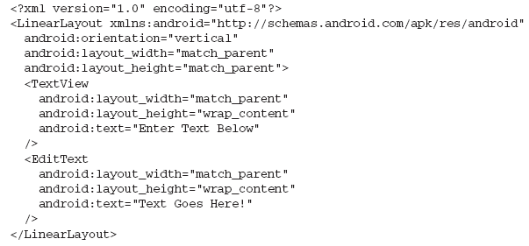
LinearLayout
This layout
Arranges views in a single column/row
That is, child views arranged either vertically or horizontally
Example

Slide 18
Common Attributes for Views and ViewGroups

Slide 19
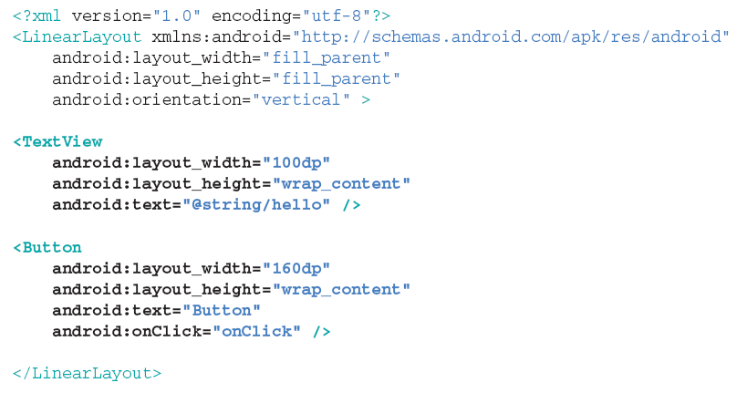
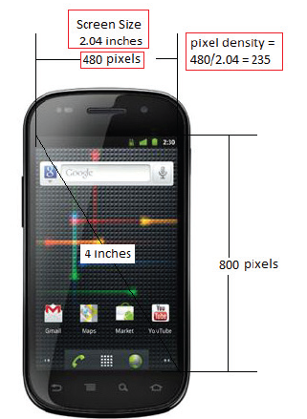
Units of measurement
dp (density independent pixel)
1 dp => 1 pixel on a 160 dpi screen
sp (scale independent pixel)
Similar to dp but recommended for font sizes
px (actual pixel on screen)

Slide 20
Screen densities
Low density (ldpi)
120 dpi
Medium density (mdpi)
160 dpi
High density (hdpi)
240 dpi
Extra High density (xhdpi)
320 dpi
Nexus S (235 dpi)
hdpi device
HTC Hero (3.2”, 320X480)
mdpi device
RAZR (4.3”, 540X960)
hdpi device

Slide 21
Converting dp to px
Formula
Actual pixels = dp * (dpi/160)
Example:
Button with width = 160 dp
On a 235 dpi device => actual width = 240 px
On 180 dpi device => width = 160 px
When using dp
Android
Scales size of the view as a function of density

Slide 22
Scaling effect

Slide 23
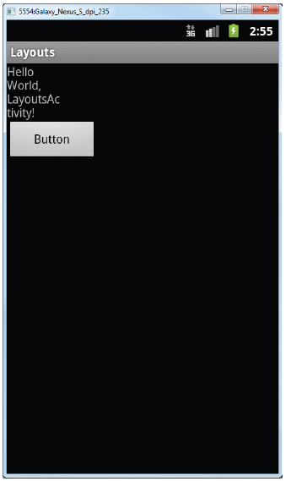
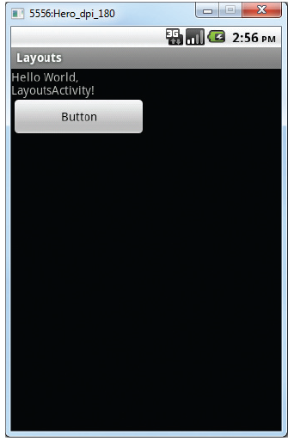
When specifying size in px

Slide 24
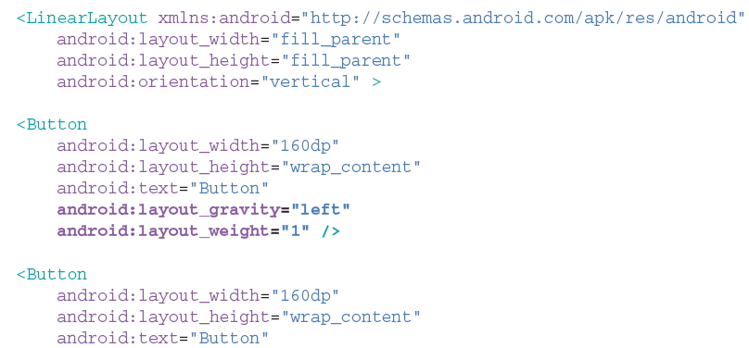
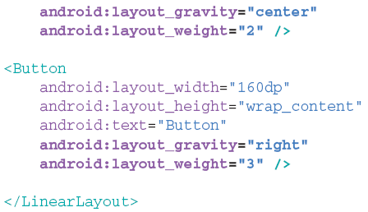

Slide 25
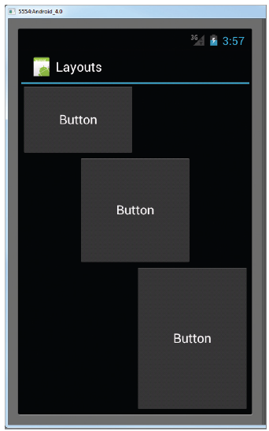
Output

Slide 26
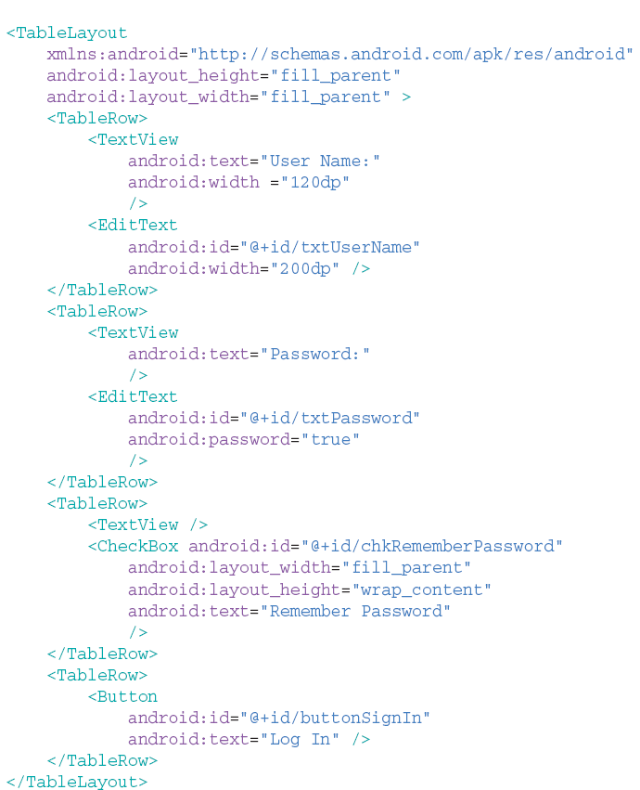
Table Layout
This layout
groups views into rows and columns
Use the <TableRow> element for rows
Each row
collection of views with
each view forming a cell
Width of column dictated
Cell with largest width

Slide 27
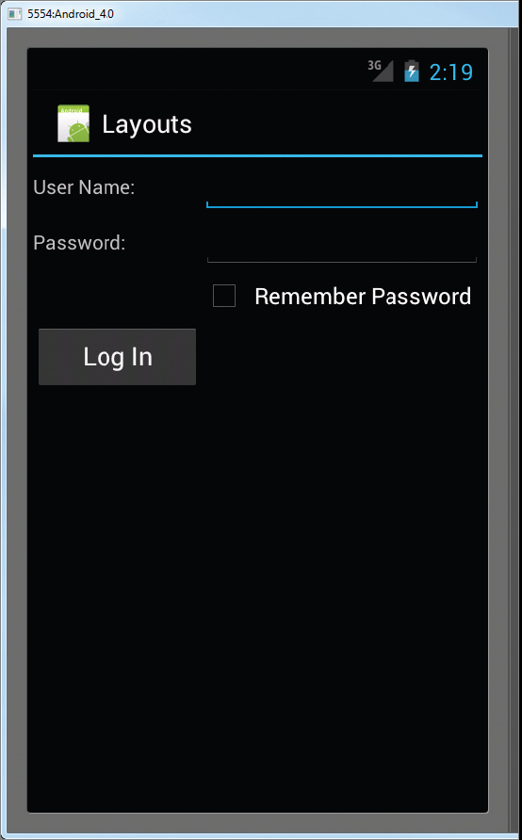
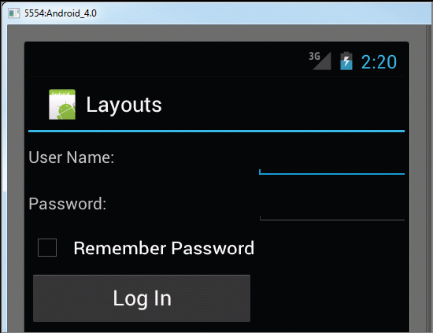
Output

Slide 28
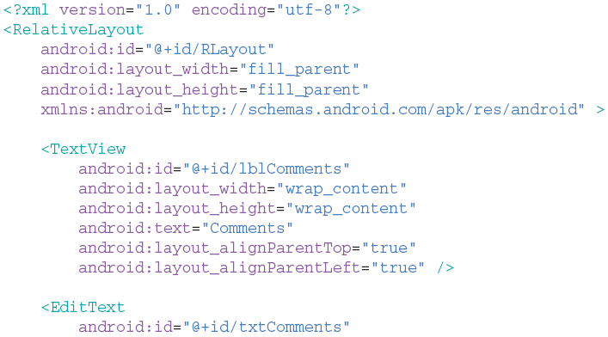
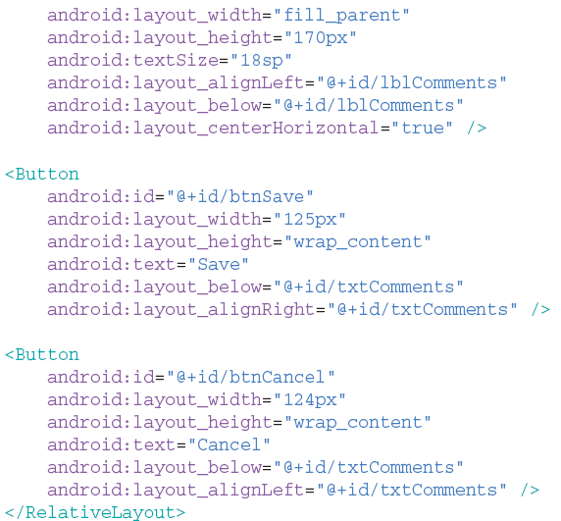
Relative Layout
This layout
Enables you to specify
How child views are positioned relative to each other
Allows views to have
layout_alignParentTop
layout_alignParentLeft
layout_alignLeft
layout_below
Layout_centerHorizontal

Slide 29
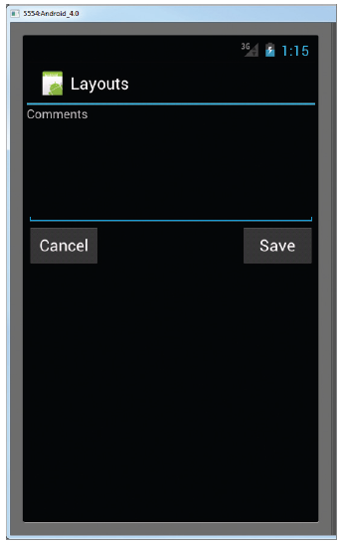
Output

Slide 30
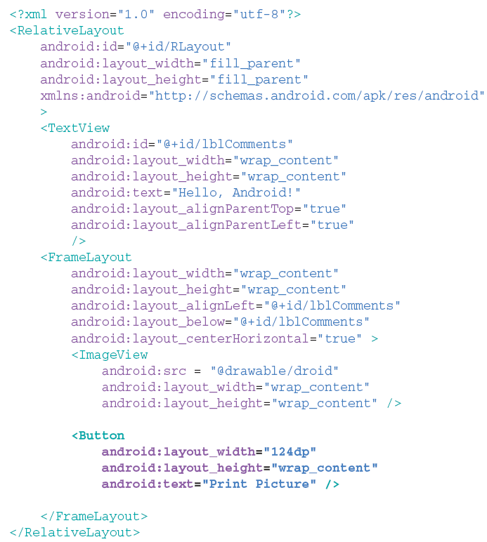
Frame Layout
This layout
Is a placeholder
For displaying single view
Views added
Anchored to top left of layout
Added views
Overlap the existing ones

Slide 31
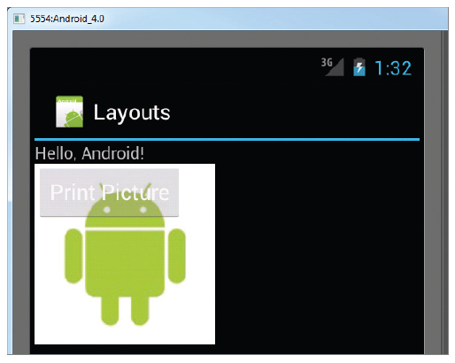
Output

Slide 32
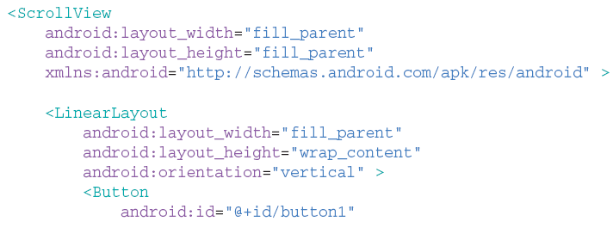
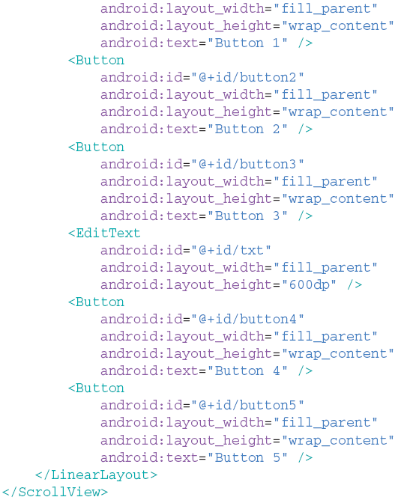
ScrollView
This layout
Enables you to
Scroll through a list
Occupying lot of space
Can include only 1 child
Normally a linearlayout

Slide 33
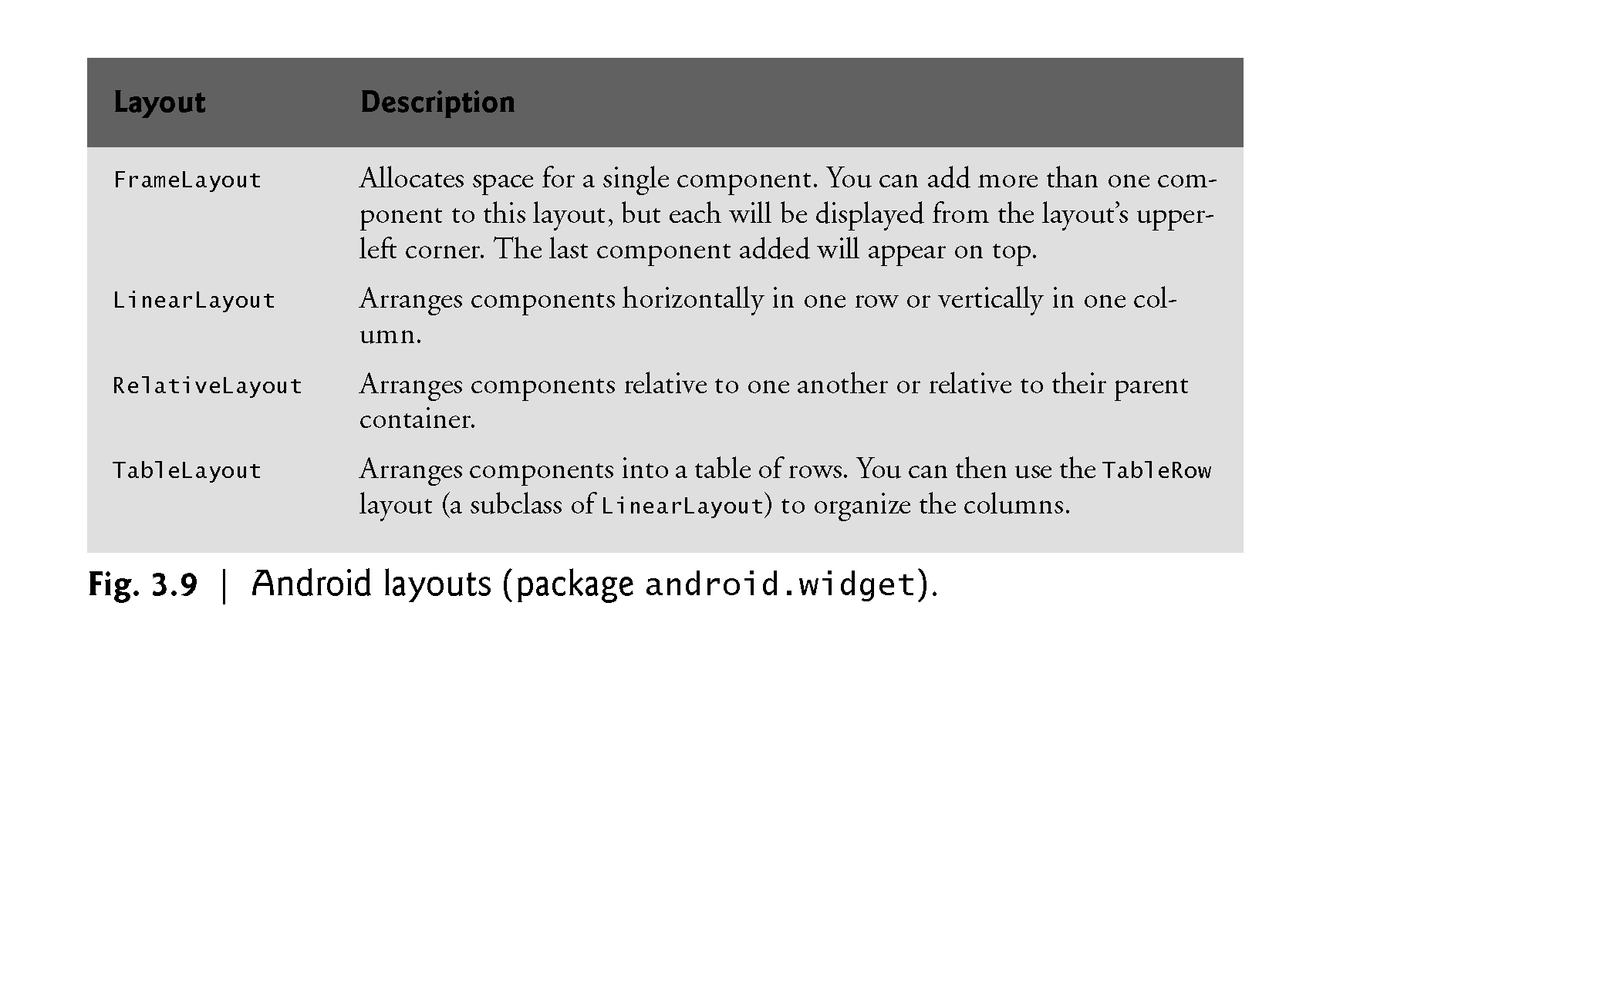
Summary

