Slide 1
TipCalculator App (Chapter 4 of Android how to Program book)
Objectives
Design a GUI using a TableLayout.
Use the ADT Plugin’s Outline window in Eclipse
to add GUI components to a TableLayout.
Directly edit the XML of a GUI layout to customize properties
that are not available through the Visual Layout Editor
and Properties window in Eclipse.
Use TextView, EditText and SeekBar GUI components.
Use event handling to respond to user interactions with an
EditText and a SeekBar.
Refer to TipCalculatorApp android project

Slide 2
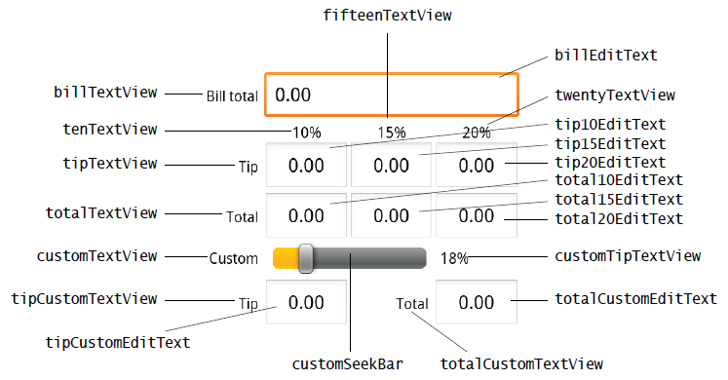
TipCalculator App (Continued)

Slide 3
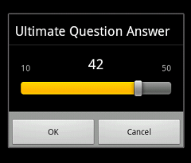
SeekBar
A SeekBar
presents a draggable thumb
The user can touch the thumb and drag left or right to set
Current progress level
provides a
setOnSeekBarChangeListener(OnSeekBarChangeListener)
sets listener to receive notification of changes to progress level

Slide 4
Edit Text Component: Text Watcher
Edit Text component provides
addTextChangeListener(TextWatcher) method
That adds a text watcher whose methods are called
Whenever the content of the edit text is changed
TextWatcher
The methods of this interface are called when text is changed
onTextChanged(CharSequence s,int start,int before,int count)
Notifies that within s, count characters beginning at start
Just replaced old text that had length before

Slide 5
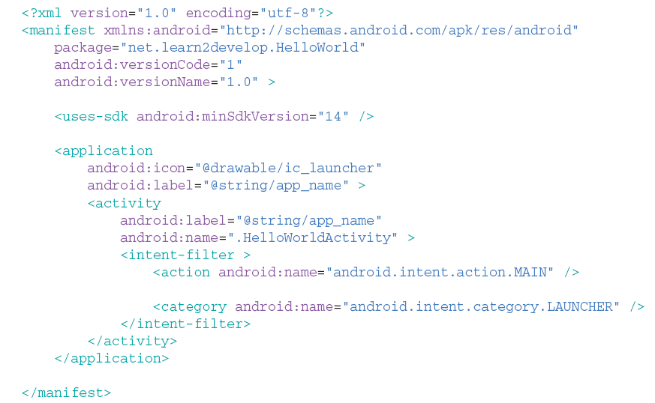
Introducing the Application Manifest File

Slide 6
Expanding your Experience: Let us Make a Toast!
Toast
Is a transient notification visible for a few seconds
Is perfect to inform users of events
Has a makeText method
Enabling you to create a standard Toast display window
Displaying a Toast:
Refer to makeToastApp android project

Slide 7
Adapting to Screen Orientation
2 possible orientations, namely
Portrait and Landscape
When orientation is changed
Activity redraws its content
In landscape mode
Empty space on the right
Should be used wisely
Views at the bottom
May be hidden

Slide 8
Techniques for Handling Orientation Changes
2 techniques are available
Anchoring
Anchor views to edges of the screen
Can be done by means of RelativeLayouts
Resizing and repositioning
Resize every view as a function of the current orientation
Refer to AlternativeLayouts Android project

Slide 9
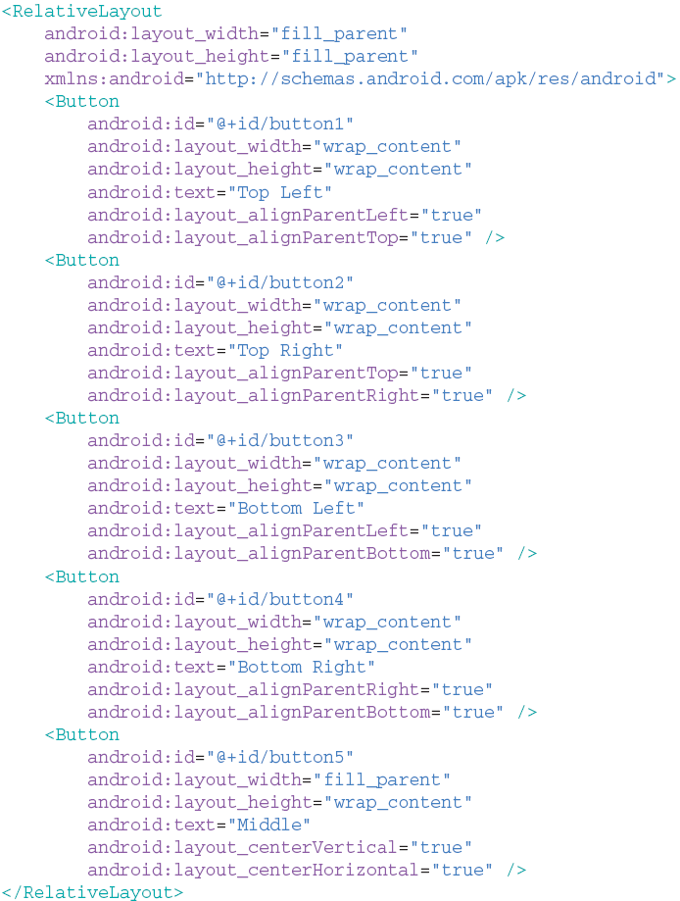
Anchoring views
RelativeLayout
Does the trick
On orientation change
Buttons remain
Anchored to screen edges

Slide 10
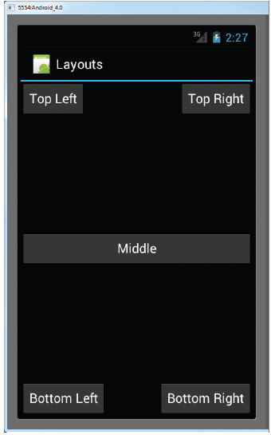
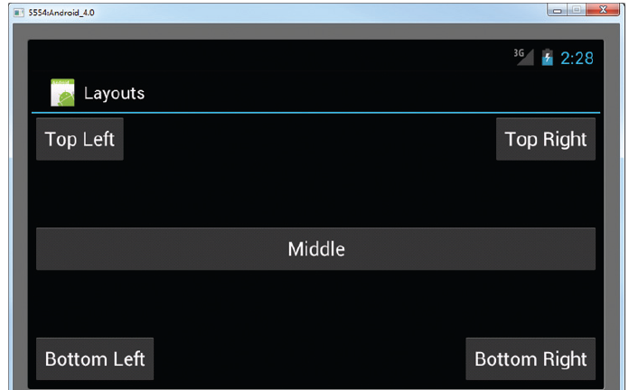
Output

Slide 11
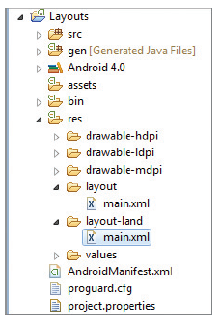
Resizing and Positioning
Idea
Create a different layout for each mode
By creating a new subfolder under res
Named layout-land
This way, there will be
main.xml contained in layout
Defining UI for portrait mode
main.xml in layout-land
Handling UI in landscape mode

Slide 12
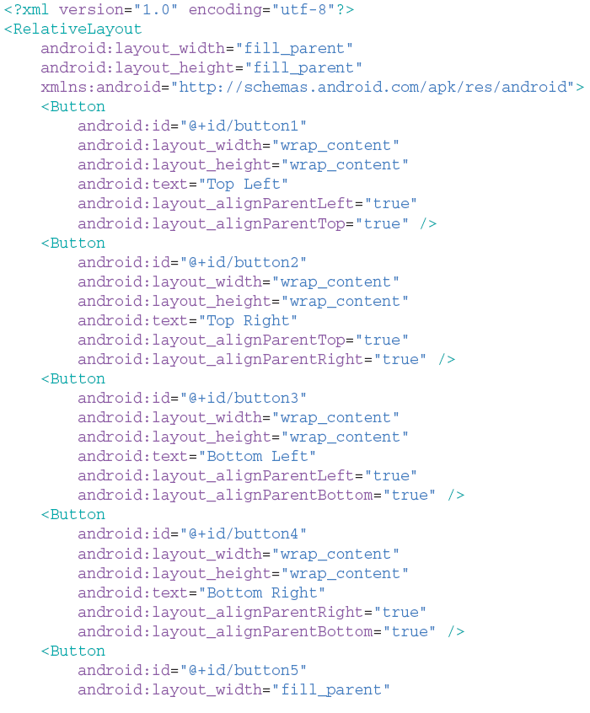
Example: layout

Slide 13
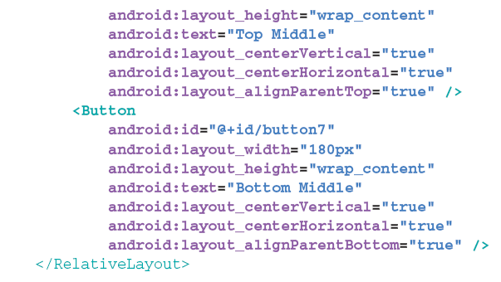
Example: layout-land

Slide 14
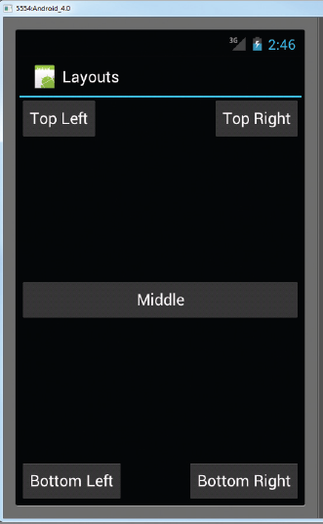
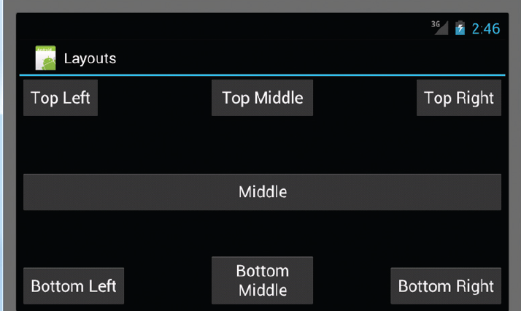
Output

Slide 15
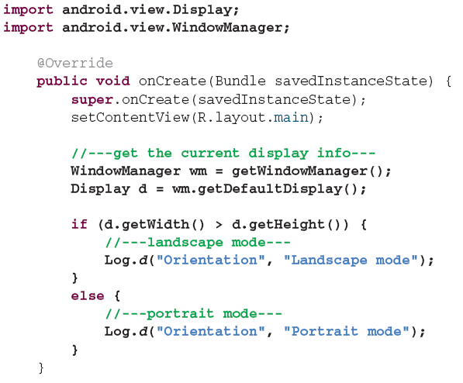
Detecting Orientation Changes
Device’s current orientation
Can be detected during runtime as follows:

Slide 16
Controlling Orientation of An Activity
A change in orientation
Can be forced programmatically as follows

Slide 17
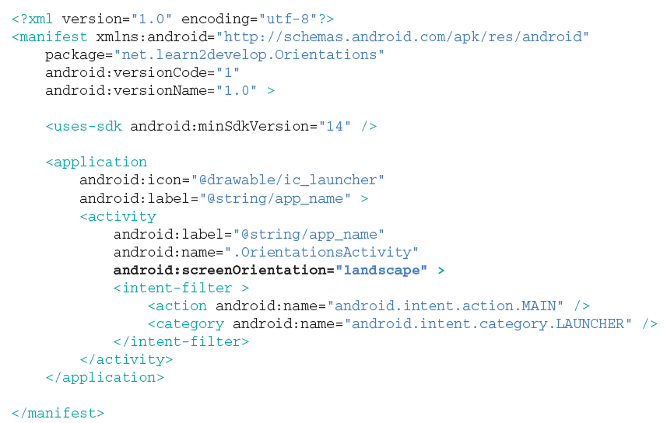
Alternative Method for Controlling Orientation
Alternatively, orientation can be forced as follows

Slide 18
Implication of Orientation Changes
Problem
Changing screen orientation destroys activity and recreates it
On recreation, current state of activity could be lost
=> Need to preserve the state of an activity
Fixes
Implement the onSaveInstance() method
Implement onRetainNonConfigurationInstance()
Refer to PreservingStateApp Android project

Slide 19
Fix#1: onSaveInstanceState
Idea
Preserve state and restore it later
Use the Bundle object to save current state:
Upon recreation, retrieve state saved previously:
Limitation
Not adequate for recovering complex data structures

Slide 20
Fix#2: onRetainNonConfigurationInstance()
This method is fired
When an activity is about to be destroyed
So, save your data by returning it in the method
Then, extract the saved data

