Slide 1
Applying Themes to an Activity
By default,
An activity occupies the entire screen
However,
One can apply a dialog theme to an activity
This way, it displays as a floating dialog
How?

Slide 2
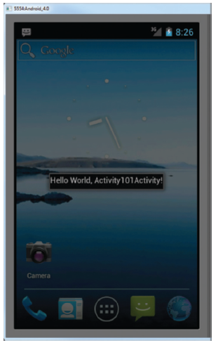
Applying Themes to an Activity (Cont’d)
One can hid the title of an activity
By means of the requestWindowFeature method
Passing it the Window.FEATURE_NO_TITLE constant
Refer to
ActivityAsDialog Android project

Slide 3
Displaying a Dialog Window
A dialog window can be created
To get a confirmation from the user
This can be done
By overriding the onCreateDialog method
Which is a callback for creating dialogs
When the showDialog method is used, this callback is invoked
showDialog accepts an int identifying a specific dialog to display
Refer to creatingDialogBoxes Android project

Slide 4
Introducing Intents
Intents
Bind application components and navigate between them
Transform device into collection of interconnected systems
Creating a workflow of different screens
Can be used to either
Start a new activity explicitly
Start an activity implicitly
Broadcast that an event has occured

Slide 5
Explicitly Starting New activities
To start a specific activity
The startActivity() method
Finds and starts the single activity matching your intent
by explicitly specifying the Activity class to open (see above)
Or by including an action that the target activity is able to perform
In which case, an activity is chosen dynamically
Through a process called intent resolution
Refer to ExplicitIntents Android project

Slide 6
Implicit intents and Runtime Binding
Implicit intent
Allows you to ask the system to start an activity
Without knowing which application will be started
Constructed by
Specifying an action to perform and data to act upon
data can be passed using setData method
Android resolves an intent into an activity class

Slide 7
Native Android Actions
ACTION_VIEW
Data supplied to be viewed in the most reasonable manner
ACTION_CALL
Brings up a dialer and immediately initiates a call
In this case,
Android.permission.CALL_PHONE should be added to the app

Slide 8
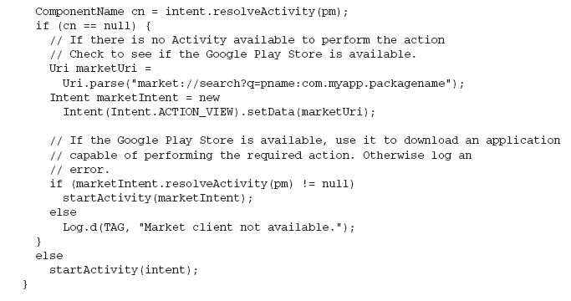
Determining if an Intent will Resolve
It is good practice
To determine if your call resolves to an Activity
Before calling startActivity

Slide 9
Using Intent Filters to Service Implicit Intents
How does Android know
Which app to use to service a request?
Using intent filters, apps can declare actions and data they support
So, add an intent-filter tag to the manifest node with tags:
action: android:name specifies the name of action
category: android:name condition to service the action
data: which data types you can act on

Slide 10
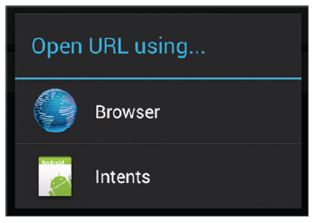
Example: loading URL

Slide 11
How Android Resolves Intent Filters
Deciding which activity to start with an implicit intent
Is called intent resolution
The aim is find the best filter match possible
Create a list of all intent filters
Intent filters not matching action or category are removed
Any mismatch between URI and data tag => removal
More than one matches => all possibilities offered to user
To find
intent used to start activity

Slide 12
Example: adding categories

Slide 13
Obtaining Data from Another Activity
To call an activity and wait for a result
startActivityForResult() should be used
In the called activity
Use an Intent object to send data back via
setData(), setResult()
In the calling activity
Override onActivityResult() to handle the returned data

Slide 14
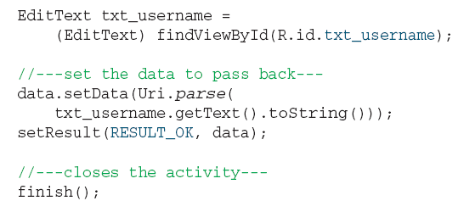
How to Set Data in Called Activity?
setResult
Sets a result code
RESULT_OK or RESULT_CANCELED
finish
Closes the activity and returns control to calling activity

Slide 15
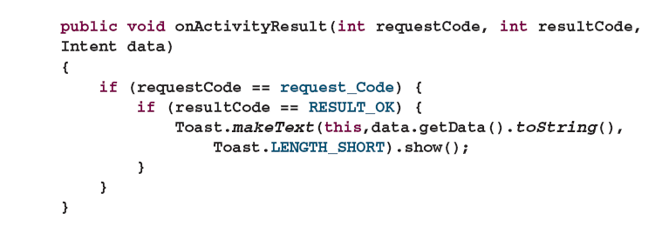
How to Retrieve Data in Calling Activity
requestCode
The code used to launch the called activity
resultCode
The result code set by called activity
Data
Intent received from called activity and encompassing data
Refer to ActivityForResult Android project

Slide 16
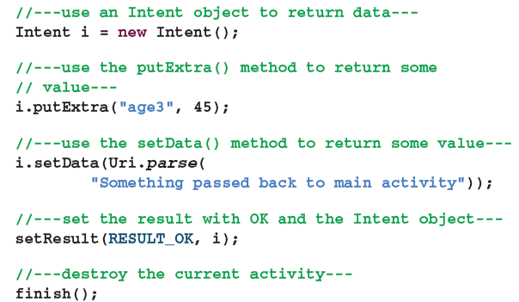
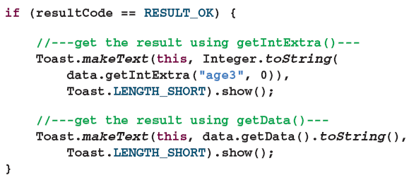
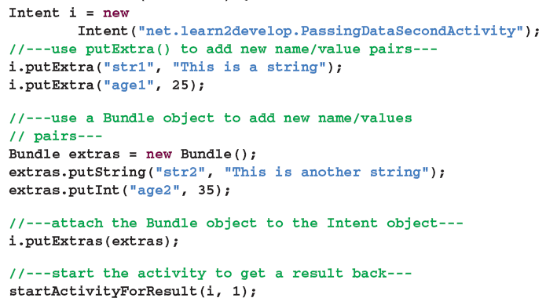
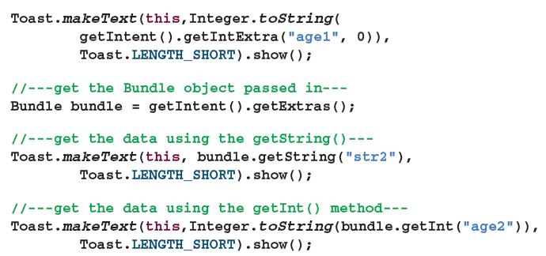
Passing Primitive Data Using the Received Intent Object

