Slide 1
Chapter 5
Gases
CO, CO₂, SO₂, O₂, O₃, ….
Affecting our life on earth, affecting our Environment
We live immersed in a gaseous solution,
“AIR”

Slide 2
The 3 states of matter:

Slide 3
(a) One mole of N₂(l) has a volume of approximately 35 mL and density of 0.81 g/mL. B) One mole of N₂(g) has a volume of 22.4 L (STP) and a density of 1.2 x 10⁻³ g/mL. Thus the ratio of the volumes of gaseous N₂ and liquid N₂ is 22.4/0.035 = 640 and the spacing of the molecules is 9 times farther apart in N₂(g).

Slide 5
Pressure
The pressure exerted by the gases in the atmosphere
can be demonstrated by boiling water in a large metal
can (a) and then turning off the heat and sealing the can (b).

Slide 6
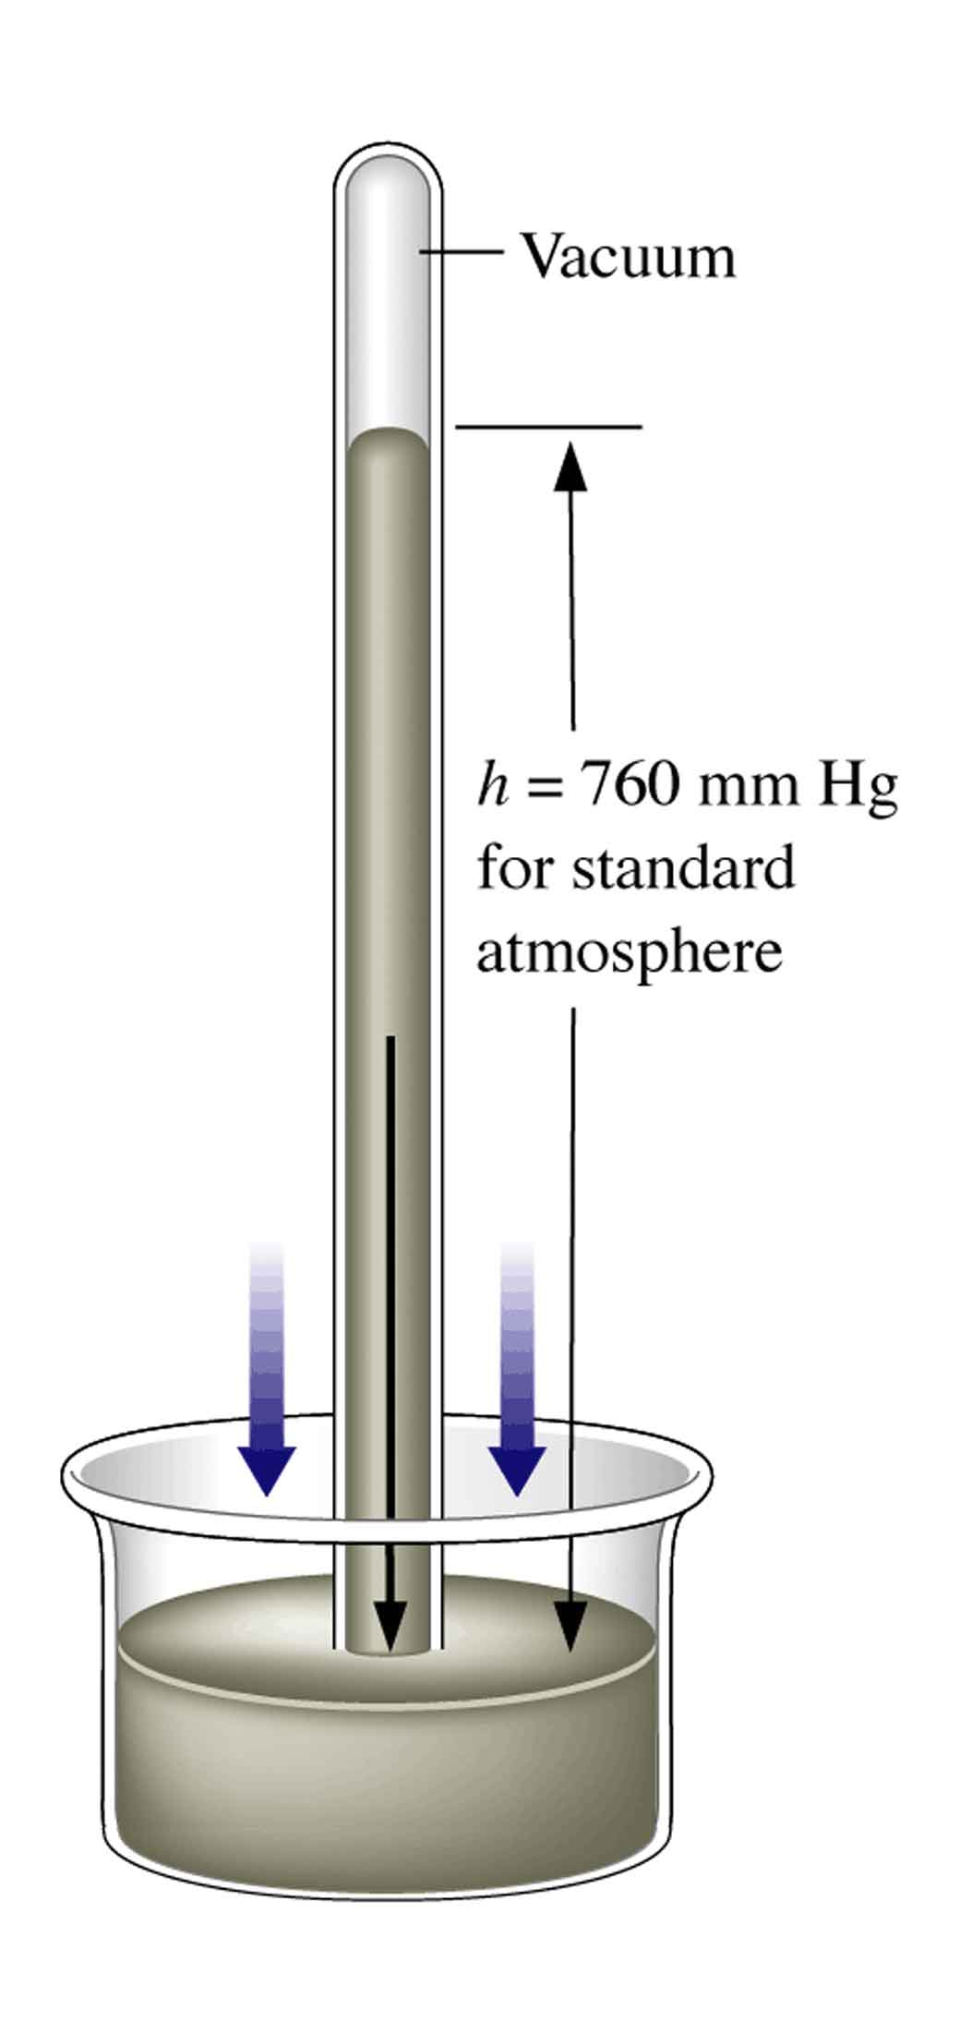
A torricellian barometer. The tube, completely filled with mercury, is inverted in a dish of mercury.
Measuring Atmospheric Pressure

Slide 7
Atmospheric Pressure
P = F/A [Pressure is force exerted per unit
area]
The mass of air pulled by gravity exerts a force on the earth’s atmosphere—this causes atmospheric pressure
A column of air 1 m² in cross section exerts a force of 10⁵ N. The pressure
exerted by air in this case is 100 kPa.

Slide 8
1 m² column of air
1 atm pressure

Slide 9
Units of Pressure
760 mm Hg = 760 torr = 1 atmosphere
= 76 cm Hg = 101.3 kPa
where 1 Pa = 1 N/m² (SI system)

Slide 10
Common Units of Pressure
Unit Atmospheric Pressure Scientific Field
pascal (Pa); 1.01325 x 10⁵ Pa SI unit; physics,
kilopascal(kPa) 101.325 kPa chemistry
atmosphere (atm) 1 atm* Chemistry
millimeters of mercury 760 mmHg* Chemistry, medicine,
( mm Hg ) biology
torr 760 torr* Chemistry
pounds per square inch 14.7 lb/in² Engineering
( psi or lb/in² )
bar 1.01325 bar chemistry, physics

Slide 11
Manometer: Measuring Gas Pressure

Slide 12
Gas Laws: 1-Boyle’s Law
A J-tube similar to the one used by Boyle.

Slide 14
PV = constant
at constant n and temp.

Slide 15
Definition of an ideal gas
A gas that obeys Boyle’s law is called an ideal gas
Real gases approach ideal behavior in the limit of low pressure and high temperature—therefore ideal behavior is a limiting behavior (in the limits of high T and low P)

Slide 16
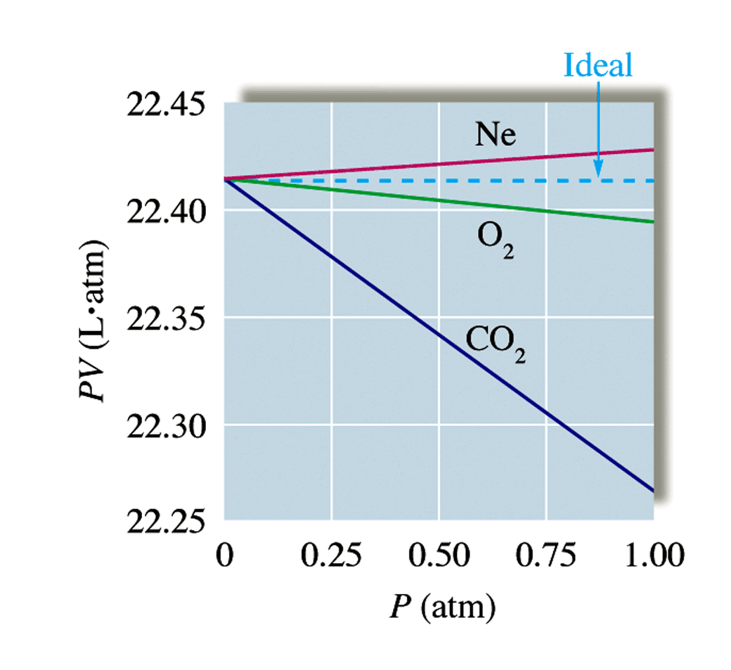
A plot of PV versus P for several gases at pressures below 1 atm.

Slide 17
Charles Law (Jacques Charles 1746-1823)
When you heat a hot air balloon it expands.
Charles’s Law: the volume of a fixed quantity of gas at constant pressure increases as the temperature increases.
Mathematically:

Slide 18
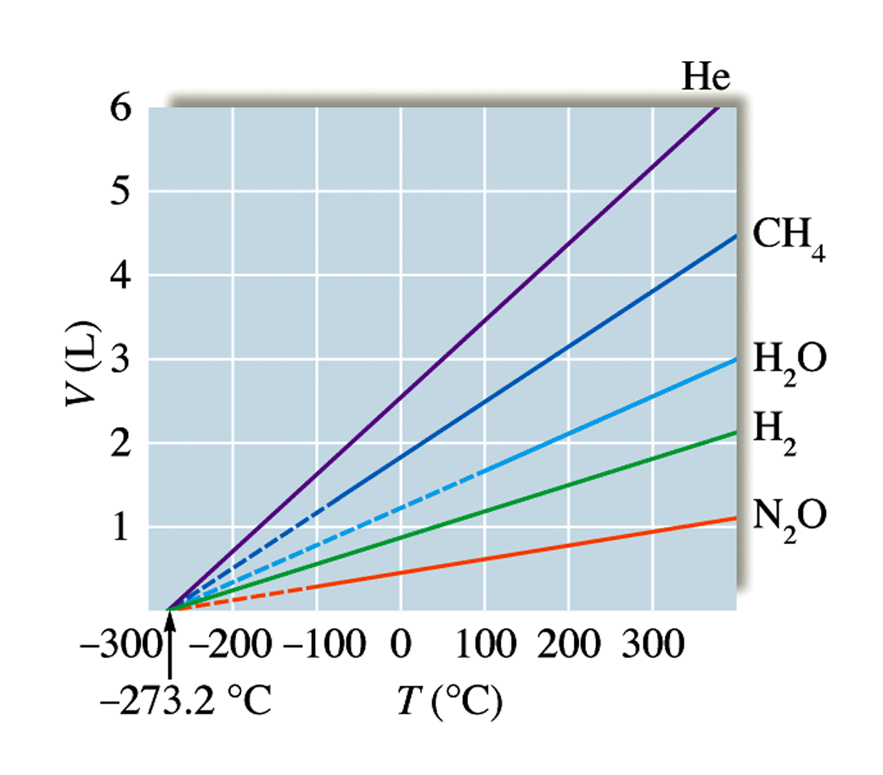
Charles Law: Plots of V versus t (ºC) for several gases.

Slide 19
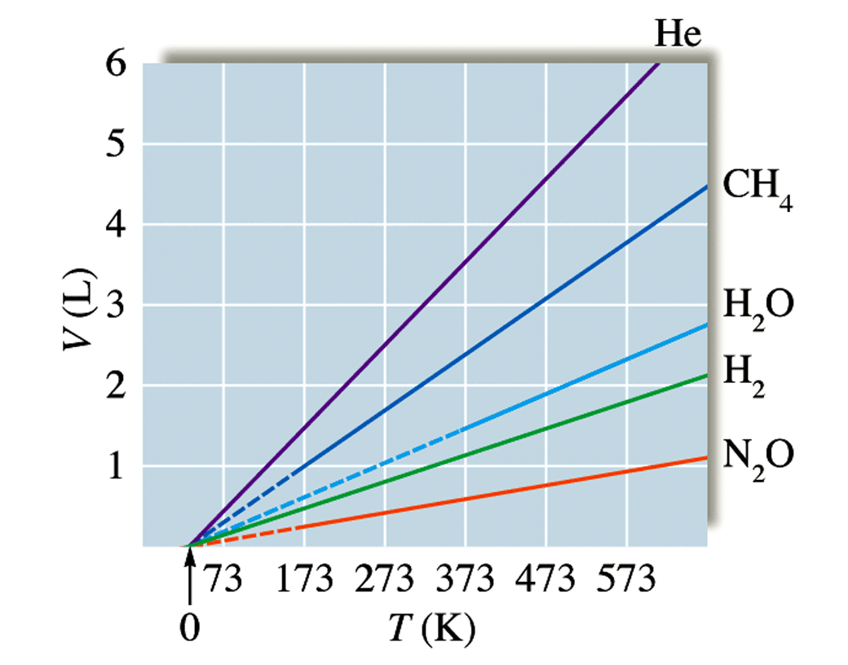
Plots of V versus T on the Kelvin scale.
K = ºC + 273.15
V=bT(K)
273.15 ºC = 0K
Absolute Zero
Below which V
is negative
⇒ physically impossible
0.000001 K has been produced but not 0 Kelvin

Slide 20
Avogadro’s Law
Avogadro’s hypothesis is that equal volumes of gas at the same temperature and pressure contain the same number of molecules
Avogadro’s Law: the volume of gas at a given temperature and pressure is directly proportional to the number of moles of gas.
V α n at constant T and P

Slide 21
Mathematically:
V = constant × n
We can show that 22.4 L of any gas at 0°C and 1 atm contain 6.022 × 10²³ gas molecules (1 mole).
We define STP (standard temperature and pressure) = 0°C (273.15 K), 1 atm.

Slide 23
Ideal Equation of State
V α T at constant P and n
V α n at constant T and P
⇒ P V α n T

Slide 24
Ideal Equation of State
PV = nRT
R = Universal Gas Constant
= 0.08206 L.atm/K.mol
P in atm
V in L
T in K
n in mole

