Slide 1
Stacks & Queues
Ch. 4 (Cont-d)

Slide 2
Project related assignment
Define and document project objectives, requirements, and project delivery plan.
Due November 10. 2009
Define and document design by November 17, 2009.
Additional assignments may also be provided.

Slide 3
Top of the stack
STACKS of ITEMS

Slide 4
Stacks
Stack: list of homogenous elements
Addition and deletion occurs only at one end, called the top of the stack
Last in first out (LIFO) data structure LIFO: Last In, First Out.
Insert: PUSH
Remove: POP
The accessible element is called TOP.
Notes:
Issues:
Which end in the array is the “top”? If it’s the low-order end, then push/pop costs θ(n). If it’s the high-order end, then push/pop costs θ(1).
Where does top point? To the top element, or to the free slot beyond the top element? So long as consistency is maintained, this is an arbitrary decision.

Slide 5
Stack ADT
// Stack abstract class
template <class Elem> class Stack {
public:
// Reinitialize the stack
virtual void clear() = 0;
// Push an element onto the top of the stack.
virtual bool push(const Elem&) = 0;
// Remove the element at the top of the stack.
virtual bool pop(Elem&) = 0;
// Get a copy of the top element in the stack
virtual bool topValue(Elem&) const = 0;
// Return the number of elements in the stack.
virtual int length() const = 0;
};
There are many ways to implement stacks.
We will consider Arrays and Links

Slide 6
Stacks as Arrays
Stack elements are stored in an array
The top of the stack is the index of the last element added to the stack
To keep track of the top position use a variable called top
Can dynamically allocate variable size elements in an array

Slide 7
Array-Based Stack
// Array-based stack implementation
private:
int size; // Maximum size of stack
int top; // Index for top element
Elem *listArray; // Array holding elements
Issues:
Which end is the top?
What is the cost of the operations?

Slide 8
Push/Pop Cost with Array Stack
If top is “0”, then all PUSH and POP would be order θ(n)– why? ➔ Inefficient
If top is “current size of array”, then PUSH and POP are order θ(1) ➔ Efficient
What is top when stack is empty?
To push x: put x into topmost slot, increment top
To pop: Decrement top, get the topmost element
See detailed code

Slide 9
AStack
// Array-based stack implementation
template <class Elem> class AStack: public Stack<Elem> {
private:
int size; // Maximum size of stack
int top; // Index for top element
Elem *listArray; // Array holding stack elements
public:
AStack(int sz =DefaultListSize) // Constructor
{ size = sz; top = 0; listArray = new Elem[sz]; }
~AStack() { delete [] listArray; } // Destructor
void clear() { top = 0; }
bool push(const Elem& item) {
if (top == size) return false; // Stack is full
else { listArray[top++] = item; return true; }
}
bool pop(Elem& it) { // Pop top element
if (top == 0) return false;
else { it = listArray[--top]; return true; }
}
bool topValue(Elem& it) const { // Return top element
if (top == 0) return false;
else { it = listArray[top-1]; return true; }
}
int length() const { return top; }
};
Last element in Array
Destructor clears memory
Clear() just sets top

Slide 10
Linked Stack
A linked list can be used to implement the stack.
The top of the stack is the head of the list
To push x: insert a node at the head
To pop: remove a node from the head

Slide 11
Linked Stack
// Linked stack implementation
private:
Link<Elem>* top; // Pointer to first elem
int size; // Count number of elems
What is the cost of the operations?
PUSH and POP are order θ(1) ➔ Efficient
How do space requirements compare to the array-based stack implementation?
Depends on static vs dynamic choice/need.
See Code Details

Slide 12
Lstack (1/2)
// Link list-based stack implementation
template <class Elem> class LStack: public Stack<Elem> {
private:
Link<Elem>* top; // Pointer to first element
int size; // Count number of elements
public:
LStack(int sz =DefaultListSize) { top = NULL; size = 0; }
~LStack() { clear(); } // Destructor
void clear() {
while (top != NULL) { // Delete link nodes
Link<Elem>* temp = top;
top = top->next;
size = 0;
delete temp;
}
}
Destructor and clear():
Both clear memory

Slide 13
Lstack (2/2)
bool push(const Elem& item) {
top = new Link<Elem>(item, top); //dynamic allocation needed
// not required with AStack
size++;
return true;
}
bool pop(Elem& it) {
if (size == 0) return false;
it = top->element;
Link<Elem>* ltemp = top->next;
delete top; //Need to delete top, not needed with AStack
top = ltemp;
size--;
return true;
}
bool topValue(Elem& it) const {
if (size == 0) return false;
it = top->element;
return true;
}
int length() const { return size; }
};

Slide 14
Queues
FIFO: First in, First Out
Similar to standing in line at the bank / intersection (In Beirut ☺)
Restricted form of list: Insert at one end (rear), remove from the other (front).
Notations:
Insert: Enqueue
Delete: Dequeue
First element: Front
Last element: Rear

Slide 15
Queue ADT
// Abstract queue class
template <class Elem> class Queue {
public:
// Reinitialize the queue. The user is responsible for
// reclaiming the storage used by the queue elements.
virtual void clear() = 0;
// Place an element at the rear of the queue. Return
// true if successful, false if not (if queue is full).
virtual bool enqueue(const Elem&) = 0;
// Remove the element at the front of the queue. Return
// true if successful, false if queue is empty.
// The element removed is returned in the first parameter.
virtual bool dequeue(Elem&) = 0; // Remove Elem from front
// Return in a copy of the front element.
// Return true if successful, false if queue is empty.
virtual bool frontValue(Elem&) const = 0;
// Return the number of elements in the queue.
virtual int length() const = 0;
};

Slide 16
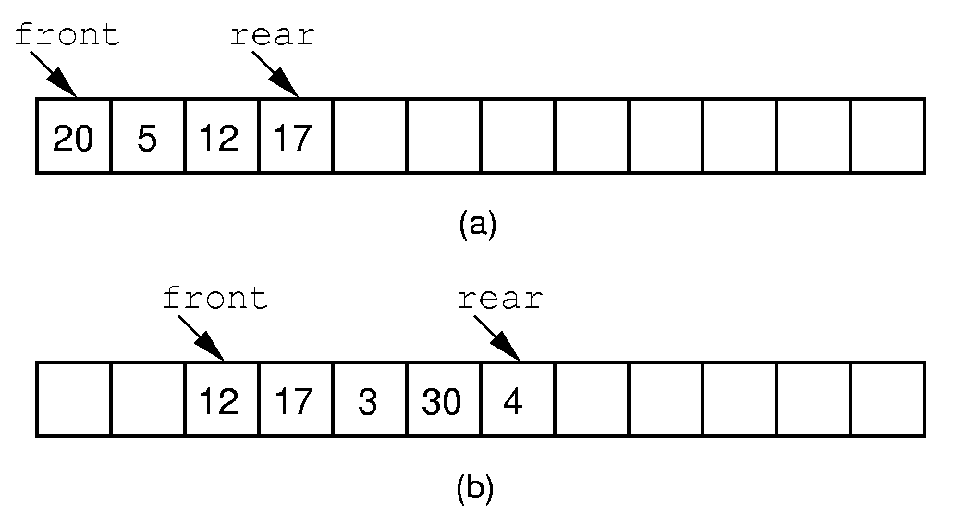
Serial Queue Implementation
Fixing front at “0” is costly – why?
Dequeue 20, 5
Enqueue 3,30, 4
Allowing front and rear to drift causes a problem – why?
Notes:
If we stick to the requirement that the queue elements be at the beginning n elements of the array, then either enqueue or dequeue must be θ(n).
Better is to let the elements “drift” within the array.
Unfortunately, as items are added and removed, the queue “drifts” toward the end. Eventually, there will be no space to the right of the queue, even though there is space in the array.

Slide 17
Circular Queue Implementation(1)
Drift operations
To insert: increment rear, then assign
To remove: get value, then increment front
To increment: rear=rear+1
Solution to drift: Circular Array
In a circular array: rear=(rear+1)%size

Slide 18
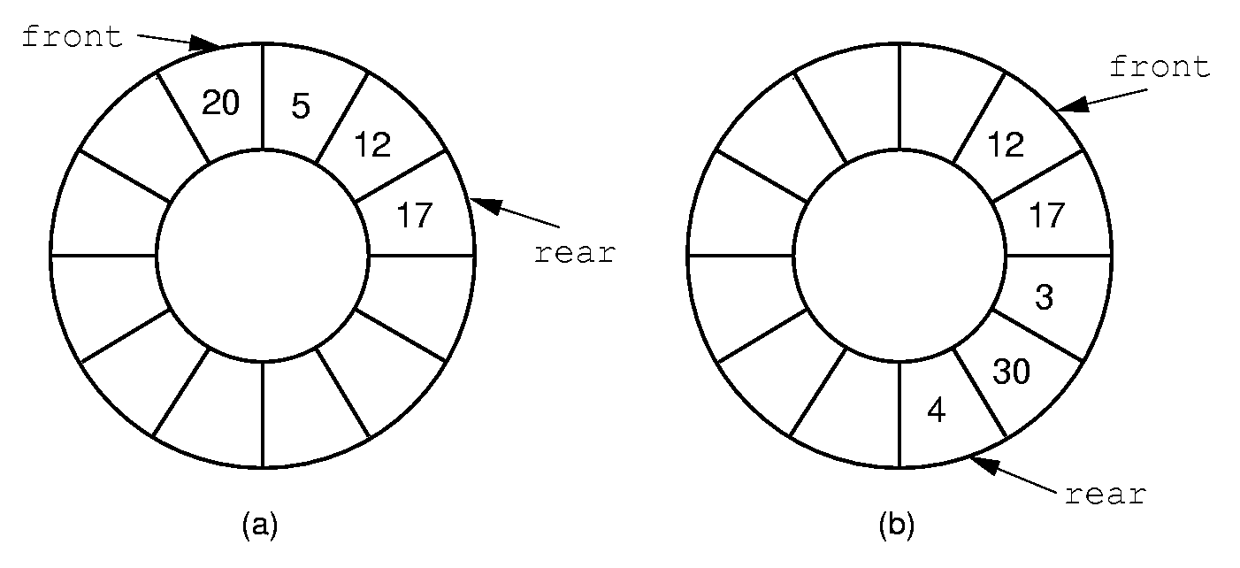
Circular Queue Implementation (2)
Dequeue 20, 5
Enqueue 3,30, 4
We solved the problem of efficiency but new problem: how do we know when list is empty? Full?
Notes:
By using the mod function, we can easily achieve the effect of a “circular” queue.
This leaves one more issue. Where do the front and rear pointers go (point to the item? Or to the space before/after the item)? And, how do we distinguish a full from an empty queue?
Given a fixed position for the front element (and its pointer), there are n+1 possible states for the queue (0 through n elements in the queue for an array of size n), but only n possible positions for rear. To solve this dilemma, we must either leave an empty slot in the queue, or use and external variable to determine if the queue is empty or not.

Slide 19
Queue Implementation(3)
Given a fixed position for the front element (and its pointer), there are n+1 possible states for the queue (0 through n elements in the queue for an array of size n), but only n possible positions for rear.
Example States of the queue:
Initially rear = 0, front = 1
rear=front: one element in queue
rear+1=front: empty queue (initial state)
rear+1=front: full queue (after queue gets full)
Solution:
queue size is n, array size is n+1
Or keep track of size

Slide 20
rear
rear
x
x
x
x
x
x
x
x
x
x
EMPTY STATE
FULL STATE

Slide 21
Queue Implementation(4)
Solution to deciding empty/full:
rear+1=front: empty queue
rear+2=front: full queue
One element is unused: Allow to distinguish between empty and full queue
See detailed Code

Slide 22
Aqueue Implementation (1/2)
// Array-based queue implementation
template <class Elem> class AQueue: public Queue<Elem> {
private:
int size; // Maximum size of queue
int front; // Index of front element
int rear; // Index of rear element
Elem *listArray; // Array holding queue elements
public:
AQueue(int sz =DefaultListSize) { // Constructor
// Make list array one position larger for empty slot
size = sz+1;
rear = 0; front = 1;
listArray = new Elem[size];
}
~AQueue() { delete [] listArray; } // Destructor
void clear() { front = 1; rear = 0; }
Initialize array with one extra slot

Slide 23
Aqueue Implementation (2/2)
bool enqueue(const Elem& it) {
if (((rear+2) % size) == front) return false; // Full
rear = (rear+1) % size; // Circular increment
listArray[rear] = it;
return true;
}
bool dequeue(Elem& it) {
if (length() == 0) return false; // Empty
it = listArray[front];
front = (front+1) % size; // Circular increment
return true;
}
bool frontValue(Elem& it) const {
if (length() == 0) return false; // Empty
it = listArray[front];
return true;
}
virtual int length() const
{ return ((rear+size) - front + 1) % size; }
};
Check FULL
Increase REAR
Check EMPTY
Increase FRONT
Or check ((rear +1) % size) = front

Slide 24
Linked Queue Implementation
Front is first element of linked list
Rear is last element of linked list
Enqueue at Rear
Dequeue at Front
Use “size” to check empty or “rear” is NULL.
No need for empty header node like we had with linked lists

Slide 25
// Linked queue implementation
template <class Elem> class LQueue: public Queue<Elem> {
private:
Link<Elem>* front; // Pointer to front queue node
Link<Elem>* rear; // Pointer to rear queue node
int size; // Number of elements in queue
public:
LQueue(int sz =DefaultListSize) // Constructor
{ front = NULL; rear = NULL; size = 0; } // No header node
~LQueue() { clear(); } // Destructor
void clear() { // Clear queue
while(front != NULL) { // Delete each link node
rear = front;
front = front->next;
delete rear;
}
rear = NULL;
size = 0;
}
// …. See continuation on next slide
Initially front and rear are NULL
Recall: for linked implementation, clear() and destructor have to reclaim storage

Slide 26
bool enqueue(const Elem& it) {
if (rear == NULL) // Empty queue
front = rear = new Link<Elem>(it, NULL);
else { // Append new node
rear->next = new Link<Elem>(it, NULL); //append
rear = rear->next; //update rear
}
size++;
return true;
}
bool dequeue(Elem& it) { // Remove Elem from front
if (size == 0) return false; // Empty
it = front->element; // Store dequeued value
Link<Elem>* ltemp = front; // Hold dequeued link
front = front->next; // Advance front
delete ltemp; // Delete link
if (front == NULL) rear = NULL; // Dequeued last element
size --;
return true; // Return element value
}
bool frontValue(Elem& it) const {
if (size == 0) return false;
it = front->element;
return true;
}
virtual int length() const { return size; }
};
Append at rear. If empty, also initialize front.
Increment size
Deqeue at front. If last element, set rear to NULL

