Slide 1
Aya Marwani
A High-Protein Diet
Lebanese American University

Slide 2
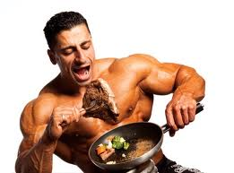
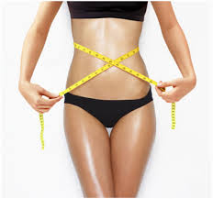
Introduction
A high-protein diet is also known as the Atkins diet. It’s know by including meals with very high amounts of protein, and very low amounts of carbohydrates.
Followed by athletes
People trying to lose weight

Slide 3
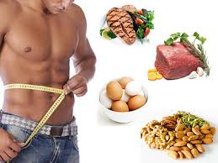
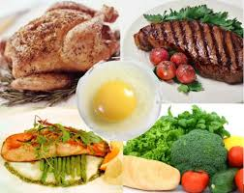
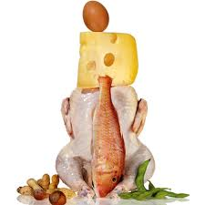
High-Protein Foods
Fish
Meat
Poultry
Eggs
Some vegetables and legumes

Slide 4
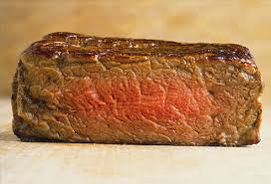
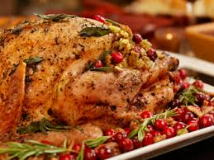
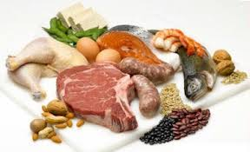
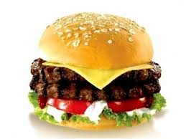
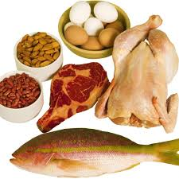
High-protein diets are also High-fat diets!!
Most protein sources are animal ones.
These animal sources such as fat cuts, shellfish,
eggs and organ meats are all rich in high amounts
of fats.

Slide 5
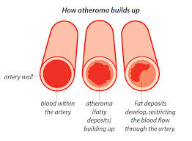
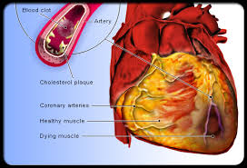
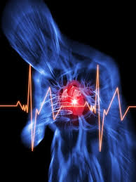
Cardiovascular Disorders
The heart arteries are hardened until they block leading to heart attacks and strokes.
Oxygen transport deficiency
-Atherosclerosis
- Atheroma
Arteries are not only blocked by cholesterol and fat’s accumulation leading to atherosclerosis, but protein is also a villain.

Slide 6
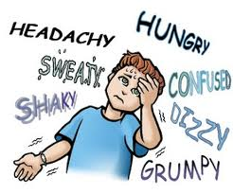
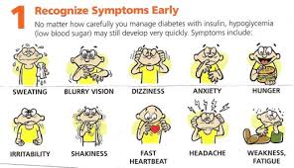
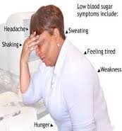
Hypoglycemia
A high-protein diet is low in carbohydrates.
Taking low amounts of carbs means depriving
the body from blood sugar, thus low levels of
glucose (fuel of energy).
Weakness
Paleness
Sweating
Dizziness
Irritating heart beats and breathing rates
Malfunction in the brain and muscles

Slide 7
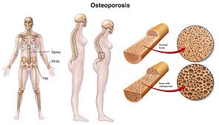
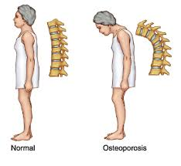
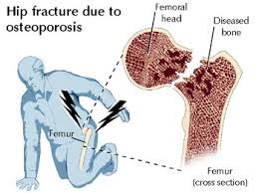
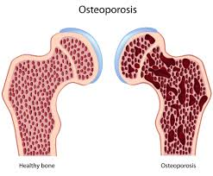
Osteoporosis
Digested proteins release acids in the blood. The body neutralizes these acids with calcium taken from the bones.
Pores in the bone
Deterioration of the vertebral support
Easily fractured bones

Slide 8
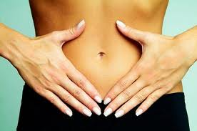
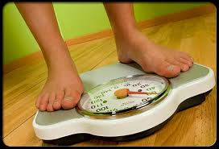
Opposers allege
Some critics claim that the high-protein diet is the most effective diet they have ever followed.
More weight loss … shorter period
Satiation… lesser meals
Satiety… smaller portions

Slide 9
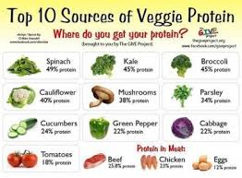
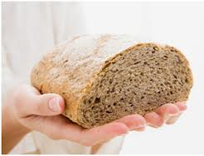
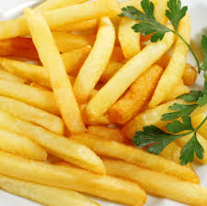
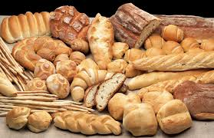
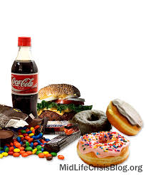
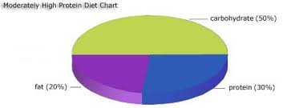
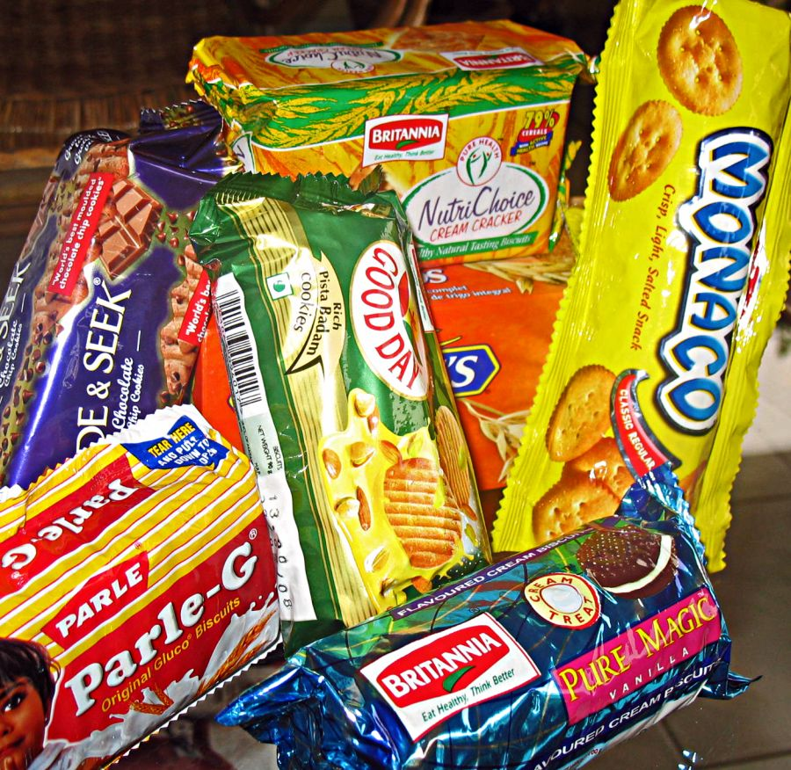
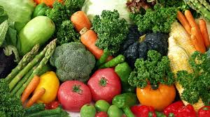
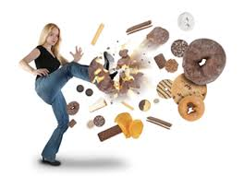
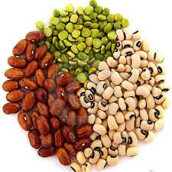
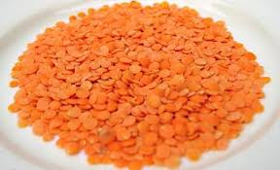
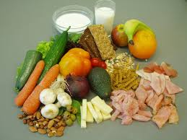
Few Recommendations may save some lives
Include three types of macronutrients in each meal.
Don’t eliminate all kinds of carbs
- choose good carbs
Make wise protein choices

