Slide 1
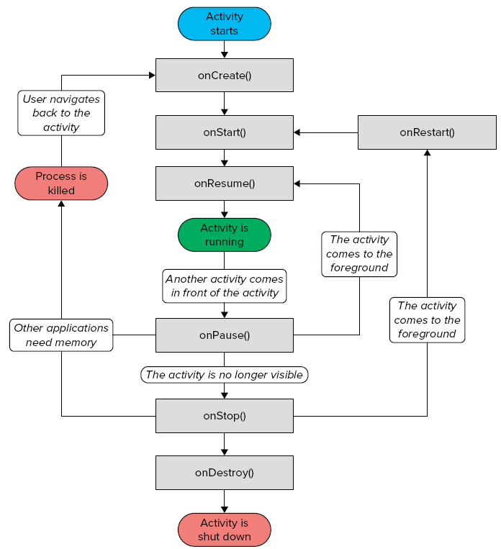
Android Activities
An application can have one or more activities, where
Each activity
Represents a screen that an app
present to its user
Extends the Activity class
Activity's event handlers
onCreate(): when first created
onStart(): when visible
onResume(): when interactive
onPause(): when paused
onStop(): when no longer visible
onDestroy(): prior to destruction
onSaveInstanceState(Bundle)

Slide 2
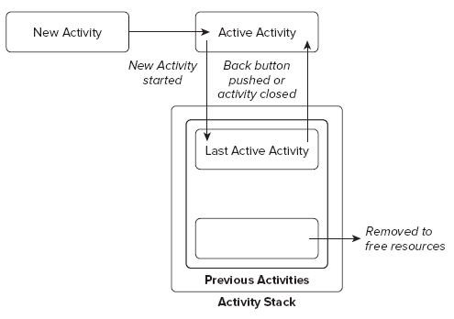
Activity States
The state of an activity depends on
Its position in the Activity stack
Activity states
Active
Activity at the top of the stack
Paused
Activity does not have focus
Stopped
Activity is not visible
Inactive
After an activity has been killed

Slide 3
Event Handlers to Monitor State Changes
Event handlers are defined to
Enable activities to react to state changes
Full lifetime:
Between onCreate and onDestroy
Visible lifetime:
Bound between onStart and onStop
Active lifetime
Starts with onResume and ends with onPause

Slide 4
TipCalculator App (Chapter 4 of Android how to Program book)
Objectives
Design a GUI using a TableLayout.
Use the ADT Plugin’s Outline window in Eclipse
to add GUI components to a TableLayout.
Directly edit the XML of a GUI layout to customize properties
that are not available through the Visual Layout Editor
and Properties window in Eclipse.
Use TextView, EditText and SeekBar GUI components.
Use event handling to respond to user interactions with an
EditText and a SeekBar.
Refer to TipCalculatorApp android project

Slide 5
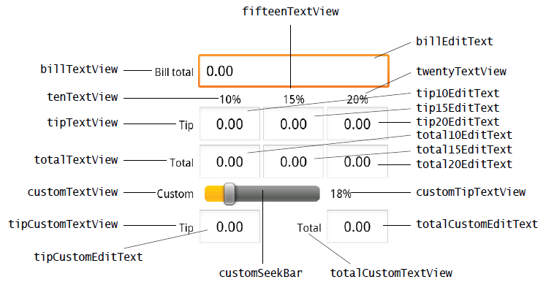
TipCalculator App (Continued)

