Slide 1
MARKETING
Cosette Fakih El Khoury
NUT 468
Spring 2017
Notes:
Check Wolf of wallstreet

Slide 2
Why are we studying marketing in this course?
Why is it important for managers ?
Why is it important for dietitians & food service managers?

Slide 3
Overview & Definition
Marketing is an essential tool for managers just like decision making and communication
In this chapter we will focus on understanding why a dietitian must understand the power and value of marketing as a tool and use marketing concepts to inform and educate the public as part of effective food and nutrition services
Notes:
Market yourself, your clinic, your personal values but also those of your profession, promote awareness campaigns, healthy lifestyles, some products that you believe in

Slide 4
Overview & Definition
Until recently, dietitians neglected marketing themselves, their profession, and their products
Food practitioners were not familiar with marketing concepts
Well… times have changed and 42% of RDs in the US claim that they promote food and nutrition programs, products, and services through interactions with others
Notes:
Awareness campains
i.e. DASH diet

Slide 5
Overview & Definition
Dietitian, as a member of the health care team, must understand the power of marketing as a tool and use it to inform and educate the public as part of effective nutrition services
Marketing also needed to be used by dietetic practitioners to send counter messages to the public concerning health (Ex: Obesity crisis)
Notes:
Awareness campaigns

Slide 6
Overview & Definition
So how do we define marketing, keeping in mind the need to promote good health?
Notes:
If I want to do an awareness campaign on diabetes for the hospital employees, it is NOT enough to just communicate this information in a nice and attractive way. I must, beforehand identify the needs, wants and demands of the population in order to know how to tailor this campaign.
Information and pamphlets might be super attractive but employees might not need this info! Maybe nobody is diabetic or maybe they have bigger issues/problems that must be resolved beforehand
What are the components of the marketing model?
Marketer
Target population
The product
Marketing techniques that will render the product appealing to the target population (efforts, activities)

Slide 7
Overview & Definition
Marketing is a management tool that focuses on identifying the needs, wants, and demands of customers and developing products to meet those needs
Source: Hudson, N; Management Practice in Dietetics

Slide 8
Overview & Definition
Continuum of efforts & activities ranging from simple marketing to media advocacy
Each form involves a relationship and two way interaction between the marketer and those to whom the marketing is being directed
Notes:
Marketing= continuum of efforts and activities ranging from simple marketing to the more complex media advocacy; each form of marketing involves a relationship and 2 way interaction between the marketer and those to whom the marketing is being directed.
Simple marketing: do research on target audience, identify they needs and communication this info
Social marketing: i.e. want people who have high cholesterol to use fat free dairy products so we bring samples of these products to make them realize that the taste is very good + we give them presentation and concrete examples on how saturated fat can clog their arteries and lead to more serious problems
Branding: “just do it” nike; apple for macs (imitation game), come as you are (crepaway)
Media advocacy: i.e. smoke free lebanon (restaurants and people had to pay fines in case they were caught transgressing the law)

Slide 9
Overview & Definition
Simple marketing involves targeted communication of information based on audience research
Social marketing aims to create attitudinal and/or behavioral change in a target audience by emphasizing relevant benefits to that audience
“Branding” strives to define and establish a positive image or impression for a product via linked association with a visual or auditory cue that will, when re-experienced, stimulate a quick, almost hard-wired short-cut reminder of the positive value of the product
Media advocacy is a strategy designed to bring about a political action and/or policy change through the reframing of issues in mass media
Notes:
Simple marketing: do research on target audience, identify they needs and communication this info
Social marketing: i.e. want people who have high cholesterol to use fat free dairy products so we bring samples of these products to make them realize that the taste is very good + we give them presentation and concrete examples on how saturated fat can clog their arteries and lead to more serious problems. Manufacturers of car seats
http://www.thensmc.com/content/social-marketing-examples#Child
Branding: “just do it” nike; apple for macs (imitation game), come as you are (crepaway)
Media advocacy: i.e. smoke free lebanon (restaurants and people had to pay fines in case they were caught transgressing the law)

Slide 10
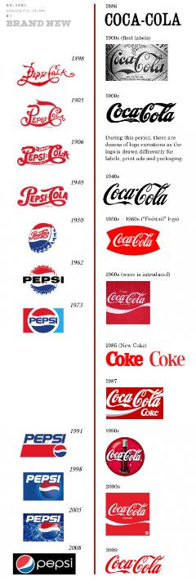
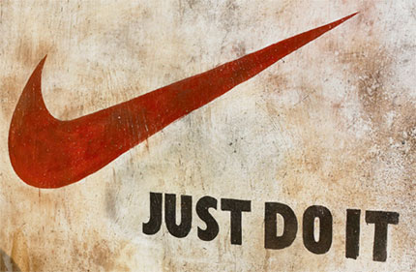
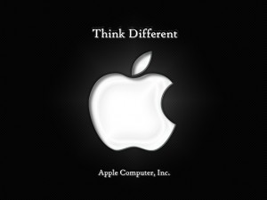
Notes:
Branding: “just do it” nike; apple for macs

Slide 11
The Marketplace
The way an organization describes, understands, and sees its market has a major impact on how the organization is perceived by staff and outsiders
There are 5 ways an organization sees its marketplace
Production perspective
Product perspective
Selling perspective
Marketing perspective
Social marketing perspective

Slide 12
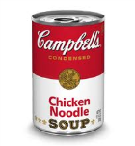
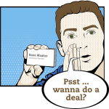
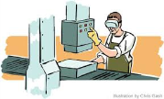
Production Perspective
Product Perspective
Selling Perspective
Marketing Perspective
Social Marketing Perspective

Slide 13
1-Production Perspective
Original view of the market
Developed prior to the industrial revolution
Demand exceeded production (goods were manufactured by hand)
Notes:
Important is to produce (Table, socks, jams etc…)
Focus is on production
The Industrial Revolution was the transition to new manufacturing processes in the period from about 1760 to sometime between 1820 and 1840.

Slide 14
2-Product Perspective
Make large quantities of a product through mass production & assembly line techniques
Goods are made in an effective and efficient way, time and effort can be put into the development and refinement of the product
This allows organizations to look at their products in terms of value, features, and performance
Notes:
Henry Ford was an American industrialist, the founder of the Ford Motor Company, and sponsor of the development of the assembly line technique of mass production.
He is credited with "Fordism": mass production of inexpensive goods coupled with high wages for workers. Ford had a global vision, with consumerism as the key to peace

Slide 15
3-Selling Perspective (1/2)
A good product with excess production capacity
Company can adopt a selling perspective accompanied by active promotion to draw attention of consumers toward it
This promotion urges consumers to buy something they do not really want or need
This promotion happens with very well adept, trained, and qualified sales people
Notes:
https://www.youtube.com/watch?v=9UspZGJ-TrI
Now that production is not a problem anymore, we focus on selling with trained and qualified people (diet products etc)
Focus is on selling: the more we sell the more we make money
Americans are the kings in that perspective

Slide 16
3-Selling Perspective (2/2)
The focus is more on selling then on marketing
Profits are based on the quantity of goods sold
Focus is to increase sales volume

Slide 17
4-Marketing Perspective (1/2)
This looks at production, product, and sales
Also takes into consideration distribution, price, and how the product is introduced and promoted to the consumer
The focus is not on any one of the factors in particular but how each one of these factors contribute to the marketing mix
Notes:
Product, price, place, promotion

Slide 18
4-Marketing Perspective (2/2)
The marketing perspective also differentiates between customer needs, wants, and demands
NEEDS
WANTS
DEMANDS
Things required for well being
Socially acceptable ways to meet needs
Wants that are supported by resources, like money that allow them to be fulfilled
Notes:
Needs: food
Wants: hamburger
Demands: hamburger from mcdonald since I can afford it
Needs: lose weight
Wants: have a consultation or take a diet pill to lose this weight
Demands: pay a maximum of 50 usd to get either of those and lose weight
Needs: food
Wants: Go to the supermarket to get the food
Demands: get this food when I g to the supermarket in exchange for money
Needs: clothes
Wants: shop online to get those clothes
Demands: pay a certain amount of money and wait for delivery for no more than 3 working days

Slide 19
5-Social Marketing Perspective (1/2)
Also known as societal marketing
Exceeds meeting consumer expectations but in turn it also focuses on the good of society
Takes into consideration consumer welfare as well as consumer wants
The goal of social marketing is to improve the common good by balancing the needs of the organization and its customers with the needs of society
Notes:
Canned products low in sodium-→ will eventually lead to a decrease of hypertension in the population
Obesity: having nutrition facts printed in McDo and other restaurants

Slide 20
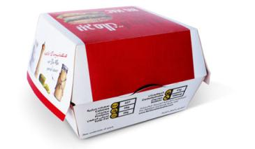
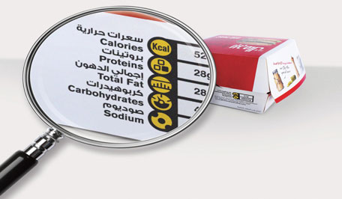
5-Social Marketing Perspective (2/2)
Example:
Quick service restaurants include messages related to balanced nutrition in their promotions
Notes:
Other examples?
Use BPA products in baby bottles etc…

Slide 21
Target Markets
Mass Marketing
Target Marketing
Product made and available to population at large
Can be used to promote a single product or several products with different features
Designed to appeal to wide segments of the population
In recent years it has been found that marketing is more effective if products are developed for and promoted to unique subgroups within the population
Ex: vitamins (liquid vitamins, chewable, vitamins with iron, ..)
Target marketing has 3 parts: market segmentation, market targeting, and market positioning
Notes:
Mass marketing: chips (cheese, vinegar, paprika, salt), coffee
Target marketing: sports wear for dancers

Slide 22
Target Marketing
Target Marketing
Market Segmentation
Market Targeting
Market Positioning

Slide 23
1-Market Segmentation (1/3)
Markets are segmented in several ways
Demographics: Age, race, gender, income, education, etc..
Geographic: Country, state, climate, ..
Psychographic: Attitude, value, belief, ..
Behavioral: Usage, benefits, …
Grouping of potential consumers is called market segmentation
Notes:
Grouping of potential consumers depending on common characteristics being age, gender, health, values
http://www.youtube.com/watch?v=RcRFBVIvJHw&sns=em

Slide 24
1-Market Segmentation (2/3)
The trick is to determine which characteristics are useful to create a useful subgroup that could benefit from a particular product
Example:
Manufacturer of cookie created a new product for brunettes
Vitamin supplements targeted to senior citizens with silver hair
Notes:
If we are a cookie company, diving the market according to hair color will not be useful
However, if we are a vitamin company, doing so can be more useful and could be feasible

Slide 25
1-Market Segmentation (3/3)
Characteristics that form the basis for segmenting the market are specific to product
In nutrition, dietetic practitioners have segmented their clients based on medical diagnosis (CVD, renal, …)
Notes:
If we are a cookie company, dividing the market according to hair color will not be useful
However, if we are a vitamin company, doing so can be more useful and could be feasible

Slide 26
2-Market Targeting (1/2)
Once market segments are identified, they need to be evaluated to see if it is feasible to develop a product for that market
Factors to evaluate include:
Size of the segment
Anticipated growth of segment
Attractiveness of segment (vs. competition)
Brand loyalty
Resources required to get a product to market (product development, promotion, ..)
Return on investment (revenue generation)
Notes:
Lets say, as vitamin producer, I segmented my market according to hair color and want to develop a product for senior citizens with gray hair. In the market targeting, I must evaluate this target population/market to see whether or not it is feasible and interesting to develop a product for this specific market
If I am dietitian willing to produce certain types of foods for people suffering from gluten intolerance (that’s my market segmentation). I must now evaluate this population to see whether or not it would be interesting for me to develop such products for them? Will gluten intolerant patients need, want and demand my product? If not, just drop the project…
Is this target market going to benefit from my product/service?
Segmentation: i.e. cvd, renal, breastfeeding, vegetarians…
Market targeting: can we develop a product for the targeted market?

Slide 27
2-Market Targeting (2/2)
The goal in target marketing is selection of the market that will need, want, and demand the product
Notes:
What are the needs, wants and demands of seniors with grey hair? will these vitamins fill them?
What are the needs, wants and demands of renal patients? Is this target market going to benefit from my product/service?

Slide 28
3-Market Positioning
After target market is identified, product must be positioned
Position is how product is perceived by customers relative to other similar products
Products are positioned on the basis of:
Attribute (physical, sensory, price)
Use
Notes:
Lets say, after identifying and evaluating my target market (gluten intolerant people) I decide to market a bread X for them
How will this population perceive my product compared to other clinics that produce similar services? This will be based on the attribute (physical, sensory, price) and use of my product

Slide 29
Market Research
Necessary to find out about potential markets
Market research begins with defining the goal or problem and gathering data to understand all aspects
Market research provides information on:
Knowledge
Belief
Attitude
Notes:
Target market: pregnant women
Problem: no tailored and individualized diet and handling of pregnant woman which leads to many pregnancy and post pregnancy complication
Goal: provide individualized dietary and physiotherapy advice for these women
During my market research I should go deeper than simple assumptions and really study this specific market to cover all potential aspects
While doing so I must gather info regarding the knowledge of this target market, their beliefs and misconceptions as well as their attitude (i.e. not willing to go too far, walk a lot, would rather have home services)

Slide 30
Market Research
Market research is conducted to identify a target market or to determine actual needs, wants, and demands of a specific group
Market research:
Needs identification
Information gathering
Primary Data
Secondary Data
Data Analysis
Notes:
Identification of needs: What do these women need?
Primary and secondary data gathered (primary: age, basic needs etc..); secondary: extra needs or wants (i.e. planning a baby shower)
Analysis of gathered data

Slide 31
Market Research
Choice whether to use primary or secondary data or a combination of them depends on:
Information already available
Money available for market research

Slide 32
Marketing Mix
Marketing mix has four components, four P’s of marketing:
Product
Place
Price
Promotion

Slide 33
Marketing Mix
Target Market
Product
Price
Place
Promotion

Slide 34
Product
Anything offered to consumers to satisfy their needs, wants, and demands
Products can be:
Goods
Durable goods: Ovens, computers, furniture, …
Non-durable goods: Dishes, uniforms, ..
Perishable goods: Meat, fresh food products, ..
Services: intangible products, …
Places
Activities
Ideas/advice
Notes:
i.e. diet, food, vitamin supp, advice,

Slide 35
Place
Location where tangible goods are offered and also includes the product’s distribution system (storage, delivery system, transport, ..)
For intangible products place denotes the location where a service is offered (daycare center, shopping mall, …)

Slide 36
Price
Most critical component of the marketing mix
Price is the component most evident to the consumer
Price is often regarded as a competitive tool
They should take into account:
Competition
Profit margins
Discounts

Slide 37
Promotion
The means to introduce the product to the targeted audience
It is communicating a message through a variety of mediums to create awareness and promote action
Advertising for instance is an important part of a promotional campaign

Slide 38
Summary Table of Marketing Mix Decisions
Product
Functionality
Packaging
Price
List Price
Discounts
Place
Channel Members
Promotion
Appearance
Quality
Brand
Allowances
Financing
Logistics
Coverage
Advertising
Personal selling
Public relations
Media
Budget
Notes:
Vitamin D cereal vs. normal not just due to packaging but research
Channel members: intermediaires were I might sell my product (i.e. aziz)

