Slide 1
EECE 311: Electronic Circuits
Part 7

Slide 2
Stability in Feedback Amplifiers
Characteristic equation:
Loop gain:
When does loop gain become equal to –1?
check |L| at ω₁₈₀

Slide 3
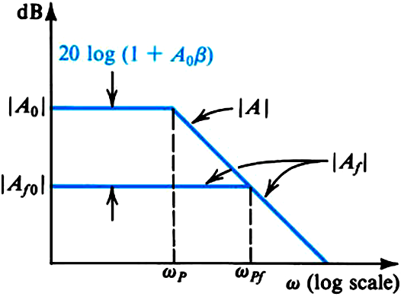
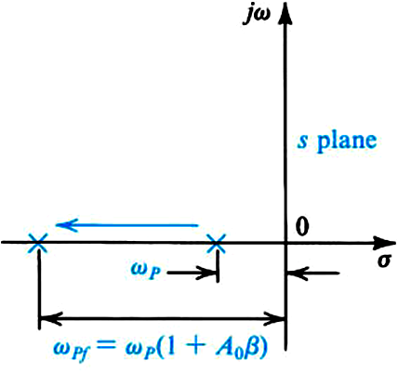
Effect of Feedback on Amplifier Poles
  Single Pole Amplifier
Bandwidth Extended
Gain Decreased
Feedback did not affect stability

Slide 4
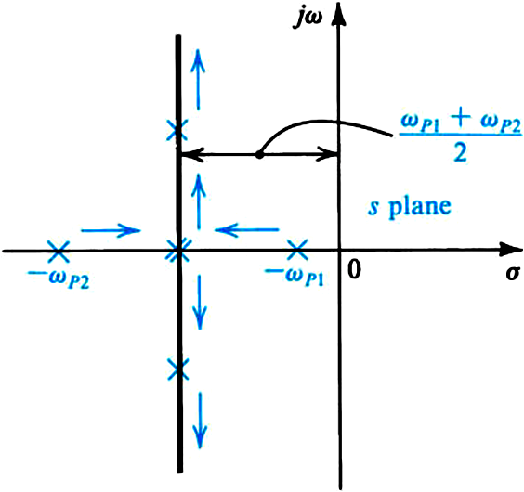
  Two-Pole Amplifier
Amplifier unconditionally stable

Slide 5
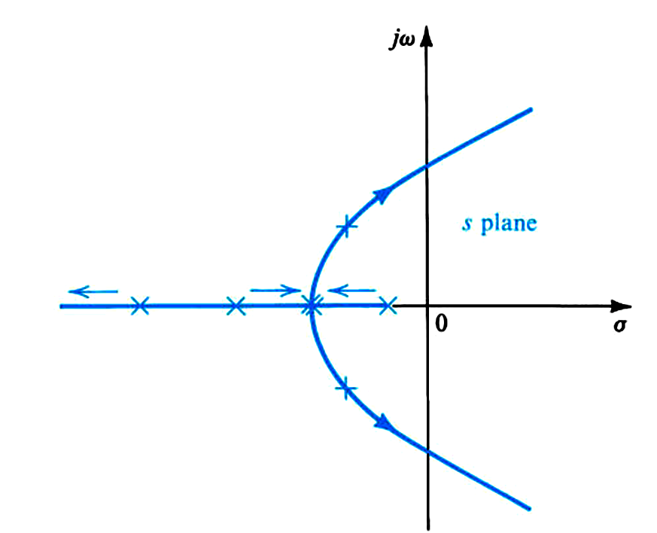
  Three-Pole Amplifier
Poles move to the right-half plane
Amplifier becomes unstable
Amplifier conditionally stable
Frequency compensation to be used to stabilize the amplifier

Slide 6
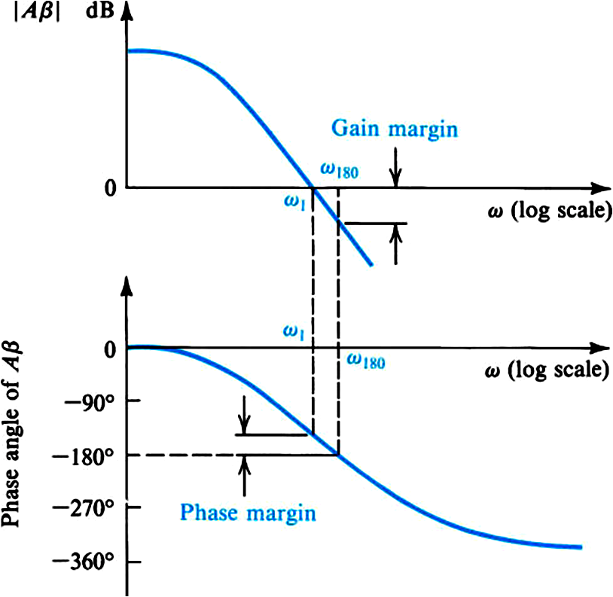
Stability Study Using Bode Plots of Loop Gain
For stability, make sure that
ω₁ < ω₁₈₀
Typically, we want: GM = 30 dB and PM = 60º

Slide 7
Example:

Slide 8
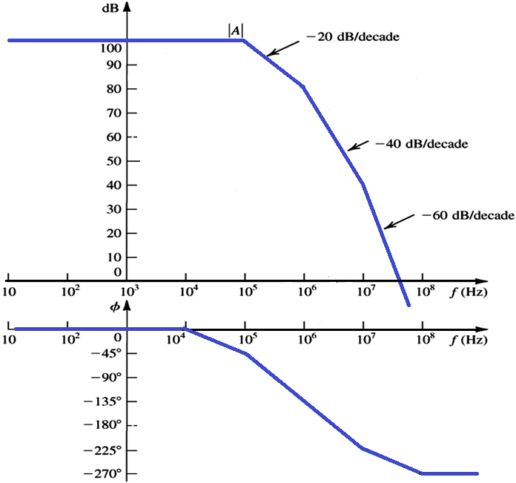
20log(1/β) = 85 dB
|Aβ | = 1
Gain Margin = 25 dB
Zero Margin Limit
20log(1/β) = 50 dB
UNSTABLE
f₁
f₁₈₀
-108º
Phase Margin = 72º

Slide 9
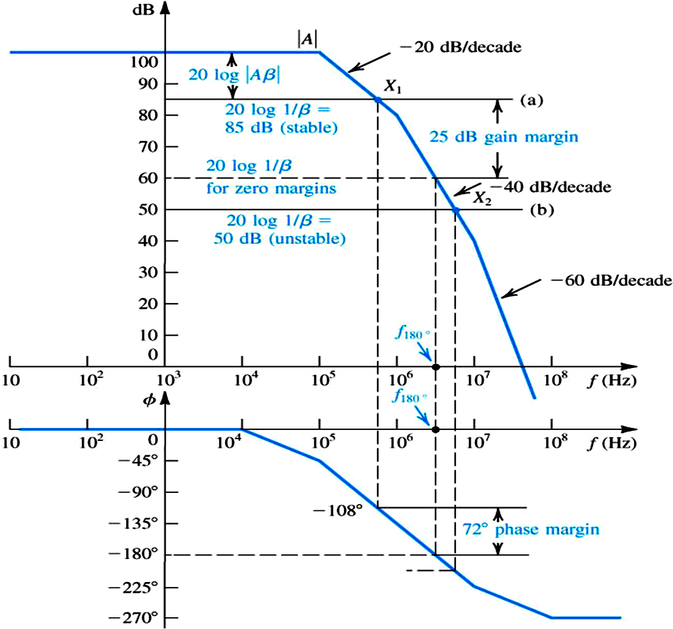

Slide 10
Rule of Thumb:
General Rule:

Slide 11
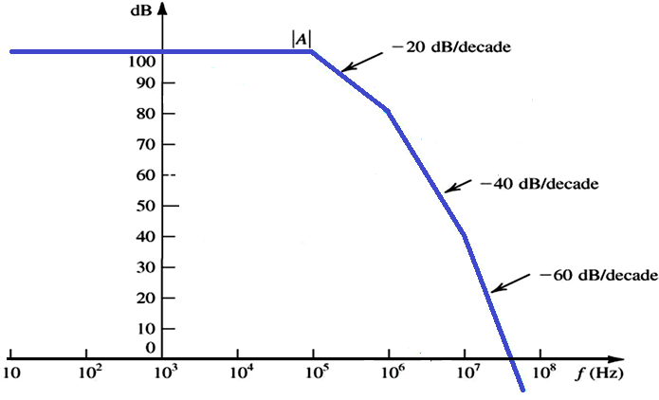
Example: Stabilize amplifier for β = 0.01
New pole
frequency

Slide 12
Example: Stabilize amplifier for β = 0.01
Shift first
pole to here

Slide 13
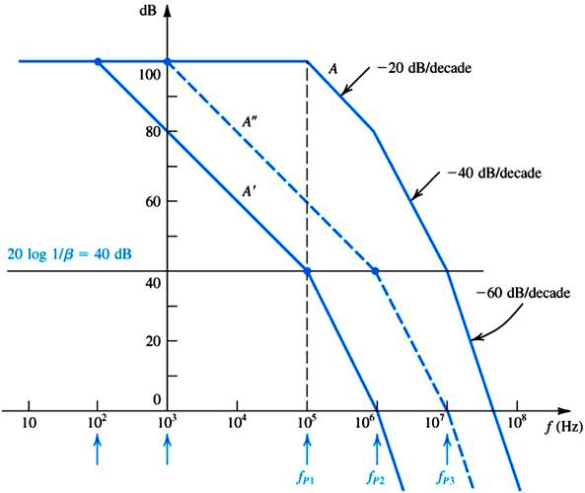
Frequency Compensation
  Gain curve A intersects the 20 log (1/β) line on the
  -40 dB/dec line.
  Option 1:
  add a low frequency pole (A’)
  Option 2:
  shift dominant pole to a lower frequency (A’’)

Slide 14
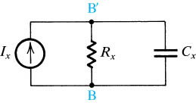
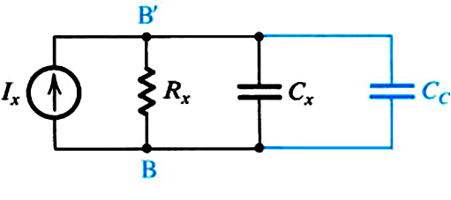
Pole Shifting
Pole shifting is done by introducing a capacitor between B and B’.
Therefore shifting the pole from
One problem with this scheme is that the C_{C} capacitor is often too large to be implemented on integrated circuits.

Slide 15
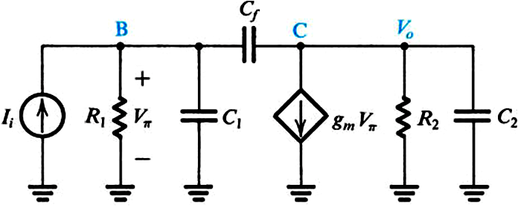
Miller Compensation and Pole Splitting
Introduce a compensating capacitor, C_{f}, in the feedback path of the amplifier stage

Slide 16
Miller Compensation therefore shifts the dominant pole to the left while at the same time shifting the second pole further to the right (Pole Splitting).
Also, the compensating capacitor is multiplied by g_{m}R₂ and allows us to use much smaller on-chip capacitors.

Slide 17
Example

Slide 18
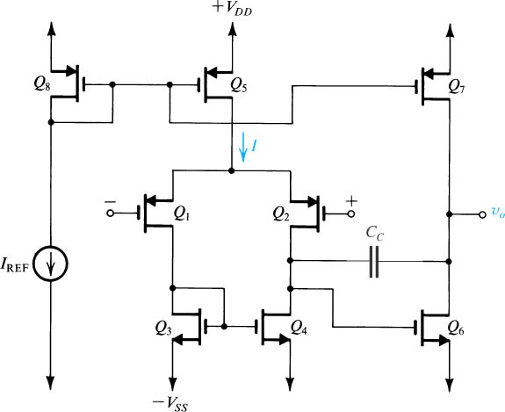
The Two-Stage CMOS OP-AMP

Slide 19
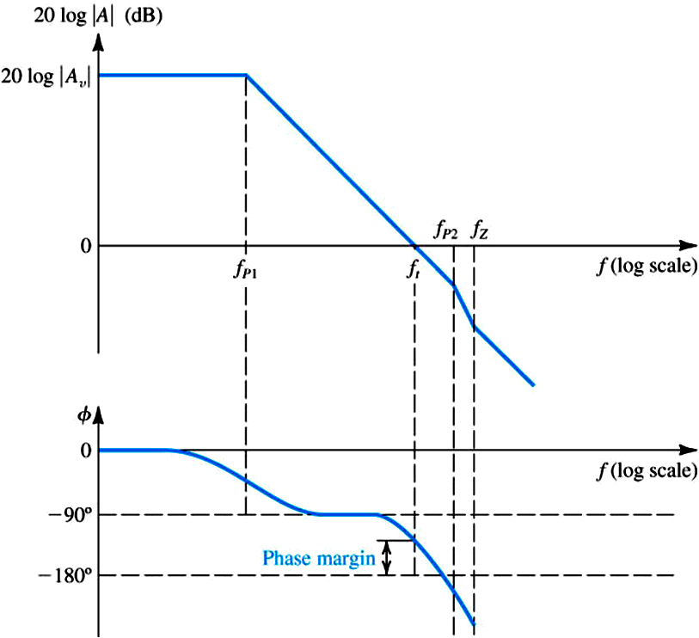
  High Frequency Model
Considering feedback with β = 1
to let the gain curve intersect with the 0 dB-line (feedback with β = 1) with a slope of -20 dB/dec.

Slide 20
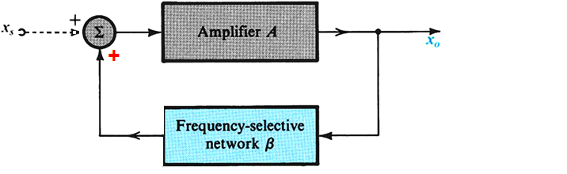
Positive Feedback
  For positive feedback: A_{f} = A / (1 – β A)
  Barkhausen criterion for oscillation
    β A = 1
    β(jω) A(jω) = 1
      magnitude(β A) = 1
      phase angle(β A) = 0

Slide 21
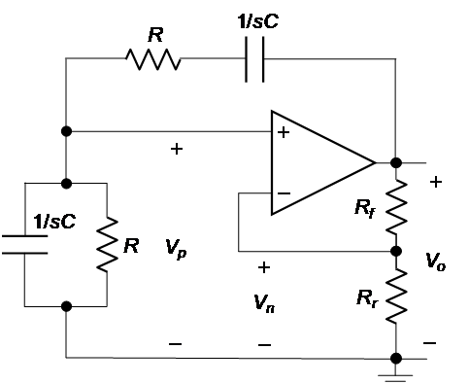
Sinusoidal Oscillators
Wien-Bridge Oscillator
  Amplifier gain
  Feedback factor

Slide 22
Sinusoidal Oscillators
Wien-Bridge Oscillator
  Oscillation condition:
  Pure real:
  At oscillation
  frequency:

Slide 23
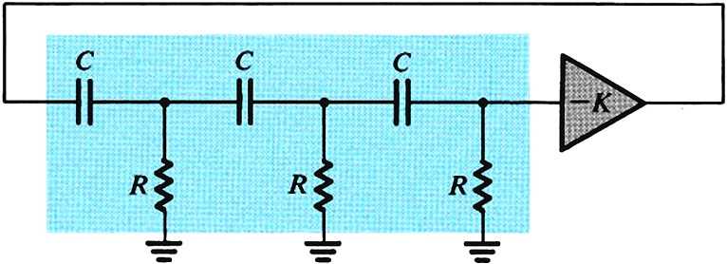
Sinusoidal Oscillators
Phase-shift oscillator
  Amplifier phase shift = 180 degrees
    Inverting OP-AMP amplifier
  The other 180 degrees come from the three RC sections
    Feedback block

Slide 24
Sinusoidal LC Oscillators
Feedback block is a tuned LC circuit

Slide 25
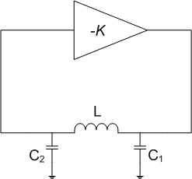
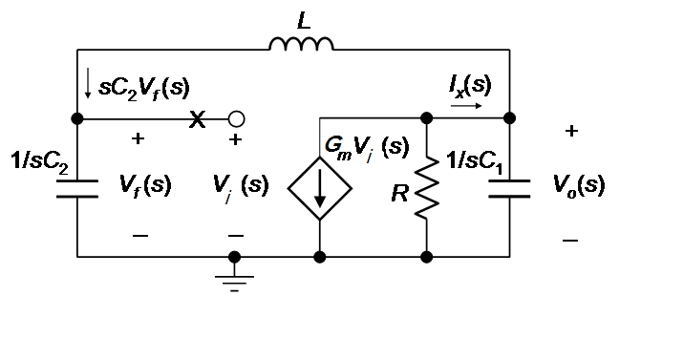
LC Oscillators
Colpitts Oscillator
  Amplifier assumed to have
  infinite input resistance

Slide 26
Colpitts Oscillator
KCL at output node
LC₂ voltage divider
Therefore

Slide 27
Colpitts Oscillator
Oscillation condition

Slide 28
Colpitts Oscillator
Amplifier gain

Slide 29
LC Oscillators
Hartley Oscillator
  Oscillation frequency

