Slide 1
EECE 311: Electronic Circuits
Part 6

Slide 2
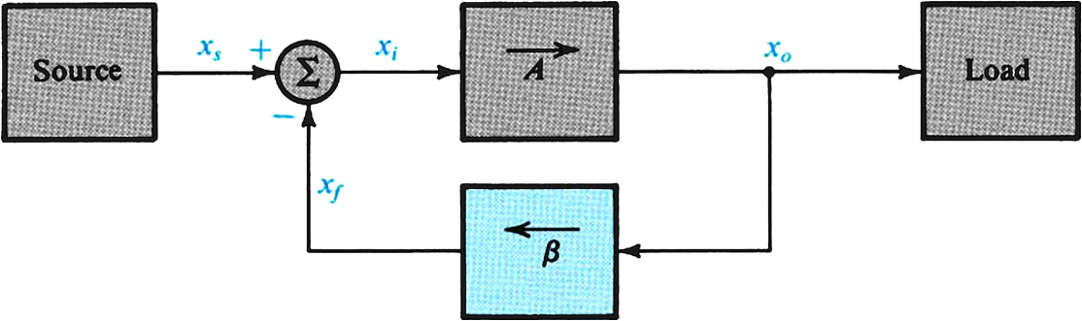
Negative Feedback
General Structure

Slide 3
Some Properties of Negative Feedback
  Gain Desensitivity
The relative change in A_{f} is much smaller than the relative change in A.
  Bandwidth Extension
Gain reduced by the feedback amount
Bandwidth extended by the feedback amount

Slide 4
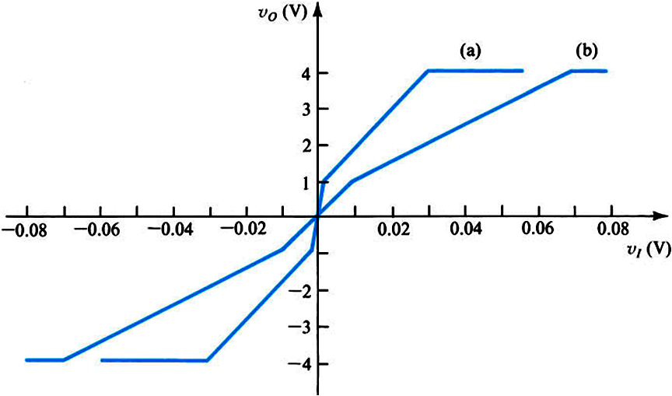
  Reduction in Nonlinear Distortion
Slope2=100
Slope1=1000
reduced distortion

Slide 5
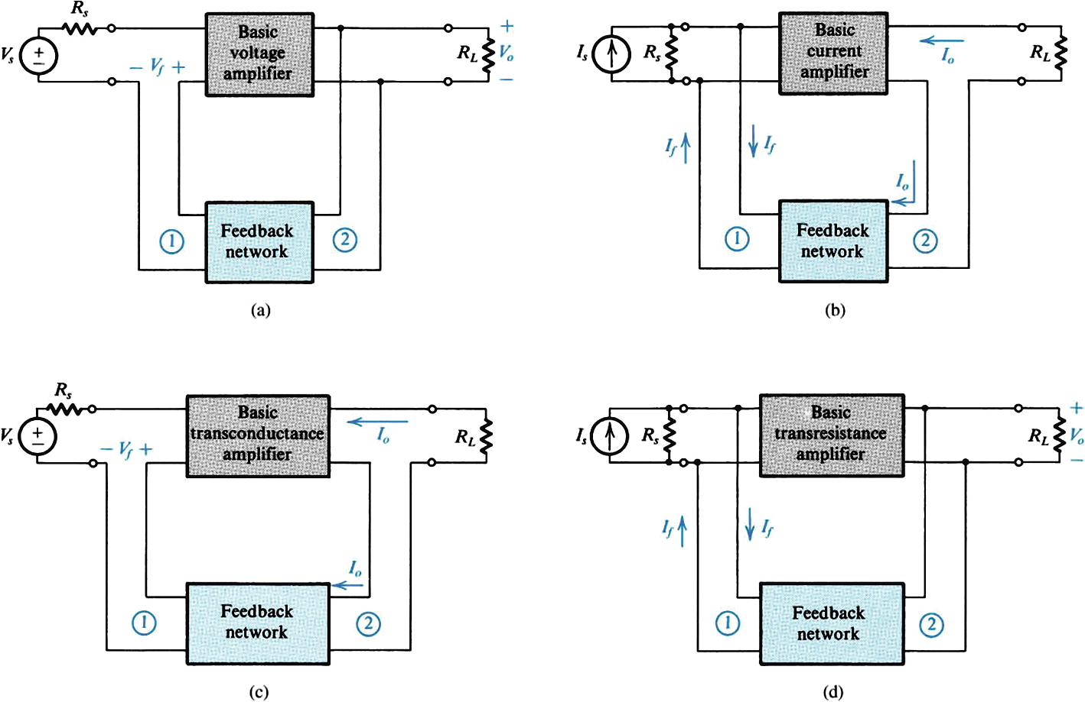
Four Basic Feedback Topologies
Voltage Amplifier (series-shunt)
Current Amplifier (shunt-series)
Transconductance Amplifier (series-series)
Transresistance Amplifier (shunt-shunt)

Slide 6
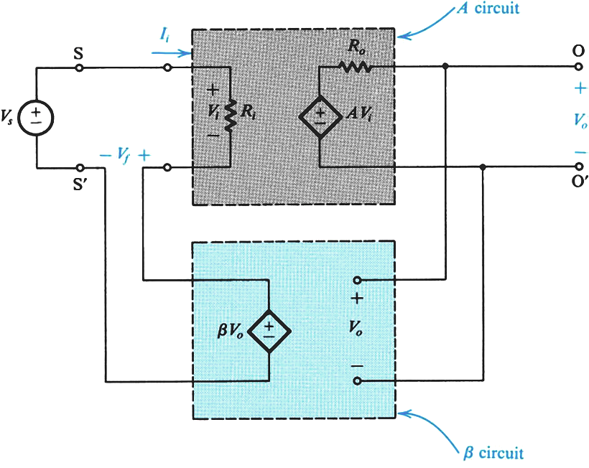
The Series-Shunt Feedback (Voltage) Amplifier
  Ideal Situation
Voltage Mixing – Voltage Sensing
series at input
shunt at output

Slide 7
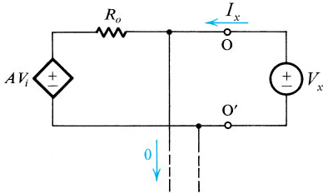
  Voltage Gain
  Input Resistance
  Output Resistance

Slide 8
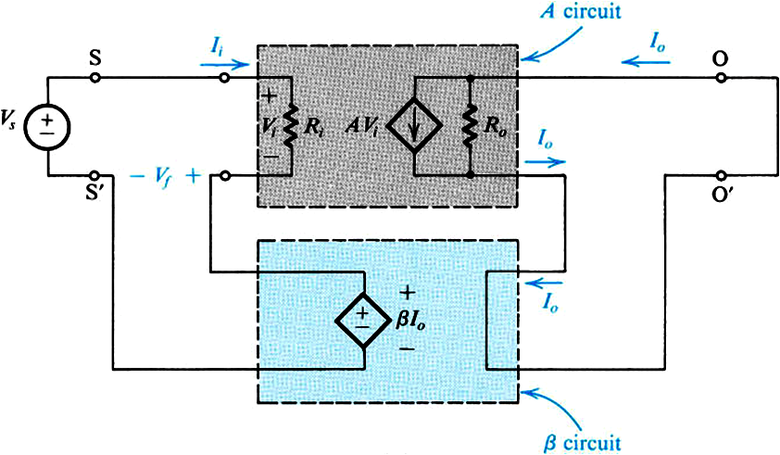
The Series-Series Feedback (Transconductance) Amplifier
  Ideal Situation
  Gain
  Input Resistance
  Output Resistance
Voltage Mixing – Current Sensing
series at input
series at output

Slide 9
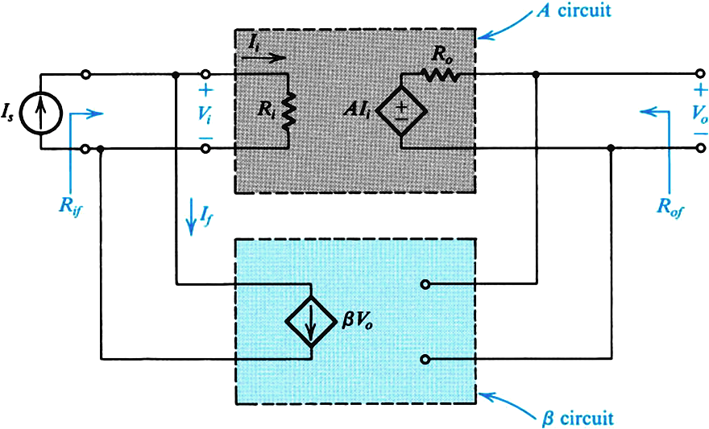
The Shunt-Shunt Feedback (Transresistance) Amplifier
  Ideal Situation
  Gain
  Input Resistance
  Output Resistance
Current Mixing – Voltage Sensing
shunt at input
shunt at output

Slide 10
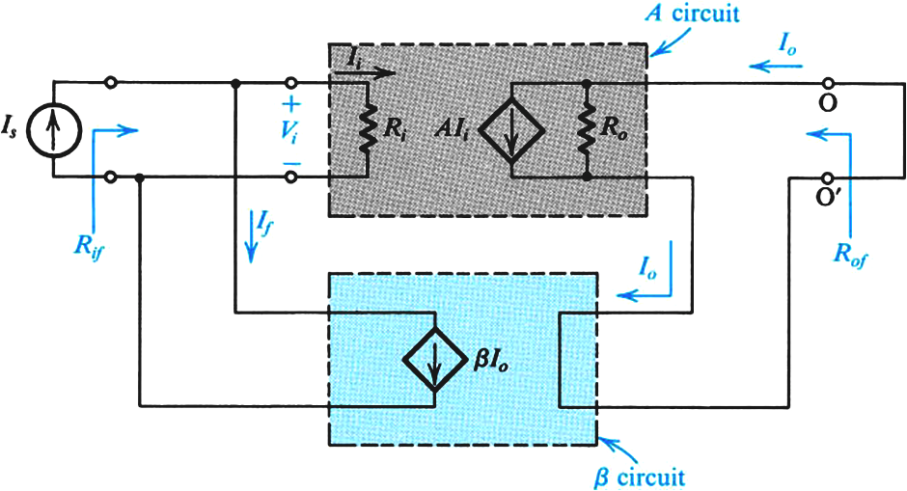
The Shunt-Series Feedback (Current) Amplifier
  Ideal Situation
  Gain
  Input Resistance
  Output Resistance
Current Mixing – Current Sensing
shunt at input
Series at output

Slide 11
Feedback Voltage Amplifier Examples

Slide 13
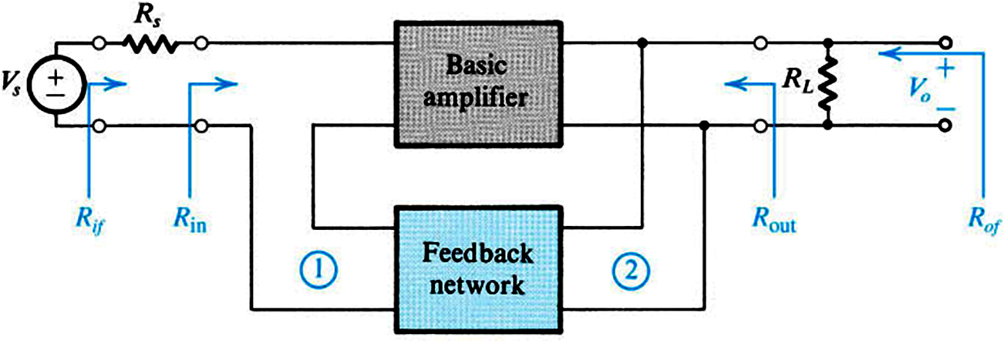
  Real Case of Series-Shunt (Voltage Amplifier)

Slide 14
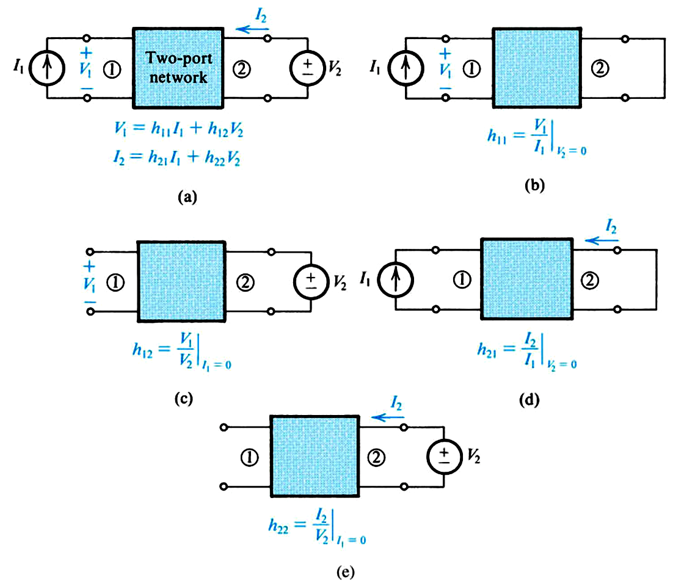
For the β block: (from two-port network theory)

Slide 15
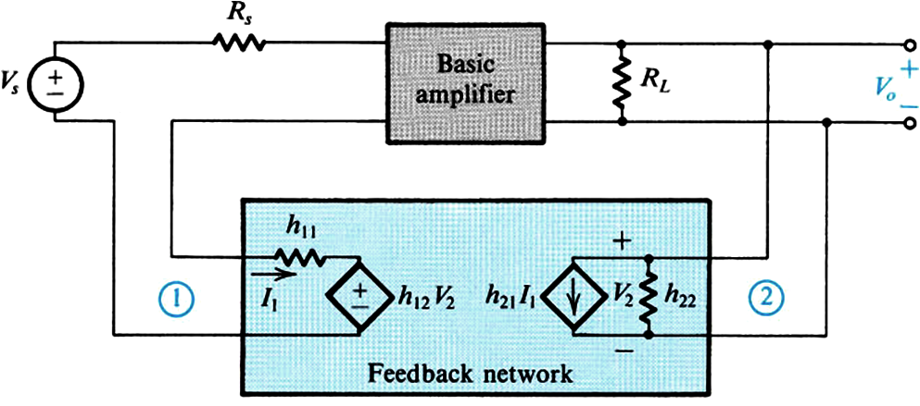
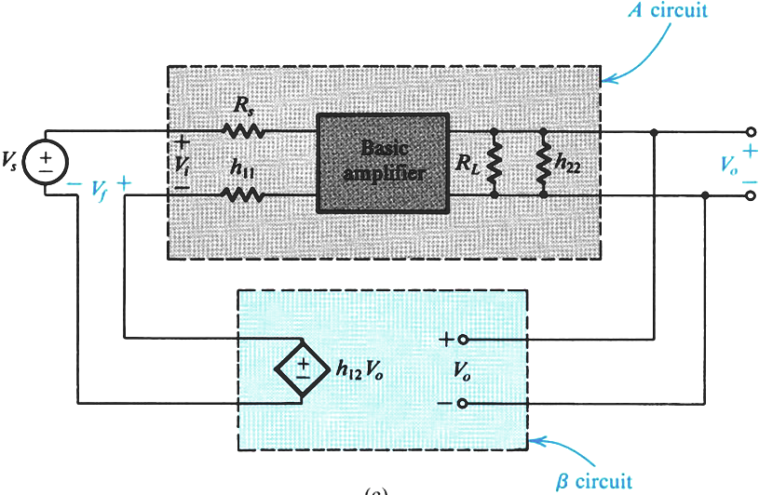
h₂₁I₁ is negligible

Slide 16
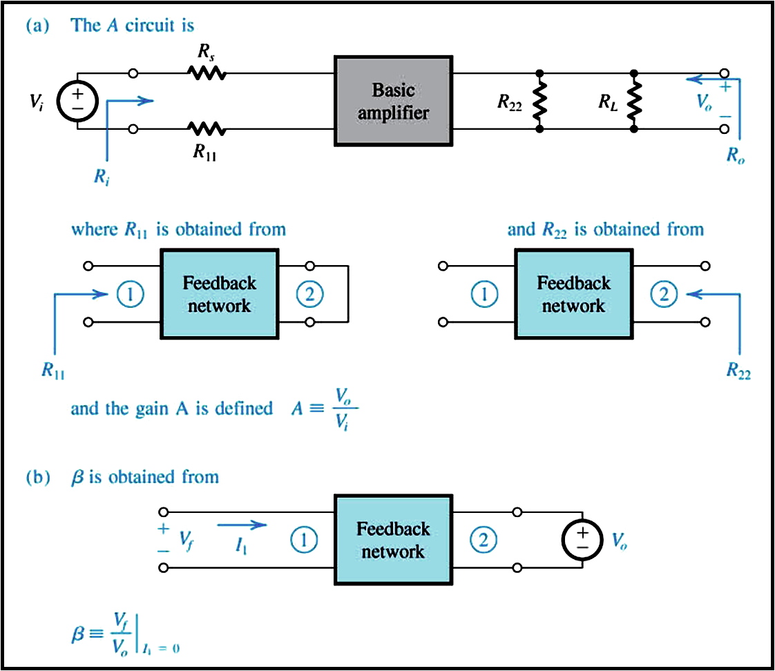

Slide 17
Feedback Voltage Amplifier Analysis

Slide 19
Feedback Voltage Amplifier Analysis

Slide 20
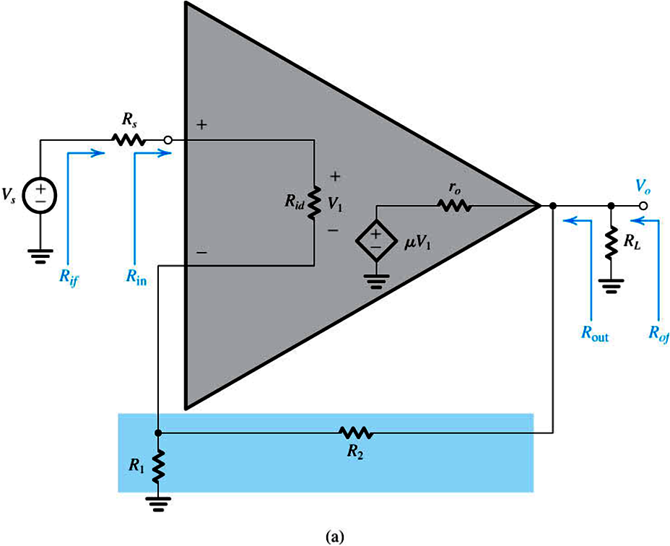
Example of a Series-Shunt Feedback Amplifier

Slide 21
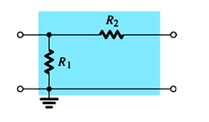
  Feedback ( β ) block
1
2

Slide 22
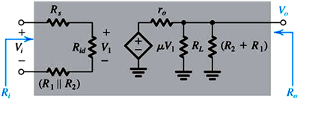
  Modified A Circuit

Slide 23
With Feedback…

Slide 24
Numerical Values

Slide 25
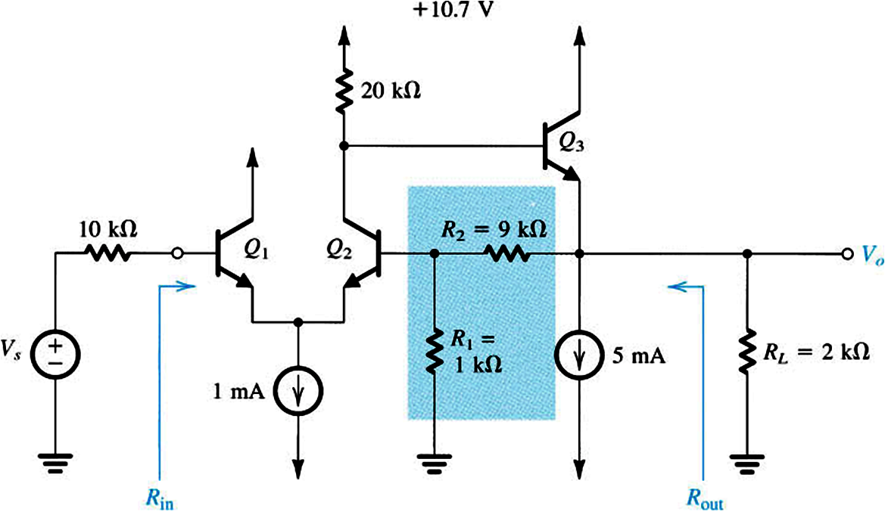
Example of a Series-Shunt Feedback Amplifier
feedback block

Slide 26
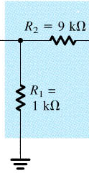
  DC analysis:
  Feedback block:
1
2
  Basic Amplifier block:
R_{i} of CC

Slide 27
  Voltage Gain of Feedback Amplifier
  Input Resistance
  Output Resistance

Slide 28
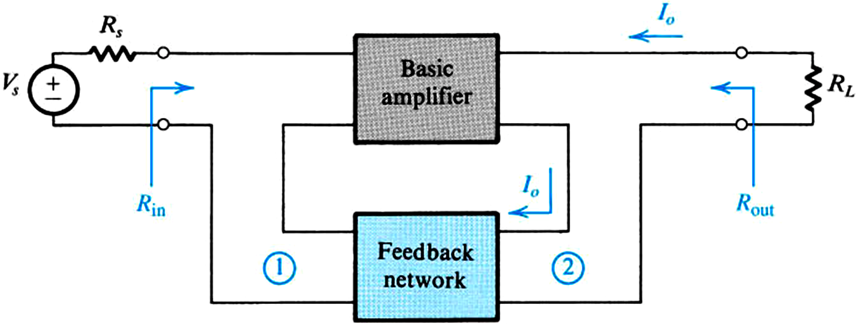
  Real Case of Series-Series (Transconductance Amplifier)

Slide 29
Feedback Transconductance Amplifier Examples

Slide 30
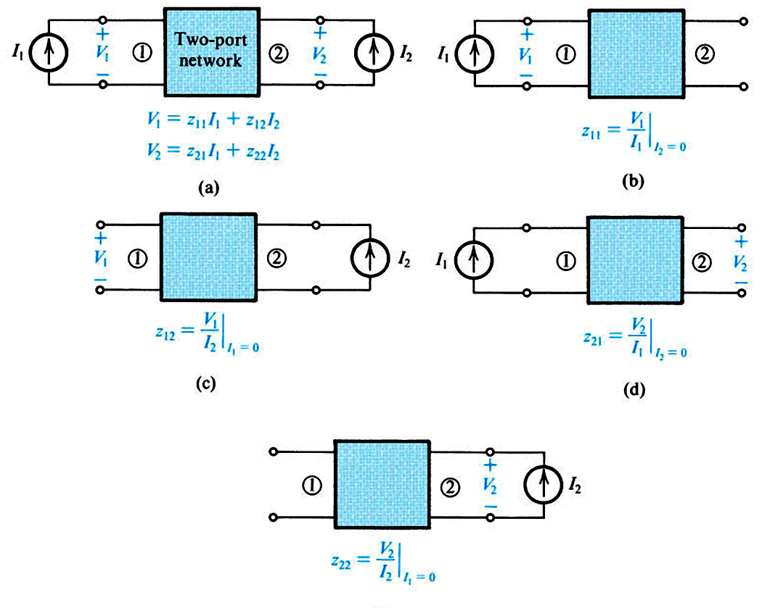
For the β block: (from two-port network theory)

Slide 31
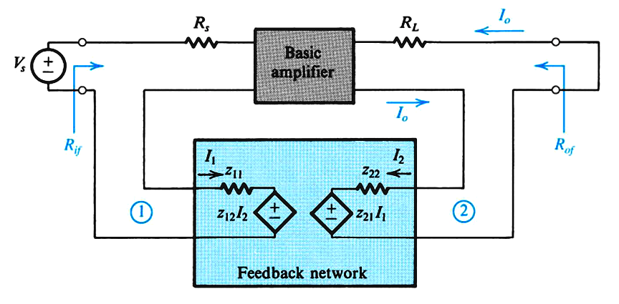
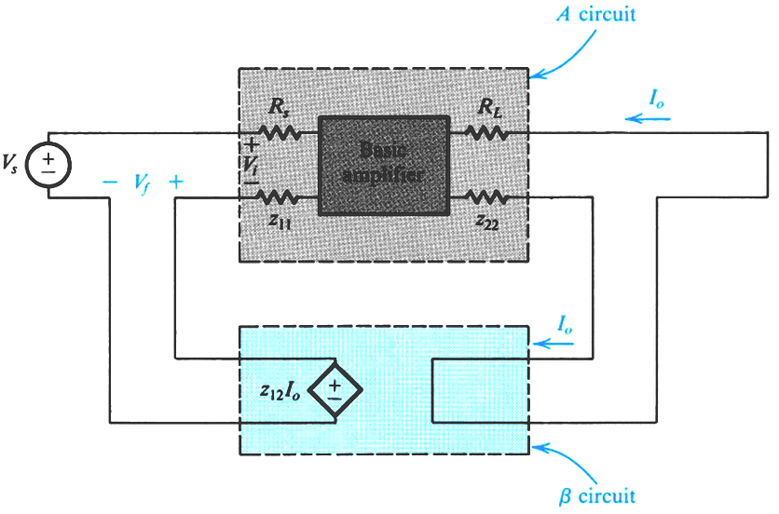
neglect z₂₁I₁

Slide 32
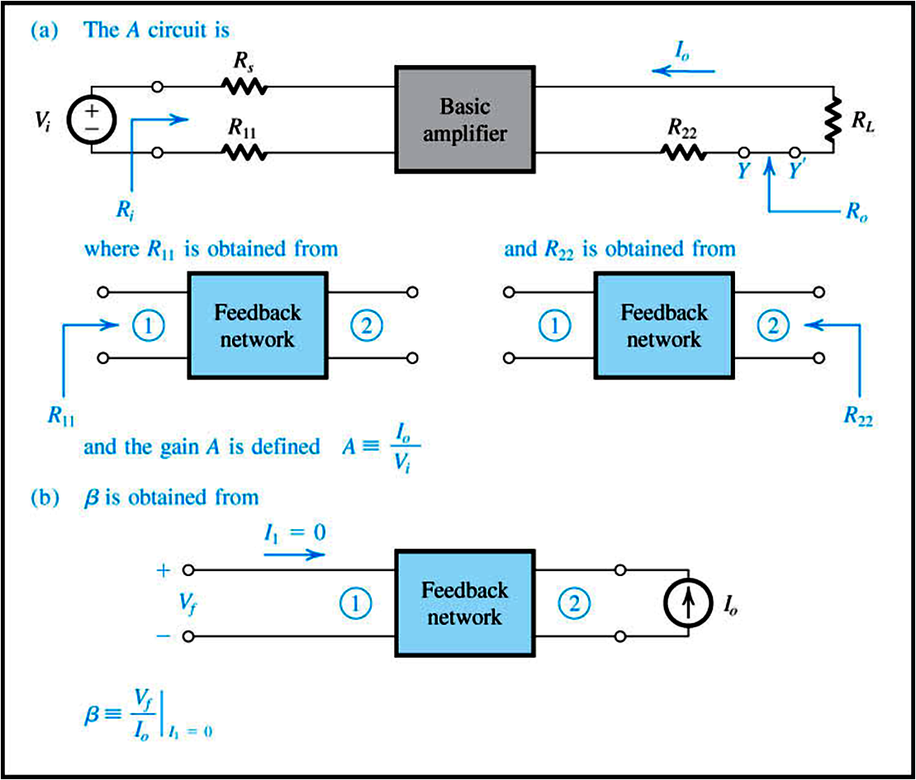

Slide 33
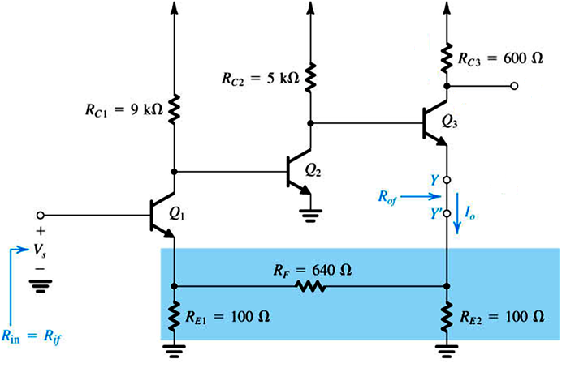
Example

Slide 34
Feedback Transresistance Amplifier Examples

Slide 35
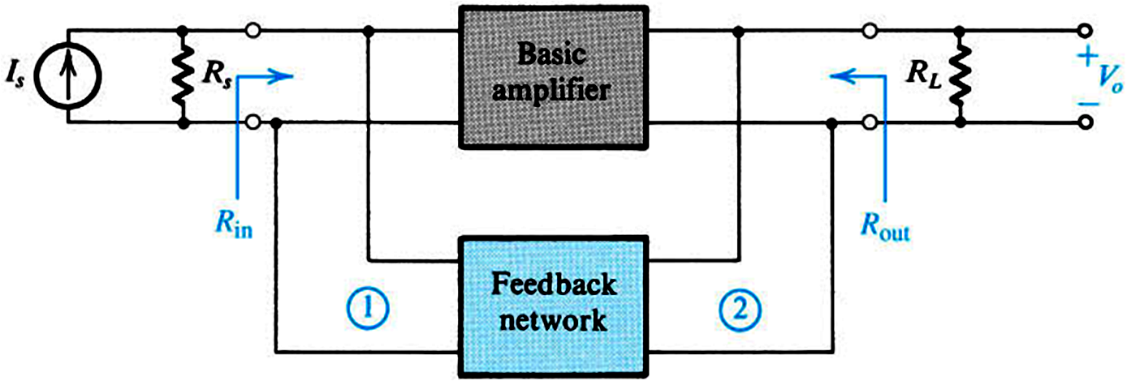
  Real Case of Shunt-Shunt (Transresistance Amplifier)

Slide 36
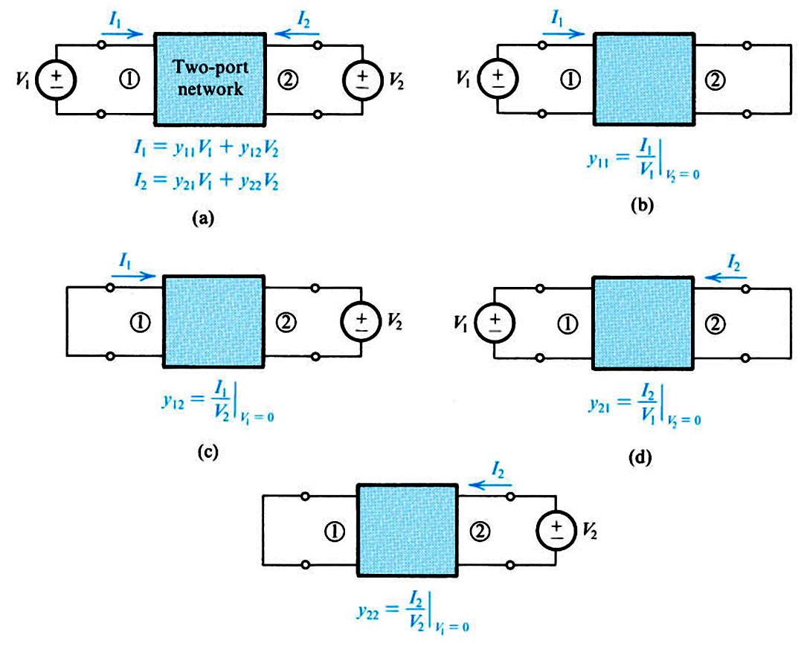
For the β block: (from two-port network theory)

Slide 37
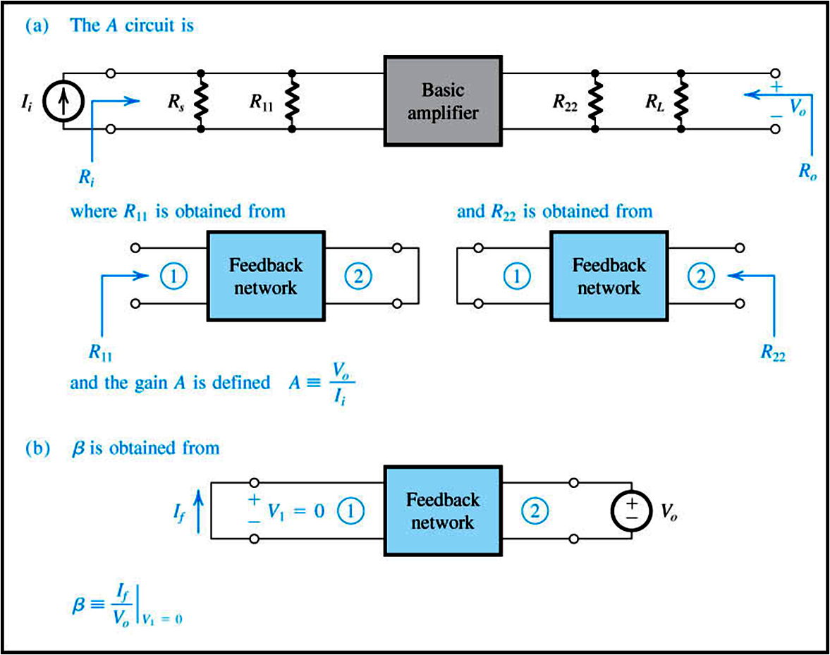

Slide 38
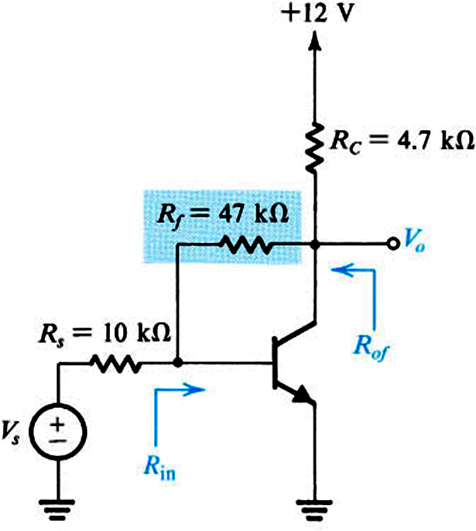
Example Shunt-Shunt Transresistance Feedback Amplifier
use Norton equivalent of the source

Slide 39
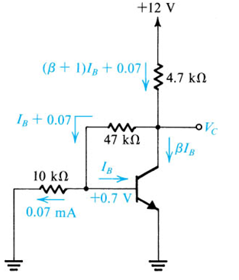
DC Analysis

Slide 40

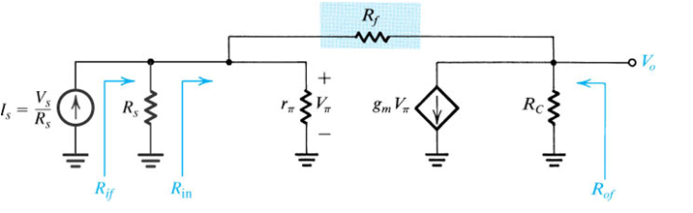
Example Shunt-Shunt Transresistance
Feedback Amplifier

Slide 41

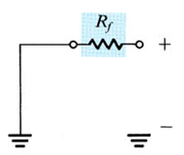
Example Shunt-Shunt Transresistance
Feedback Amplifier
  Feedback ( β ) block
1
2

Slide 42
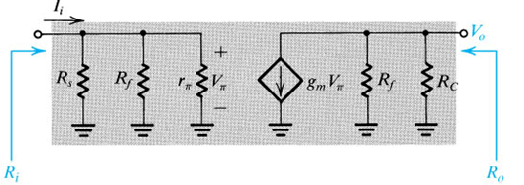
Example Shunt-Shunt Transresistance
Feedback Amplifier
Modified A Circuit

Slide 43
Example Shunt-Shunt Transresistance
Feedback Amplifier
Modified A Circuit

Slide 44
Example Shunt-Shunt Transresistance
Feedback Amplifier

Slide 45
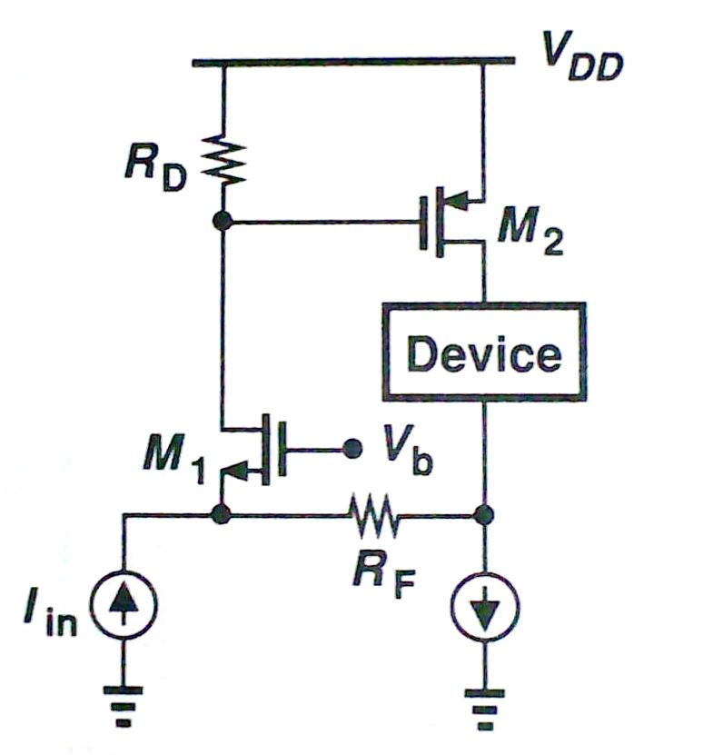
Feedback Current Amplifier Example

Slide 46
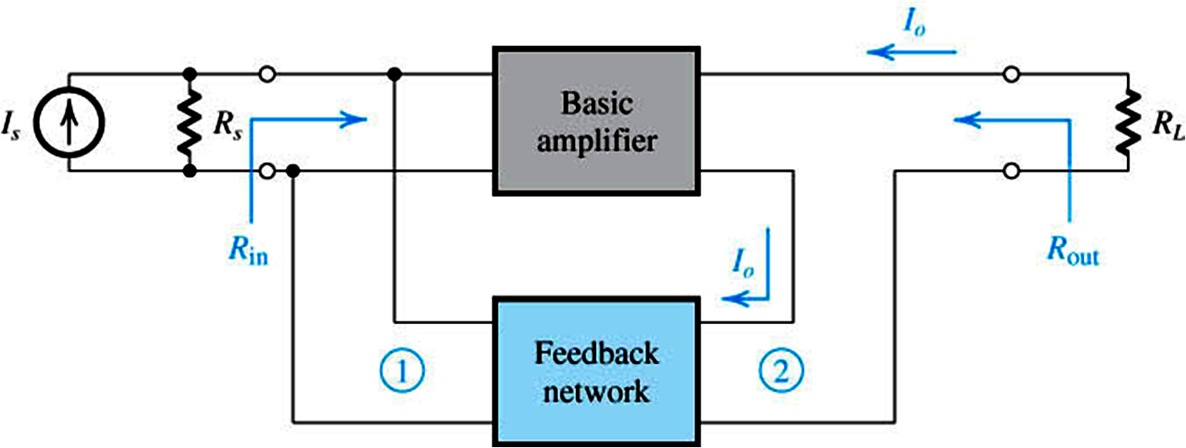
  Real Case of Shunt-Series (Current) Amplifier

Slide 47
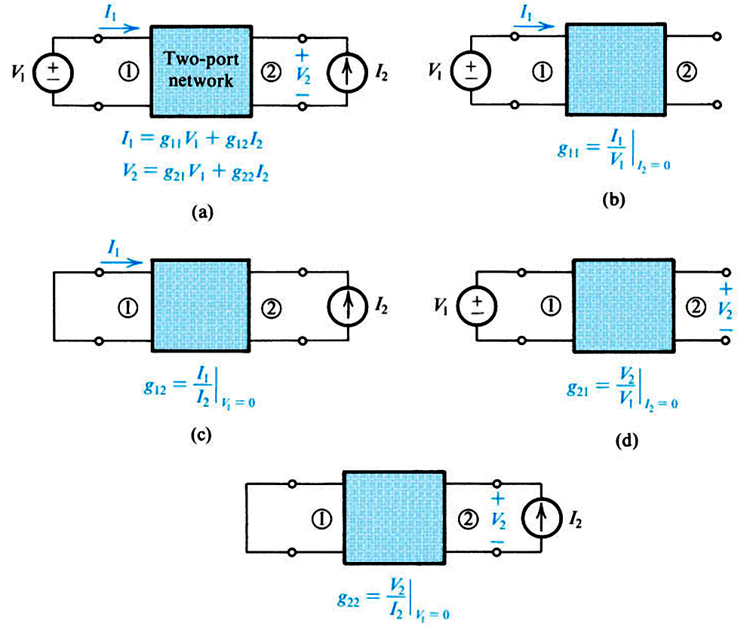
For the β block: (from two-port network theory)

Slide 48
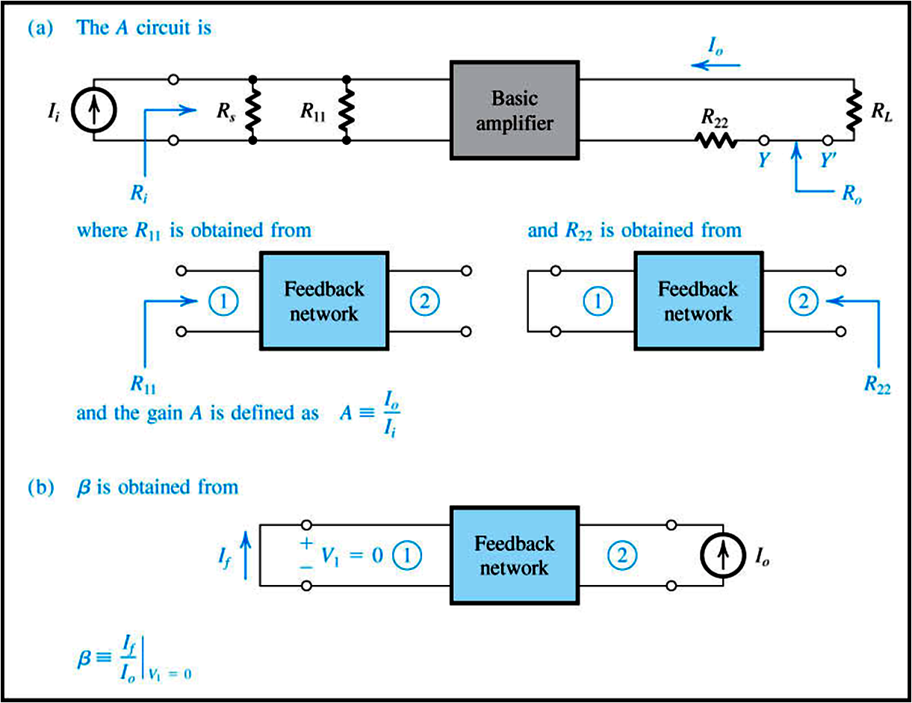

Slide 49
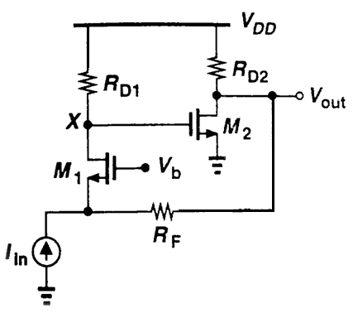
Problem
Type of feedback
  Input quantity
  Output quantity
  Sense mechanism at output
  Mix mechanism at input
Identify A block
Identify β block
Is feedback negative?

Slide 50
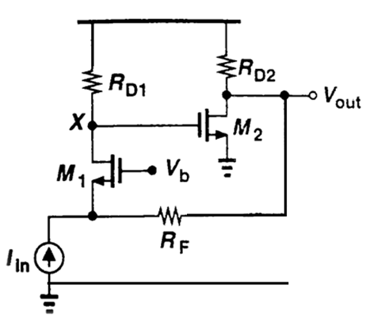
Problem
Type of feedback
  Input quantity: current
  Output quantity: voltage
  Sense mechanism at output: shunt
  Mix mechanism at input: shunt
Identify A block
  A = V_{out}/I_{in}
Identify β block
  β = I_{f}/V_{out}
Is feedback negative?
  A β should be positive
  A is negative
  so is β

Slide 51
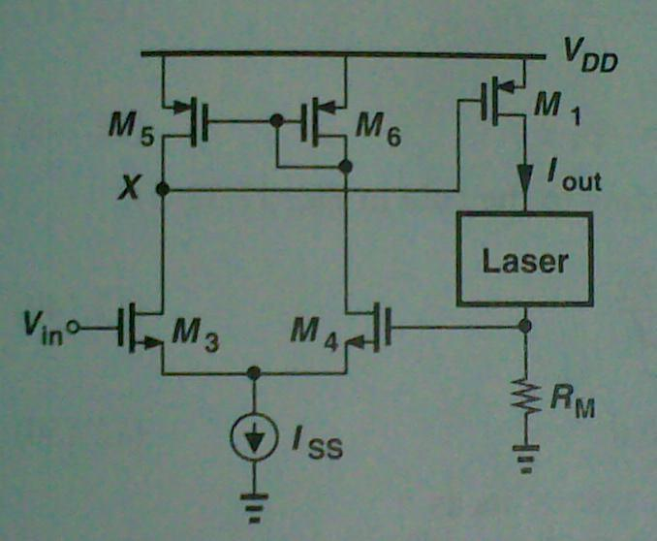
Problem
Type of feedback
  Input quantity
  Output quantity
  Sense mechanism at output
  Mix mechanism at input
Identify A block
Identify β block
Is feedback negative?

Slide 52
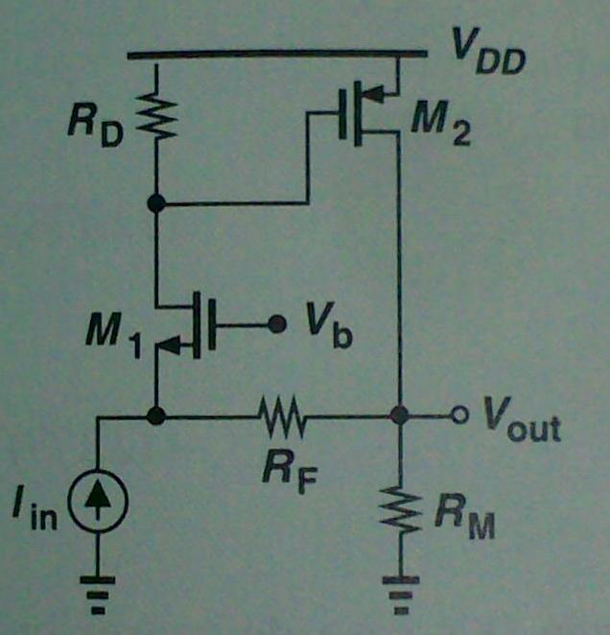
Problem
Type of feedback
  Input quantity
  Output quantity
  Sense mechanism at output
  Mix mechanism at input
Identify A block
Identify β block
Is feedback negative?
How do answers change if
output quantity is drain current of M₂?

