Slide 1
EECE 311: Electronic Circuits
Part 4

Slide 2
Operational amplifier

Slide 3
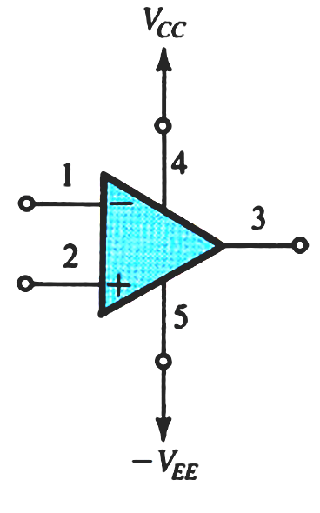
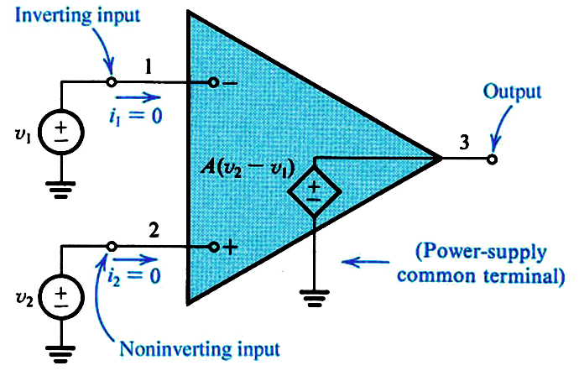
Ideal Op-Amp
Infinite input impedance
Zero output impedance
Infinite open-loop gain
Infinite bandwidth
…
…
Open loop gain

Slide 4
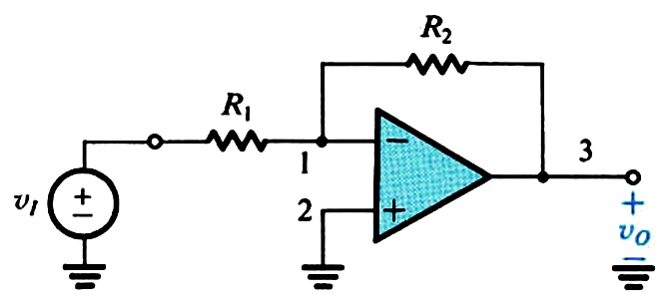
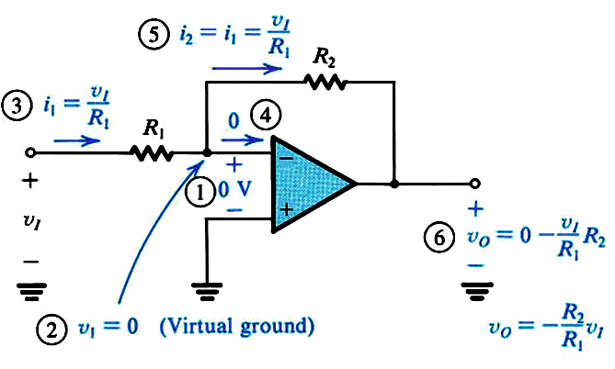
Inverting Amplifier Configuration
Input and output signals out of phase
Trade-off between a large input resistance and a large gain

Slide 5
  Effect of Finite Open-Loop Gain

Slide 6
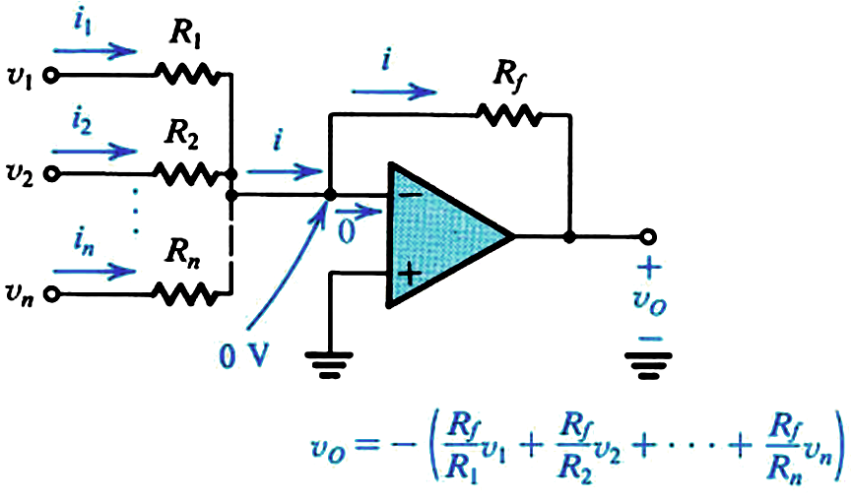
Summing Amplifier

Slide 7
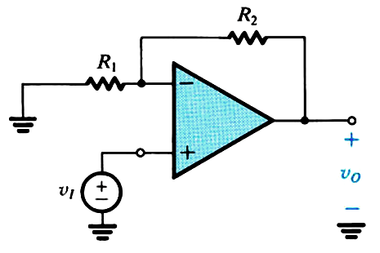
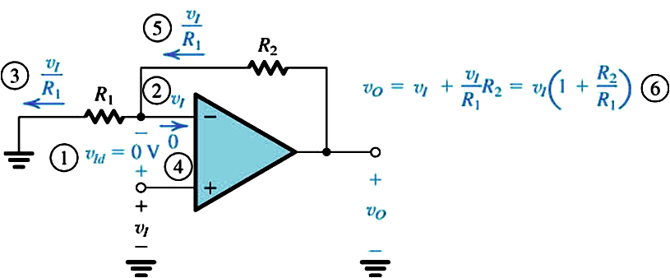
Non-Inverting Amplifier Configuration
Infinite input resistance
Input and output signals in-phase

Slide 8
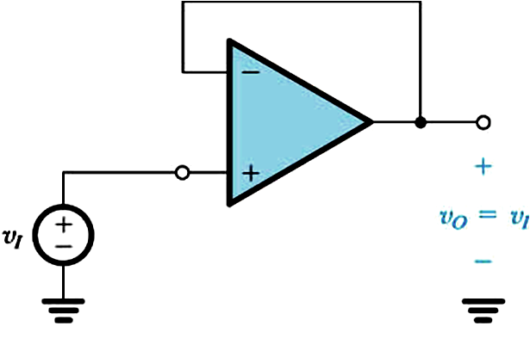
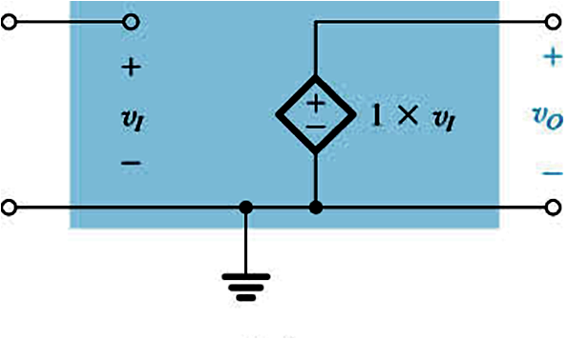
Voltage Follower
Infinite input resistance
Zero output resistance
Input and output signals are equal

Slide 9
Difference Amplifier: Amplify the difference of two signals
Difference signal
Two input signals:
let
Common-mode

Slide 10
Difference Amplifier: Amplify the difference of two signals
Two input signals:

Slide 11
Common-Mode Rejection Ratio
In a differential amplifier, A_{cm} is ideally zero and CMRR is ideally infinite

Slide 12
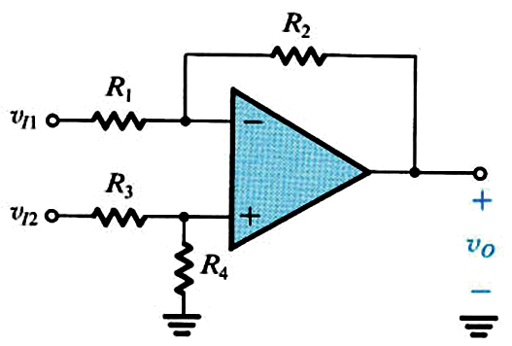
Op-Amp Difference Amplifier Circuit

Slide 13
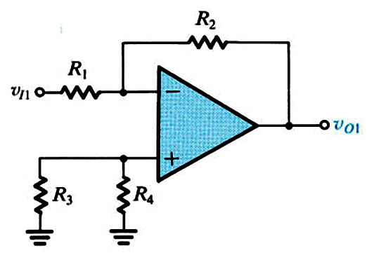
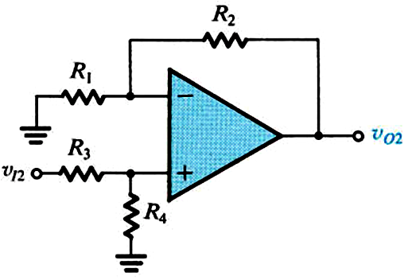
By superposition:

Slide 15
For the difference amplifier, the output should be a function of v_{ID} only.
For the difference amplifier, A_{cm} should be zero:

Slide 16
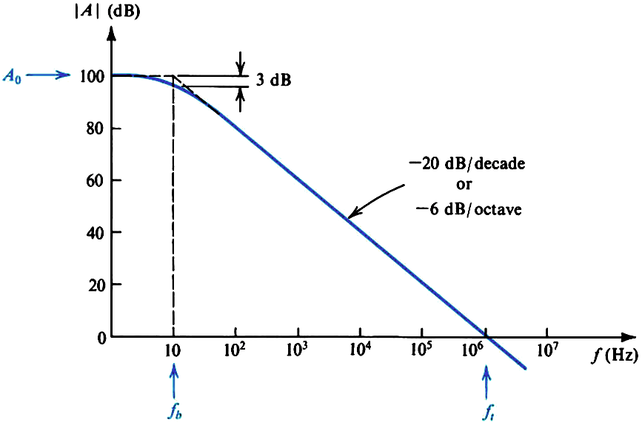
Effect of Finite Bandwidth
f_{b} = f_{3dB} is made very low to stabilize the op-amp

Slide 17

  Frequency Response of the Inverting Op-Amp

Slide 18
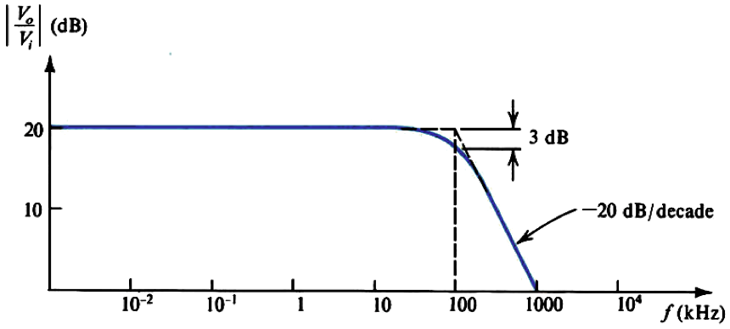
  Frequency Response of the Inverting Op-Amp
    Example: R₂/R₁ = 10

Slide 19
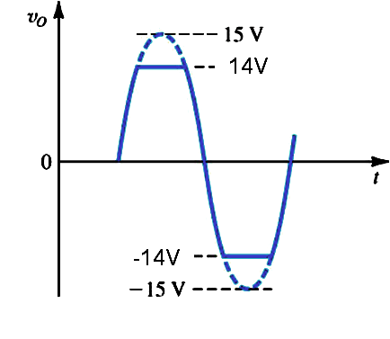
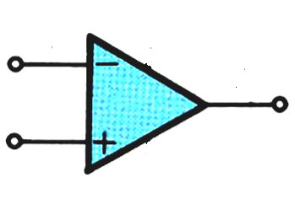
Large-Signal Operation of Op-Amps
  Output Voltage Saturation
The op-amp output voltage saturates within 1V of the power supplies voltages (rail-to-rail op-amps reach to within a few mV)
  Output Current Limits
Output current limited to a few mA (or few tens of mA, usually 20mA) in either direction (source or sink)

Slide 20
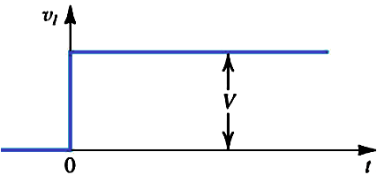
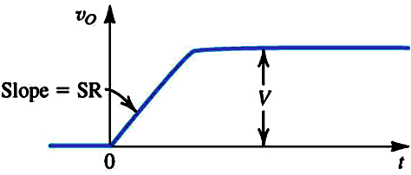
  Slew Rate
There is a maximum rate of change possible at the output of the op-amp.

Slide 21
  Slew Rate
For a voltage follower:
For a step input V:
Slew-rate distortion if dv_{o}/dt > SR

Slide 22
  Full-Power Bandwidth
The output of the op-amp can be slew rate limited or frequency limited.
It is slew rate limited when (for a sinusoidal input):
Frequency at which op amp stops behaving linearly
    Example:

Slide 23
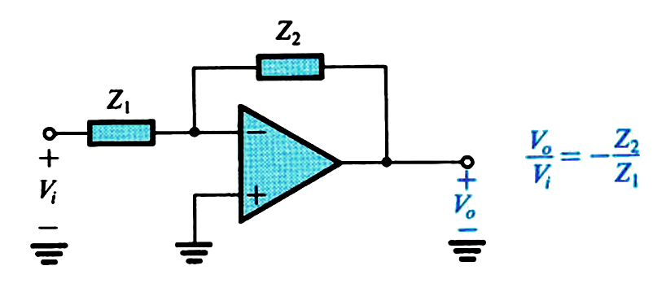
Op-Amp Integrator and Differentiator
Integrator:
Differentiator:

Slide 24
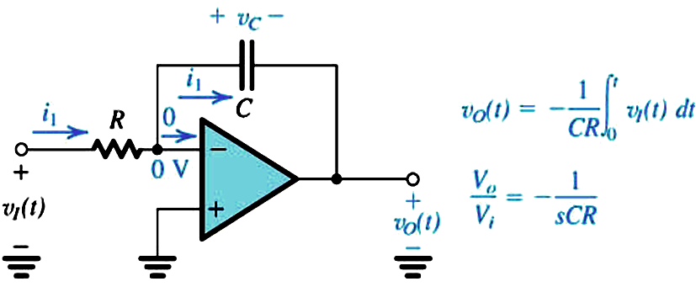
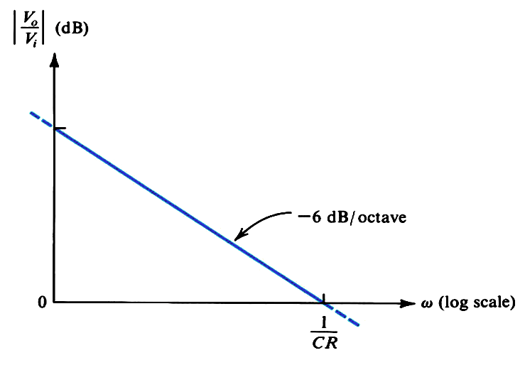
  Op-Amp Integrator

Slide 25
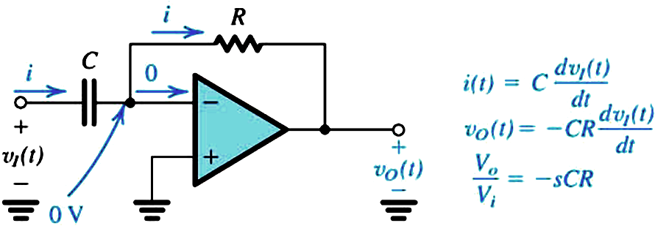
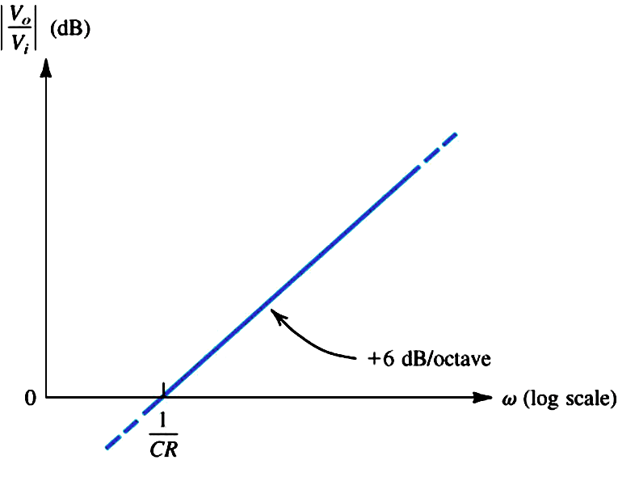
  Op-Amp Differentiator

Slide 26
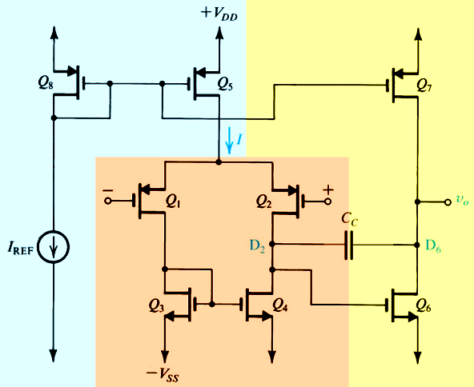
Simple CMOS Op-Amp

