Slide 1
EECE 311: Electronic Circuits
Part 1

Slide 2
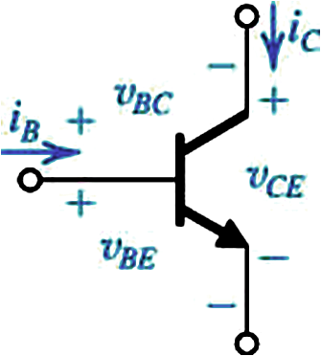
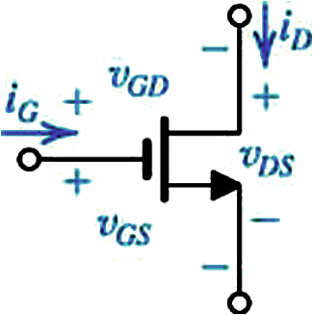
Review of MOSFETs and BJTs
For amplification:
  MOSFET in Saturation (NMOS)
  BJT in Active mode (NPN)

Slide 3
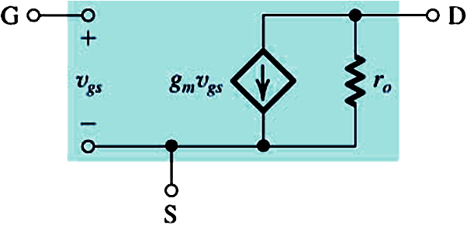
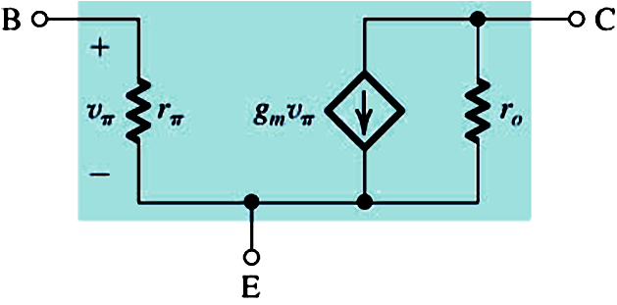
Current-Voltage Characteristics
  MOSFET in SAT
  BJT in Active
Low-Frequency Small-Signal Hybrid-π Models

Slide 4
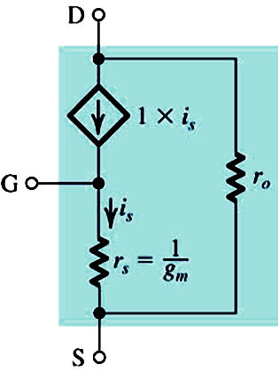
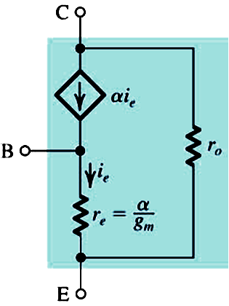
Transconductance and Output Resistance
  MOSFET
  BJT
Low-Frequency Small-Signal T Models

Slide 5
Intrinsic Gain
  MOSFET (gate to drain)
  BJT (base to collector)

Slide 6
Example: Find
Given:
  NMOS MOSFET
  NPN BJT
Solution:

Slide 7
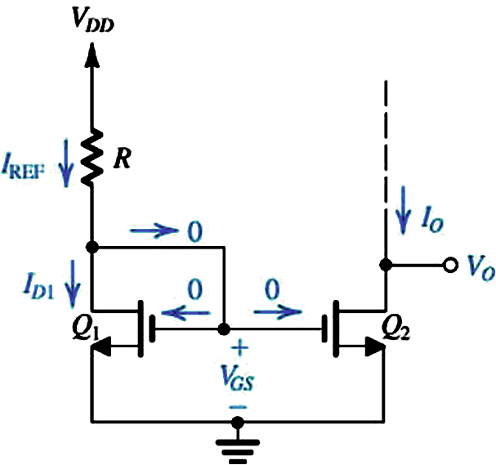
Biasing in IC amplifiers
The Basic (NMOS) MOSFET Current Source
Matched MOSFETs have same k’ and V_{t}

Slide 8
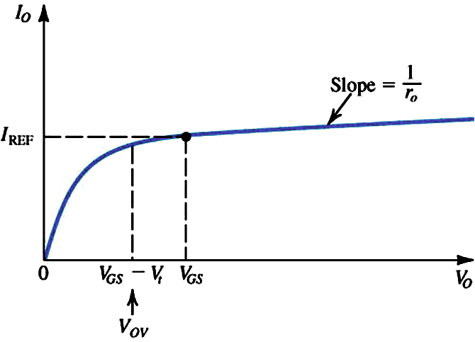
  Considering Channel-Length Modulation
  What is the ideal value of
  output resistance for a current source?

Slide 9
  Example
    Given: V_{DD} = 3 V, I_{REF} = 100 μA, design for I_{O} = 100 μA.
    Q₁ and Q₂ are matched with L = 1 μm, W = 10 μm,
    V_{t} = 0.7 V, k’_{n} = 200 μA/V².
    What is the lowest V_{O} for current source operation?
    Given V’_{A} = 20 V/μm, find the output resistance of the current source
    Find the change in I_{O} when V_{O} changes by +1V

Slide 10
  Solution

Slide 11
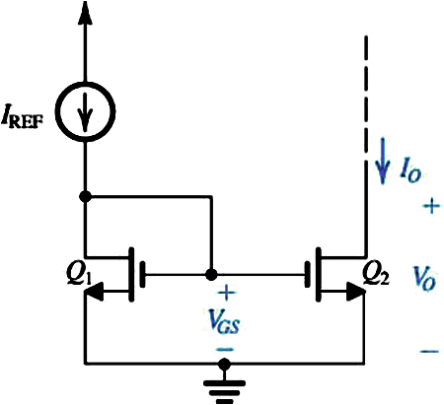
  Simple MOSFET Current Mirror
Note that this circuit and the previous one implement actually a current “sink”,
not a current “source”. How do I build a current source?
Question: What is the small-signal equivalent circuit?

Slide 12
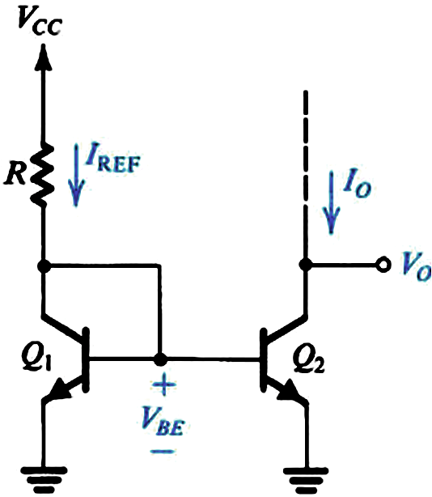
The Basic NPN BJT Current Source
  Neglecting the base current
  and as long as V_{o} > 0.3 V

Slide 13
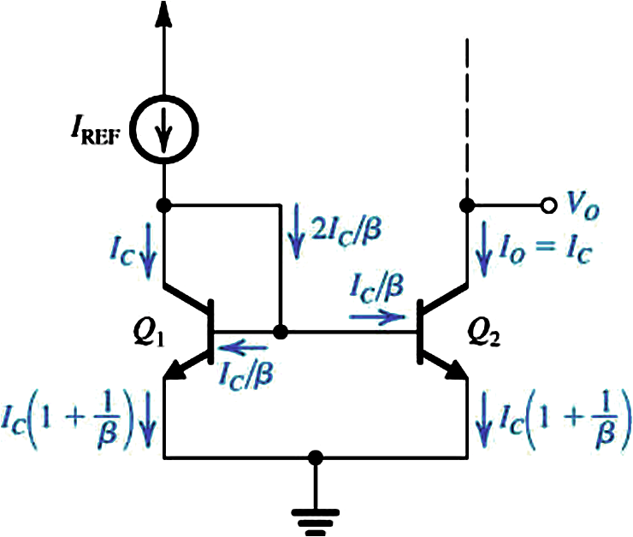
  Considering the base current with m = 1 (equal BJT areas)
  Error term is 2/β
  Considering the base current and different BJT areas
  How do we include the Early Effect?

Slide 14
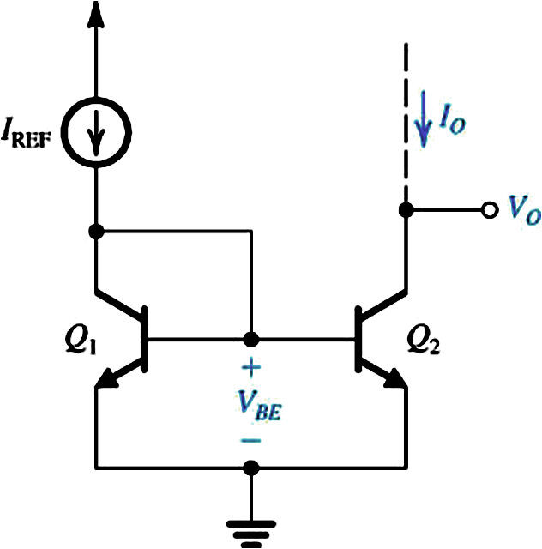
  Simple BJT Current Mirror
Again, this is a current “sink”, not current “source”.
How do I build a current source? Hint: PNP
What is the small-signal equivalent of this circuit?

Slide 15
Common Source Amplifier with Resistive Load (Review from 310)
Voltage gain, input resistance, output resistance

Slide 16
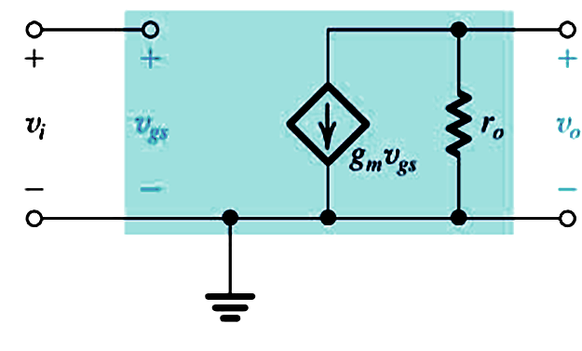
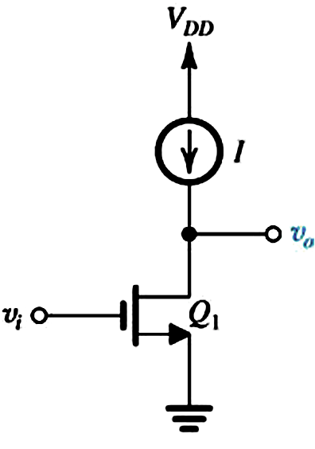
Common Source Amplifier with Active Load
Replace resistor with current source
  Small-Signal Analysis

Slide 17

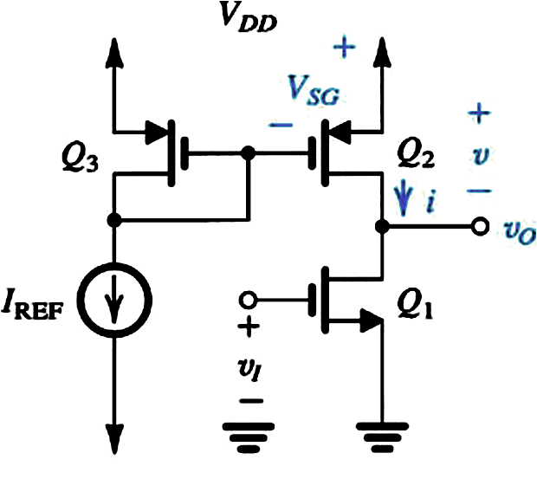
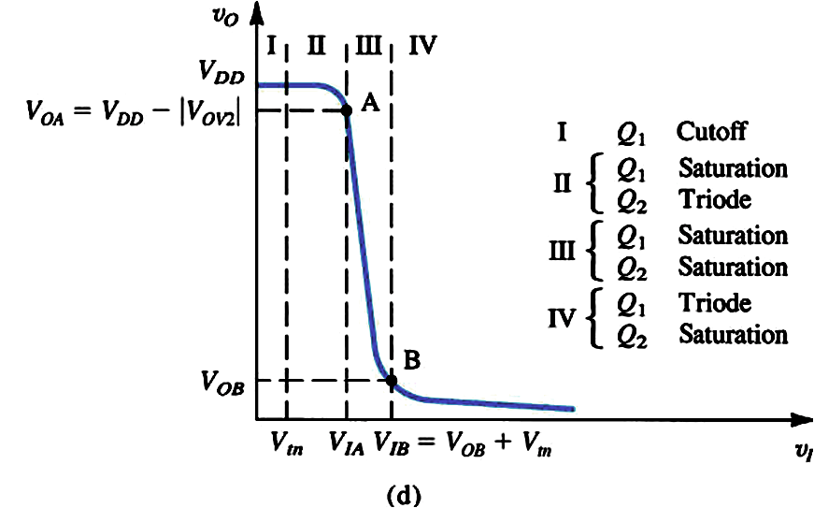
CMOS Common Source Amplifier

Slide 18
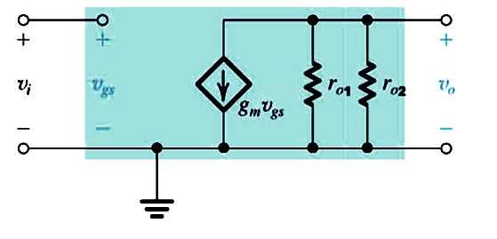
  Small-Signal Analysis of CMOS Common-Source Amplifier
  Small-signal equivalent of Q₃-Q₂ is simply r_{o2}
    v_{SG2} is pure DC

Slide 19
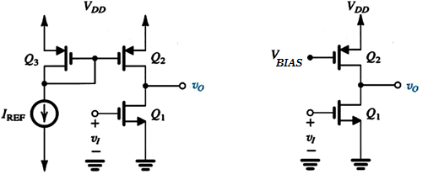
CMOS Common-Source Amplifier
Voltage at gate of Q₂ is a pure DC level (V_{BIAS})
In small-signal analysis, Q₂ appears as simply r_{o2}
The resistance seen looking into MOSFET drain,
with gate and source at DC levels is equal to r_{o}

Slide 20
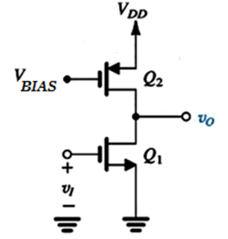
CMOS CS – Output Resistance
The small-signal resistance seen looking into MOSFET drain,
with gate and source at DC levels, is equal to r_{o}
r_{o2}
R_{o} = r_{o1} // r_{o2}
r_{o1}

Slide 21
  Example: CMOS Common-Source Amp
  Find:
    Output resistance of amplifier
    Small-signal voltage gain v_{o}/v_{i}
    Limits of v_{o} to keep Q₁ and Q₂ saturated

Slide 22
  Solution:
We will neglect channel-
length modulation in
DC analyses.

Slide 23
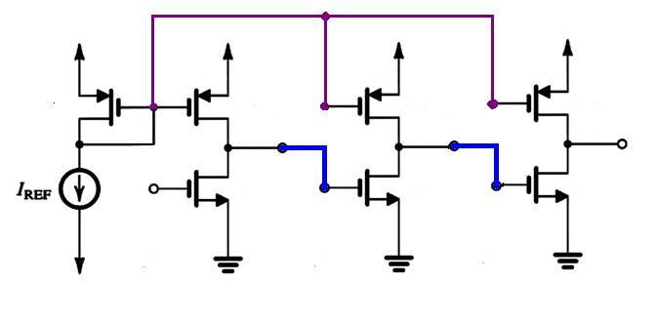
  CMOS Common-Source Cascade
  Assume identical stages
    What is the overall low-frequency gain if the per-stage gain is –42?
    What is the input resistance?
    What is the output resistance?

Slide 24
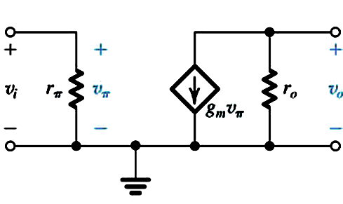
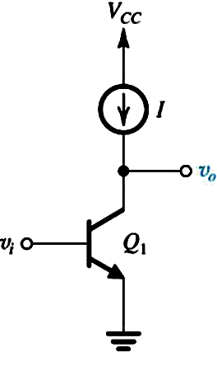
Common Emitter Amplifier with Active Load
  Small-Signal Analysis

Slide 25
BJT Version
Common-Emitter Amplifier

Slide 26
BJT CE – Output Resistance
The small-signal resistance seen looking into BJT collector,
with base and emitter at DC levels, is equal to r_{o}
R_{o} = r_{o1} // r_{o2}
A_{v} = -g_{m}(r_{o1} // r_{o2})
What is the
input resistance?
resistance looking into base, with emitter at DC level, is equal to r_{π}.
r_{o2}
r_{o1}

