Slide 1
EECE 311: Electronic Circuits
Part 3

Slide 2
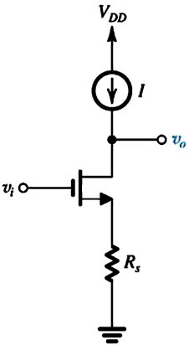
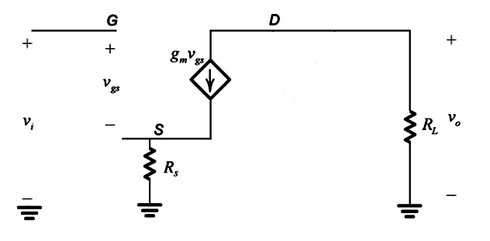
Common Source Amplifier with Source Resistance
Small Signal Model at Low Freq:
Note that v_{i} ≠ v_{gs}
What does R_{L} model?

Slide 3
Common Source with Source Resistance
The current flows in R_{S}
Voltage gain:
  Reduced by factor (1+ g_{m} R_{S})
What is the input resistance?
What is the output resistance?

Slide 4
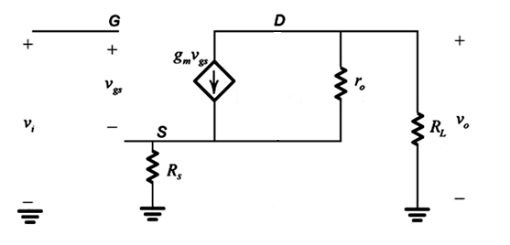
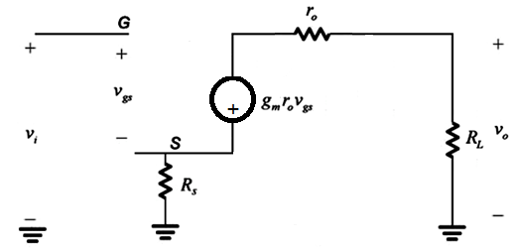
Common Source with Source Resistance
Do not neglect channel length modulation (r_{o})
Thevenin - Norton

Slide 5
Common Source with Source Resistance
Do not neglect r_{o}
i
r_{o} causes the gain to drop (further)

Slide 6
Common Source with Source Resistance
Do not neglect r_{o}
What is the input resistance?
What is the output resistance?

Slide 7
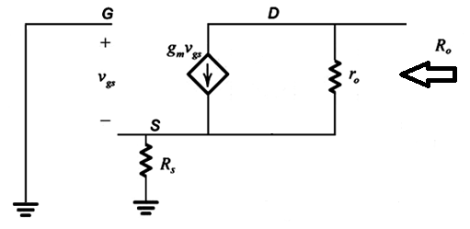
Common Source with Source Resistance
Do not neglect r_{o}
Output resistance?

Slide 8
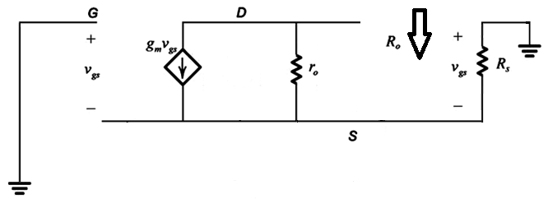
Common Source with Source Resistance
Do not neglect r_{o}
Output resistance
R_{XY} = R_{X} + R_{Y} + g_{m} R_{X} R_{Y}
R_{o} = r_{o} + R_{S} + g_{m} r_{o} R_{S}
Looking into the drain of a MOSFET, with gate at DC (no signal), and resistance R_{S} between source and ground, a resistance r_{o} + R_{S} + g_{m}r_{o}R_{S} is seen (from drain to ground).

Slide 9
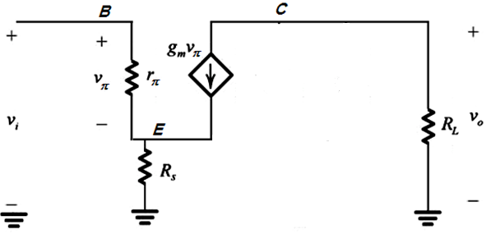
BJT Common-Emitter with R_{S}
Small-Signal Equivalent Circuit

Slide 10
Input Resistance of CE with R_{S}
R_{i} = v_{i} / i_{i}
v_{π} = r_{π} i_{i}
v_{i} = v_{π} + R_{s} (i_{i} + g_{m} v_{π})
= r_{π} i_{i} + R_{S} (i_{i} + g_{m} r_{π} i_{i})
v_{i} / i_{i} = r_{π} + R_{S} (1 + g_{m} r_{π})
But g_{m} r_{π} = β :
R_{i} = v_{i} / i_{i} = r_{π} + (β + 1)R_{S}

Slide 11
BJT Base Reflection Rule
The resistance seen looking into the base is:
r_{π} + (β + 1) times the resistance between the emitter and ground
…the resistance in the emitter appears (β + 1) times larger when looking into the base.
Fine print: The above rule applies when r_{o} is very large (negligible Early Effect)

Slide 12
BJT Common-Emitter Small-Signal Equivalent Circuit
Voltage gain:
Similar to MOSFET result

Slide 13
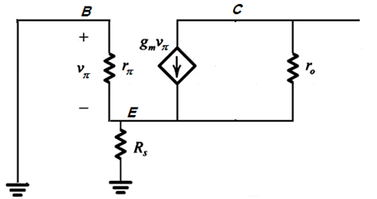
BJT Common-Emitter with R_{S}
Output Resistance
Hint: Recycle!
Output resistance:
use MOSFET result
after noting that
r_{π} and R_{S} are connected in parallel for the R_{o} calculation (when v_{i} is set to zero):
R_{o} = r_{o} + (r_{π} // R_{S}) + g_{m} r_{o} (r_{π} // R_{S})

Slide 14
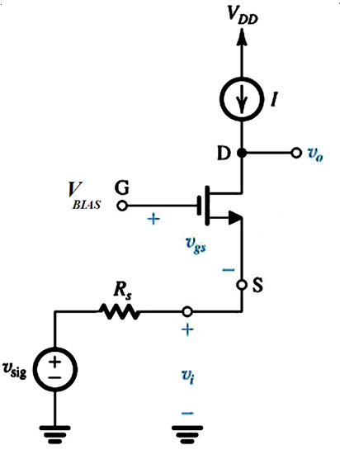
Common-Gate Amplifier with Active Load

Slide 15
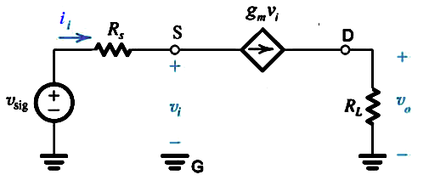
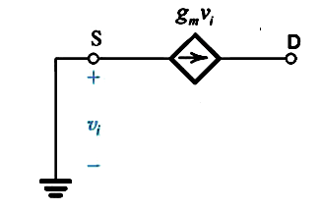
Common-Gate Amplifier
  Input Resistance:
  Current gain:
  Voltage gain:
  Output resistance:

Slide 16
Resistance Looking into
MOSFET Source Terminal
The resistance seen looking into the MOSFET source with gate at DC levels (no signal) is equal to 1/g_{m}
Does NOT apply when r_{o} is not neglected (not ∞)
  1/g_{m} becomes an approximation

Slide 17
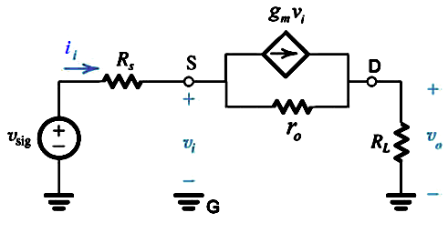
Common-Gate Amplifier (with r_{o})
  Input Resistance
Note
We calculated R_{in} and not R_{i}
R_{in} depends on R_{L}

Slide 18
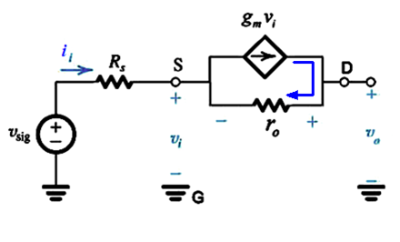
  Open-Circuit Voltage Gain
  Voltage Gains (R_{L} connected)
Note
A_{v} , G_{v} are positive (non-inverting)

Slide 19
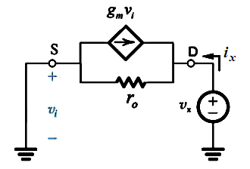
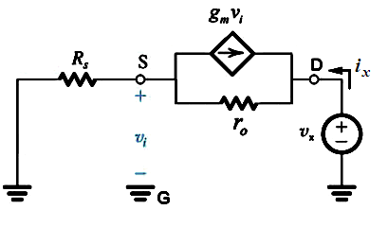
  Output Resistance
    R_{o} = output resistance with v_{i} = 0
    R_{out} = output resistance with v_{sig} = 0
  Common Gate Characteristics
    Large Output Resistance
    Small Input Resistance
    Unity Current Gain
Good current buffer

Slide 20
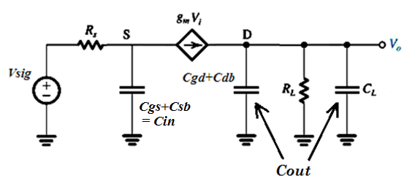
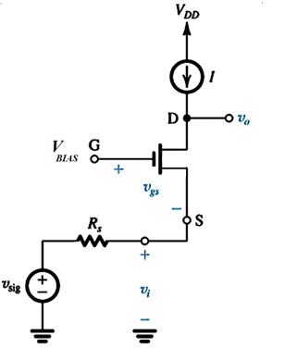
Common-Gate at High Frequency (no r_{o})
Note: body is grounded

Slide 21
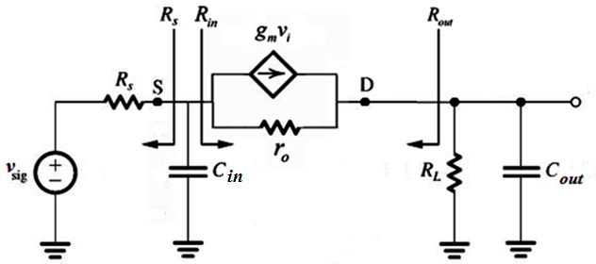
  Considering r_{o}
Note
No Miller (multiplication) effect
Larger bandwidth than Common-Source

Slide 22
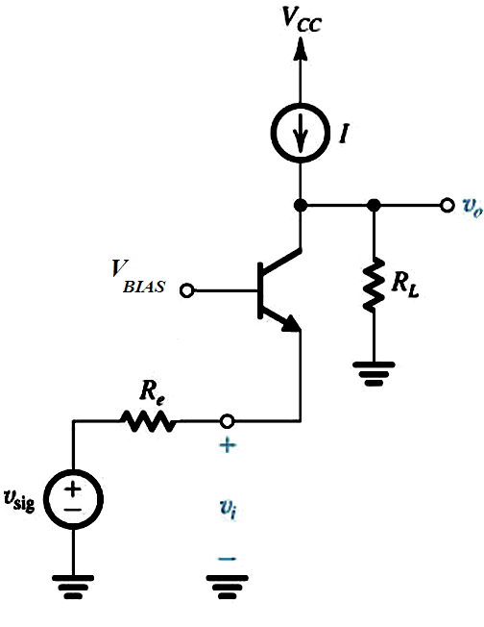
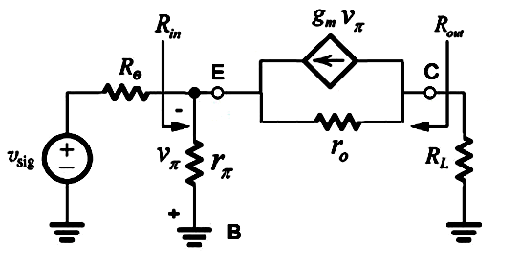
Common-Base Amplifier
Small Signal Model:

Slide 23
  Input Resistance
very small input resistance

Slide 24
  Output Resistance

Slide 25
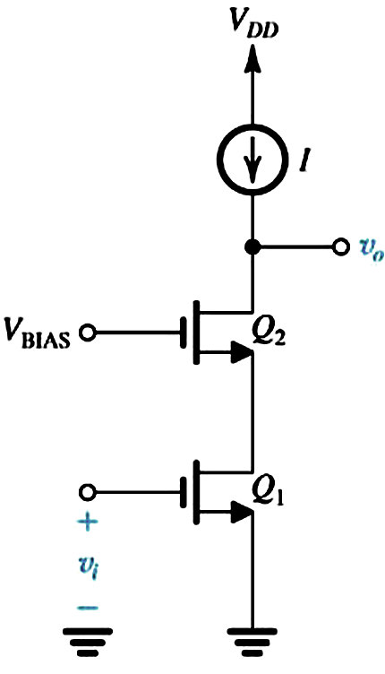
Cascode Amplifier
Common-Source + Common-Gate

Slide 26
  Input Resistance:
  Output Resistance:
    The last stage is a common-gate
the signal source resistance of the common-gate stage is the output resistance of the common-source stage.

Slide 27
  Voltage Gain
  Open-Circuit Voltage Gain of Cascode
  Voltage Gain with Load Connected

Slide 28
  Cascode High Frequency Response

Slide 29
  Resistance seen by C_{gs1}

Slide 30
  Resistance seen by C_{db1}+C_{gs2}+C_{sb2}

Slide 31
  Resistance seen by C_{L}+C_{gd2}+C_{db2}

Slide 32
  Resistance seen by C_{gd1}

Slide 33
We use the results derived previously for input and output resistances of common-source and common-gate stages

Slide 34
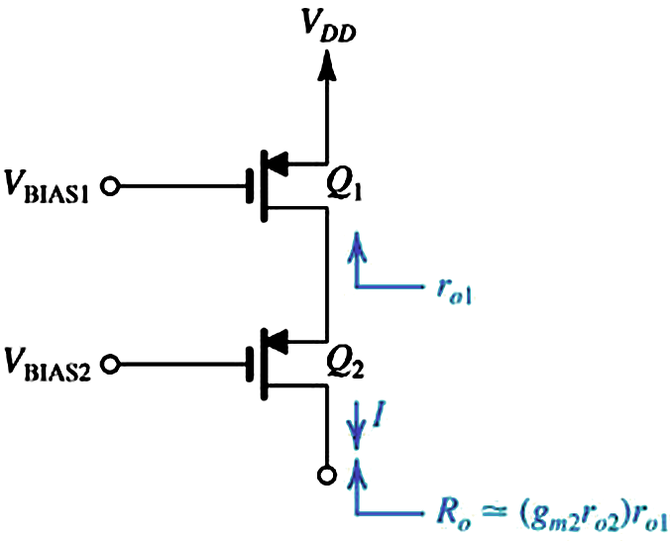
Cascode Current Source
Large Output Resistance
Serves well as a current source (load) for an amplifier

Slide 35
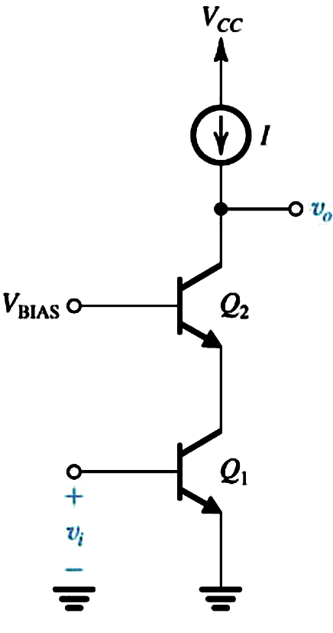
BJT Cascode

Slide 36
  Open-Circuit Voltage Gain
  Input Resistance by inspection
  Output Resistance
CB formula

Slide 37
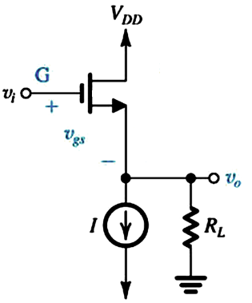
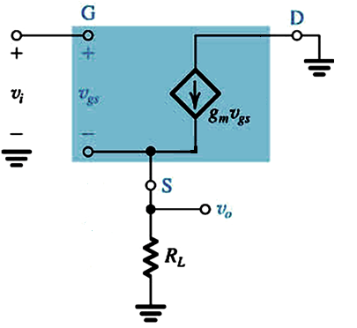
Common Drain (Source Follower)
Small Signal Model:

Slide 38
  Input Resistance
Small-signal equivalent circuit:
  Voltage Gain
  Open-Circuit Voltage Gain

Slide 39
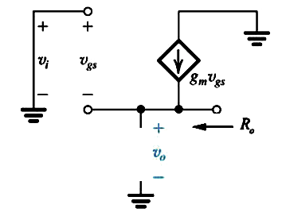
  Output Resistance

Slide 40
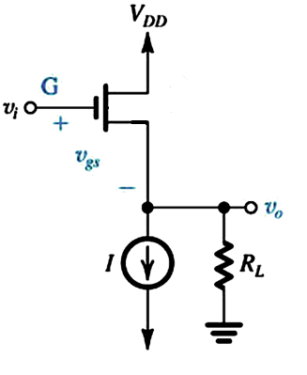
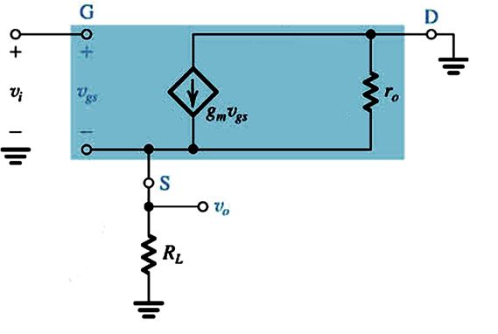
Common Drain with channel length modulation (r_{o})
Small Signal Model:

Slide 41
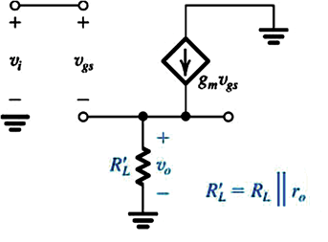
  Input Resistance
  Voltage Gain
Equivalent Circuit:
  Open-Circuit Voltage Gain

Slide 42
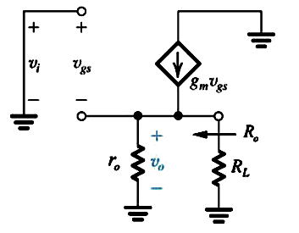
  Output Resistance

Slide 43
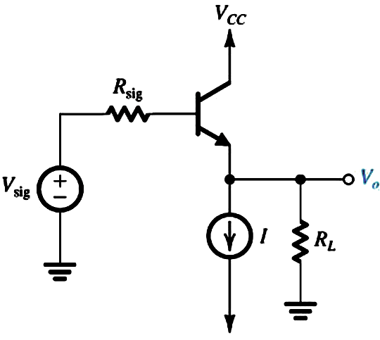
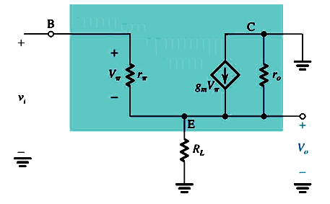
Common Collector (Emitter Follower)

Slide 44
  Input Resistance
  Voltage Gain
  Open Circuit Voltage Gain
Large Input Resistance
Open Circuit Voltage Gain nearly one: Signal at emitter “follows” signal at input

Slide 45
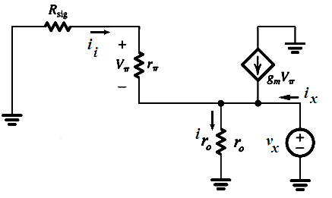
  Output Resistance
Very Low Output Resistance

Slide 46
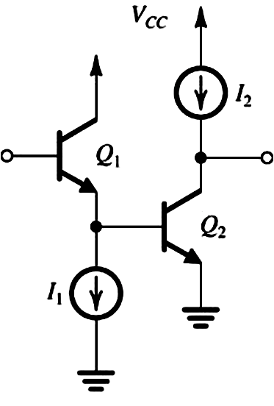
Some Useful Transistor Pairings
Common Collector – Common Emitter Pairing
Wide Bandwidth
Large Input Resistance

Slide 47
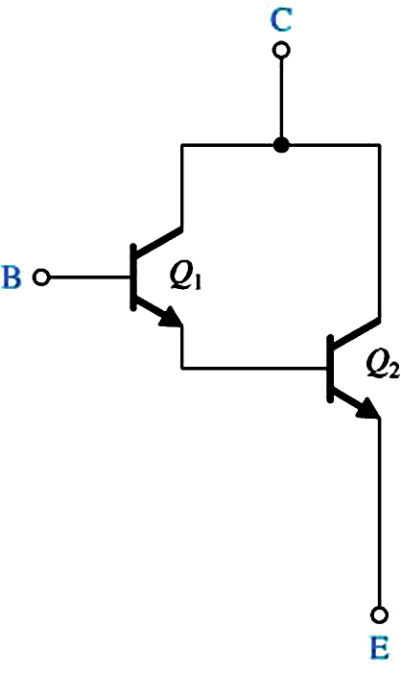
Darlington Pair
High-Performance Voltage Follower

Slide 48
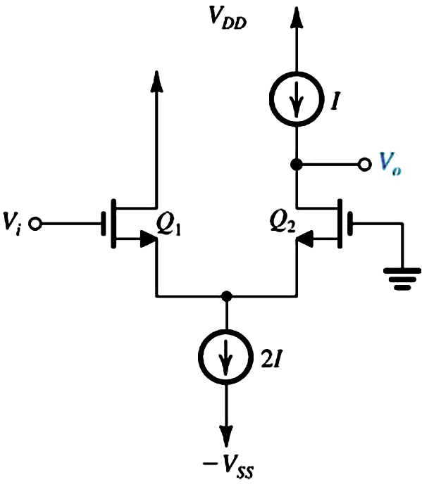
Common Drain – Common Gate Pairing
Infinite Input Resistance
Voltage gain ~ ½ CG
Very Good High Frequency Response

Slide 49
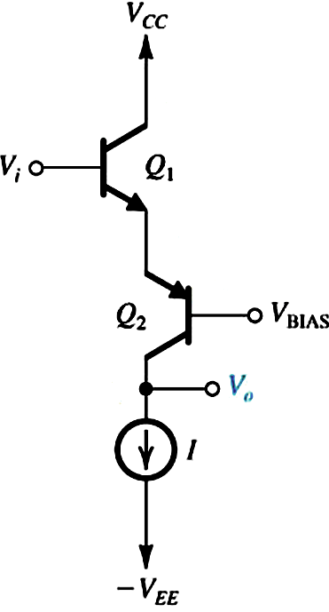
Common Collector – Common Base Pairing
PNP Common-Base Stage
Very Good High-Frequency Performance

Slide 50
Improved Current Sources
Larger output resistance (current less dependent on voltage – closer to ideal)
Less dependence on transistor parameters (such as β in BJT)
Without sacrificing voltage range?
  Voltage across real current sources (V_{CS}) cannot drop below a certain minimum

Slide 51
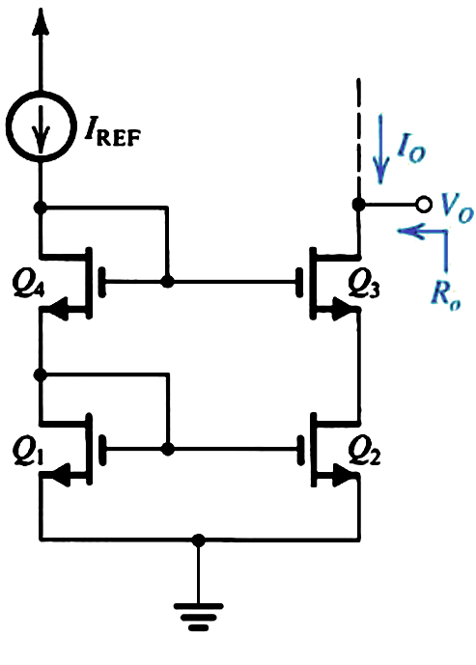
Cascode MOS Mirror
Large output resistance
But reduced range of V_{O}

Slide 52
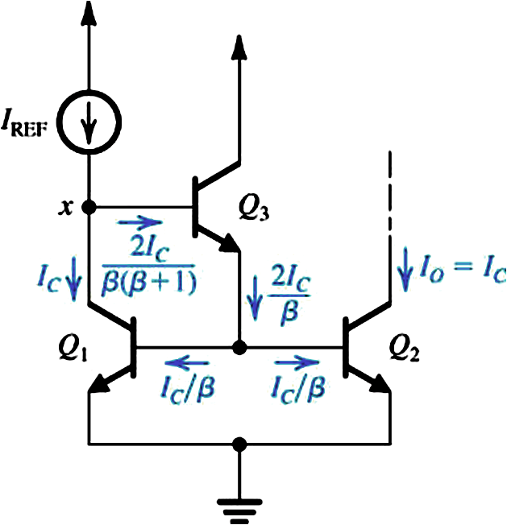
Improved Bipolar Current Mirror
Dependency on β decreased from 1/ β to 1/ β² (error term is β times smaller)
But output resistance still the same (r_{o2})
What about voltage range?

Slide 53
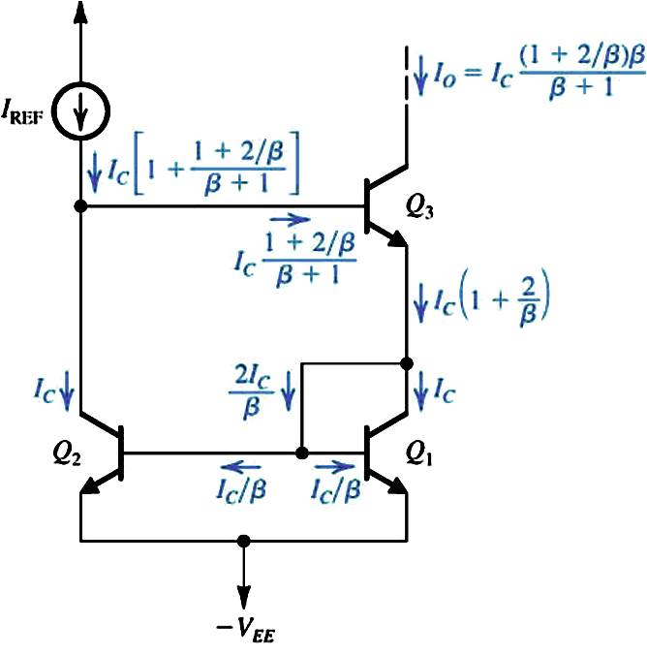
Wilson Current Mirror
Dependency on β decreased from 1/ β to 1/ β²
Output resistance multiplied by β/2
But reduced range of V_{o} (V_{omin} = 1V)

Slide 54
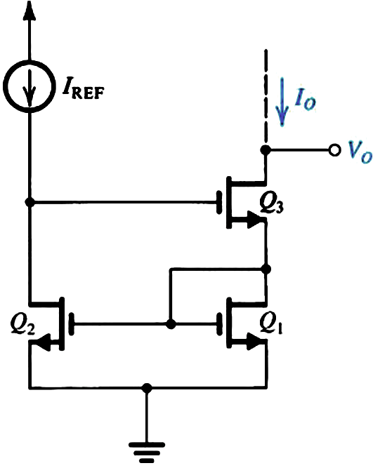
Wilson MOS Mirror
Large output resistance
But reduced range of V_{O}

Slide 55
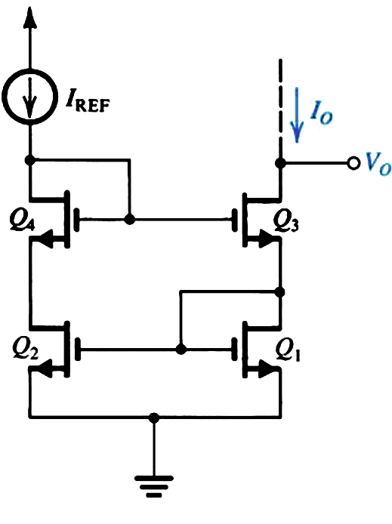
Improved Balanced Wilson MOS Mirror
Same as Wilson MOS current but with balanced drain voltages of Q₁ and Q₂.

Slide 56
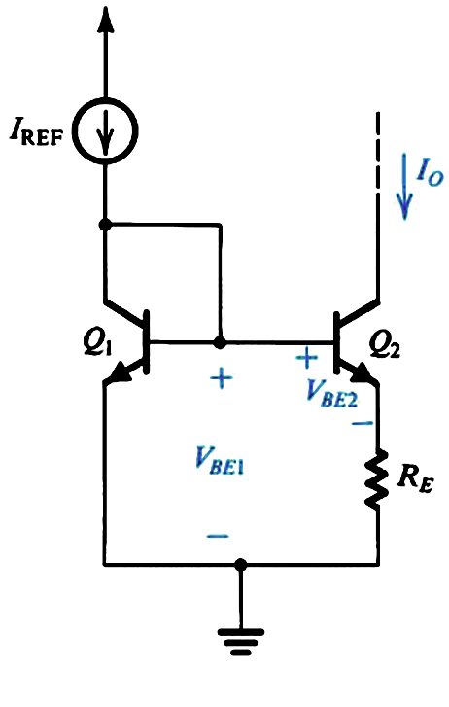
Widlar Current Source
Can generate a small constant current using relatively small resistors.

