Slide 1
EECE 311: Electronic Circuits
Part 2

Slide 2
Amplifier frequency response

Slide 3
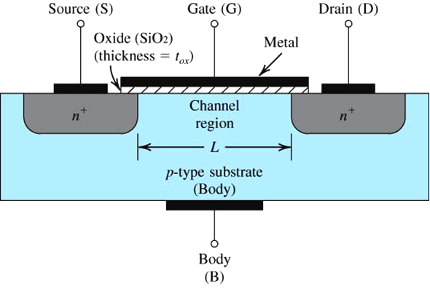
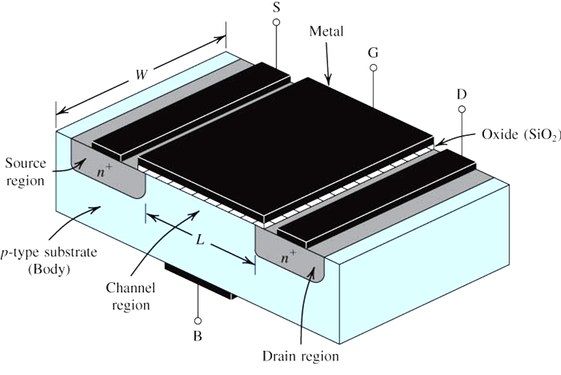
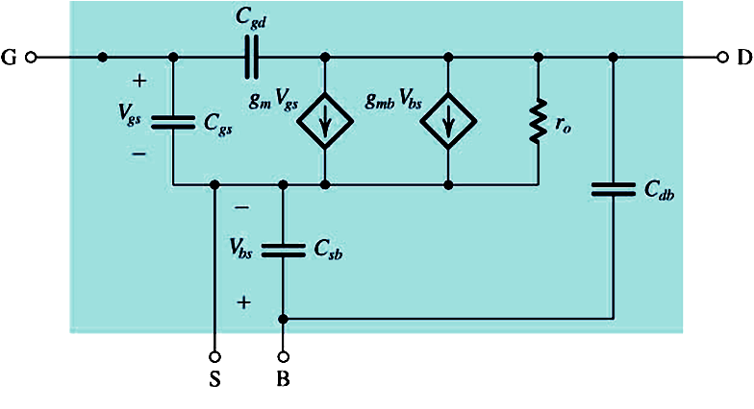
MOSFET High-Frequency Model
The Basic N-channel
MOSFET Structure
  High-Frequency Small-Signal Model

Slide 4
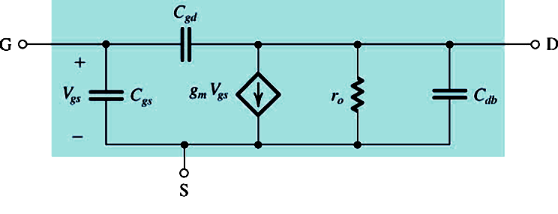
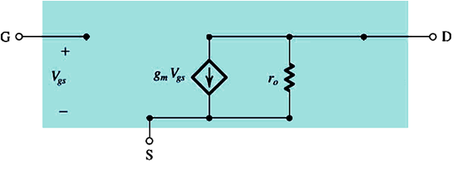
When B is shorted to S or body effect is negligible (the usual case)
At low frequency, caps are open circuits

Slide 5
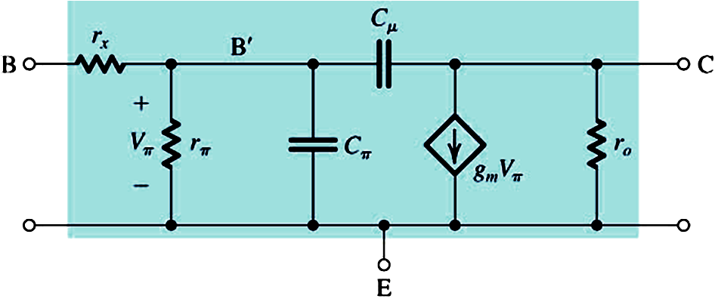
BJT High-Frequency Model
  High-Frequency Small-Signal Model
  B’ is the internal base
    r_{x} is base spreading resistance B-B’ (small, negligible at low frequency)
    V_{π} = V_{b’e}

Slide 6
DEFINITION: Unity-Gain Frequency
Used to find capacitance values
MOSFET
BJT

Slide 7
Frequency Response
At low frequency
  capacitors are open-circuits (and inductors are short circuits)
    amplifier characteristics are not affected by frequency (no frequency-dependent elements)
Capacitor impedance
  Changes with frequency: , Z(jω) = -j /ωC (infinite at DC)
As ω increases, we need to study the “Frequency Response”
  Input is
  Output is since the system is linear
  How do A (magnitude) and φ (phase) vary with frequency ω?

Slide 8
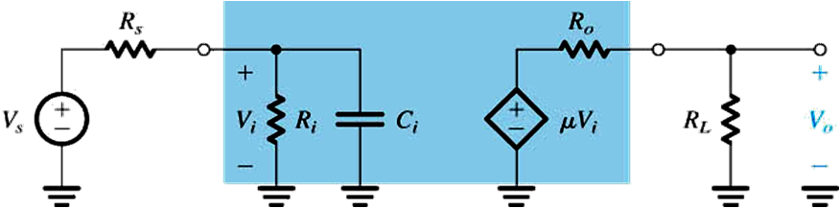
Example – How does one capacitor affect amplifier gain?
Given: Blue block is the amplifier
  R_{s} = 20 KΩ
  R_{i} = 100 KΩ
  C_{i} = 60 pF
  μ = 144 V/V
  R_{o} = 200 Ω
  R_{L} = 1 KΩ
Find:
  V_{o}/V_{s}
  Plot
    magnitude response
    phase response
  v_{o}(t) when v_{s}(t) = 0.1 sin10^{n}t V
  for n = 2, 5, 6, 8

Slide 9
Solution
Express V_{i} as a function of V_{s}
Express V_{o} as a function of V_{i}

Slide 10
Solution
K
1/ω₀
This is of the form:
Low-pass single-time-constant (LP-STC)
  K is the low-frequency gain
  ω₀ is the 3-dB frequency

Slide 11
Review: Low-Pass Single Time Constant
Gain (or Transfer) function:
Low-frequency gain = K
Upper 3-dB frequency = ω₀
-20 dB/decade drop at high frequency (ω >> ω₀)
What is T at ω₀?

Slide 12
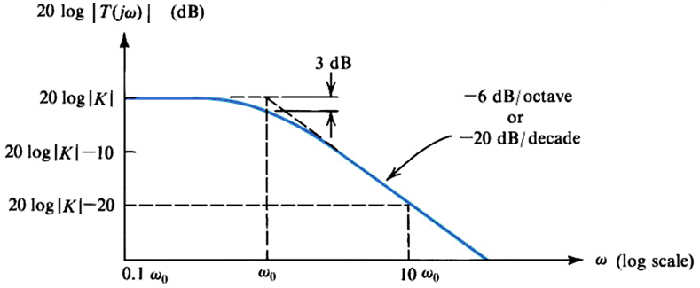
Solution (continued)
Bode Plot - Magnitude

Slide 13
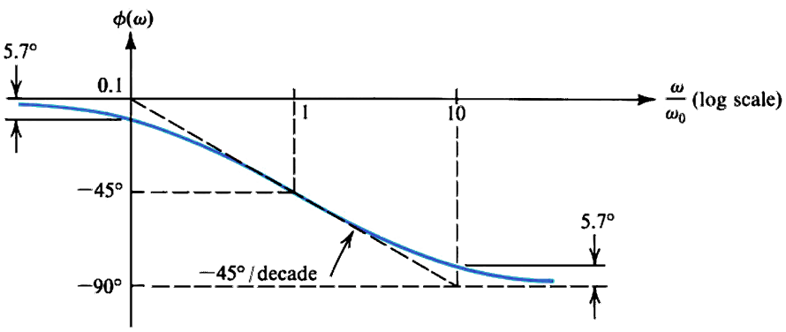
Solution
Bode Plot - Phase

Slide 14
Solution
Output voltage v_{o}(t) when
  v_{s}(t) = 0.1 sin10²t V
  v_{s}(t) = 0.1 sin10⁵t V
  v_{s}(t) = 0.1 sin10⁶t V
  v_{s}(t) = 0.1 sin10⁸t V
  For ω = 10² rad/sec: v_{o}(t) = 10 sin(10²t) V
  For ω = 10⁵ rad/sec: v_{o}(t) = 9.95 sin(10⁵t – 5.7º) V
  For ω = 10⁶ rad/sec: v_{o}(t) = 7.07 sin(10⁶t – 45º) V
  For ω = 10⁸ rad/sec: v_{o}(t) = 0.1 sin(10⁸t – 89.4º) V

Slide 15
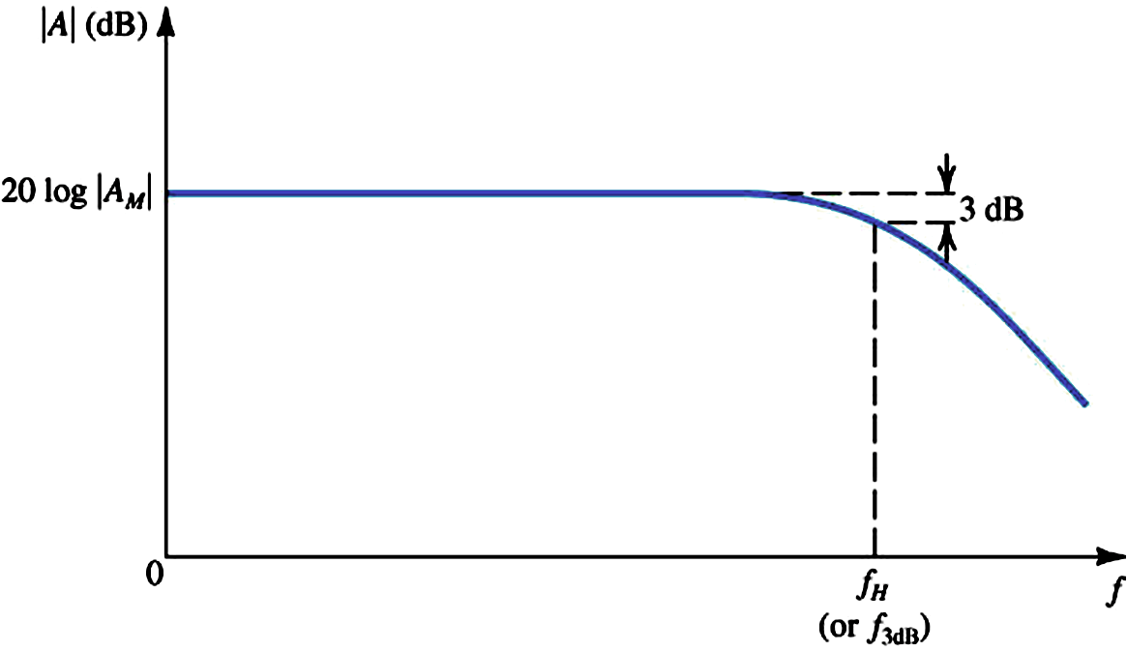
Amplifier High-Frequency Response
Bode Plot
We will not consider low-frequency effects
  In IC amplifiers, neither bypass nor coupling capacitors are used because of their large size: Amplifiers are directly coupled.

Slide 16
The High-Frequency Gain Function

Slide 17
The Dominant Pole Approximation
ω_{p1} is 2 octaves down
(less by a factor of 4)
Better Approximation
  If one pole is obviously smaller than the other zeroes and poles.

Slide 18
The Exact Solution: Solve |A|=|A_{M}|/√2
ω_{H} = √x

Slide 19
Example: Find
  Given:
  Solution:
      Dominant Pole?
      Better Approximation:
      Exact Solution:

Slide 20
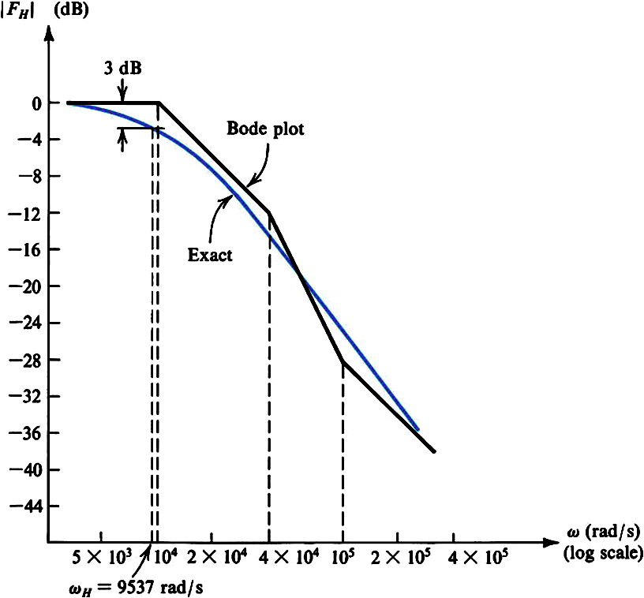
Example: Magnitude Bode Plot
  Given:

Slide 21
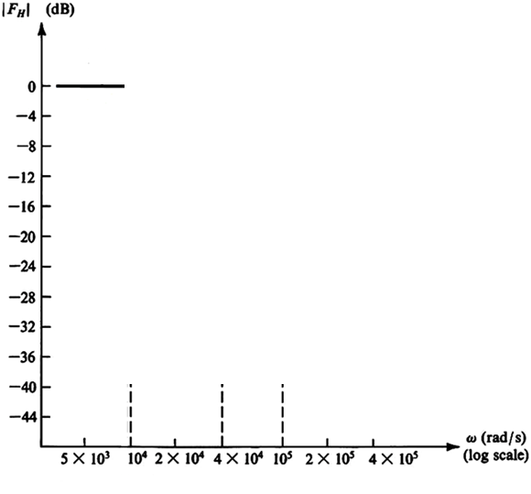
Bode Plot Construction
P
P
Z

Slide 22
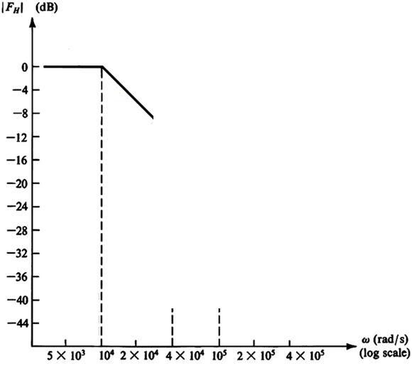
Bode Plot Construction
What is the slope?

Slide 23
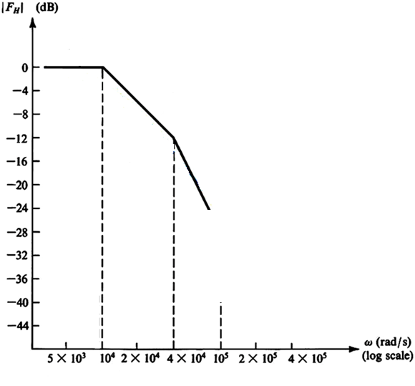
Bode Plot Construction
What is this value (dB)?
What is the slope?

Slide 24
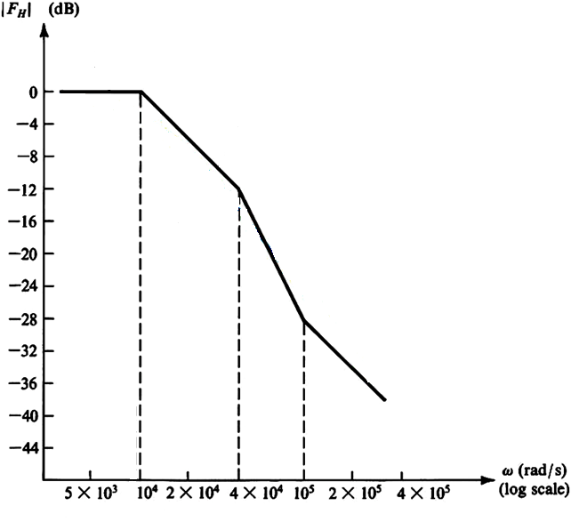
Bode Plot Construction
What is this value (dB)?
What is the slope?

Slide 25
High-Frequency Response of
Common Source and Common Emitter Amplifiers

Slide 26
At signal frequencies

Slide 27
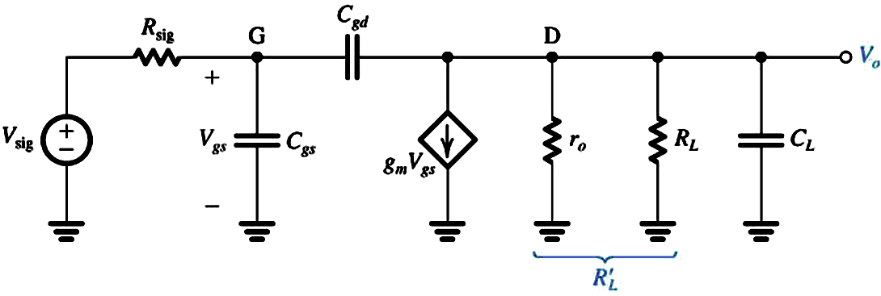
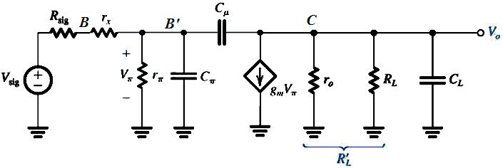
High-Frequency Response of
Common Source and Common Emitter Amplifiers
High-Frequency Small-Signal Equivalent Circuits
CS:
CE:

Slide 28
  R_{L} represents the output resistance of the active load and any load resistance
  C_{L} represents the total capacitance between drain (or collector) and ground. It also includes the input capacitance of a succeeding amplifier stage, and parasitic/load capacitances.
  We will analyze the CS circuit only since the analysis of the CE amplifier is exactly the same after relabeling
Thevenin equivalent for circuit composed of V_{sig}, R_{sig}, r_{x}, and r_{π}

Slide 29
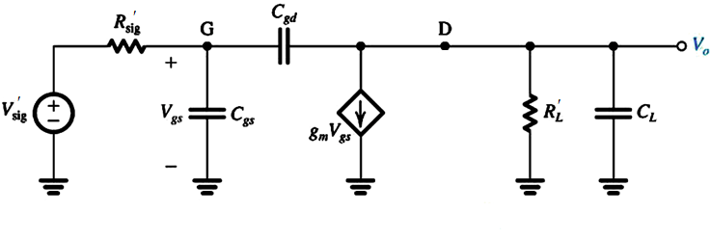
Common Source / Common-Emitter High-Frequency
Small-Signal Equivalent Circuits

Slide 30
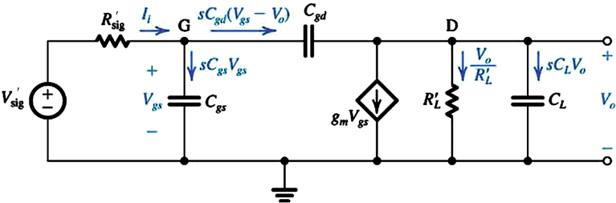
Exact Analysis in s-domain: Y_{C} = sC

Slide 31
Low frequency gain is –g_{m}R’_{L}
Zero frequency g_{m}/C_{gd} is very high
What is the 3-dB frequency?

Slide 32
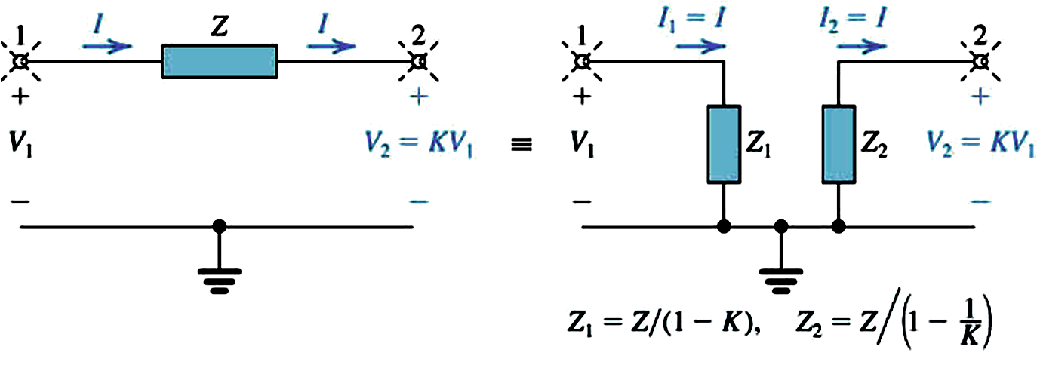
Miller’s Theorem
When Z is a capacitor C
  C₁ = C (1 – K)
  C₂ = C (1 – 1/K)

Slide 33
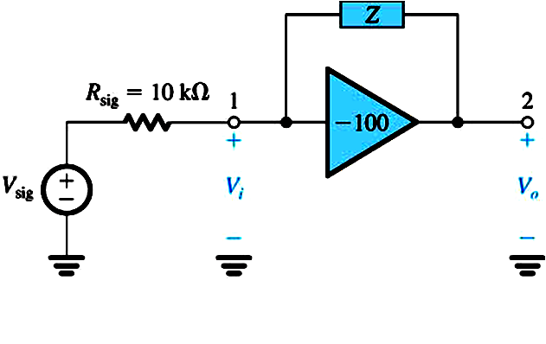
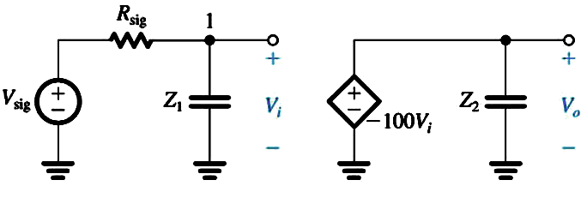
Example 2: Find
  Given:
  Solution using Miller

Slide 34
Find using Miller’s Theorem

Slide 35
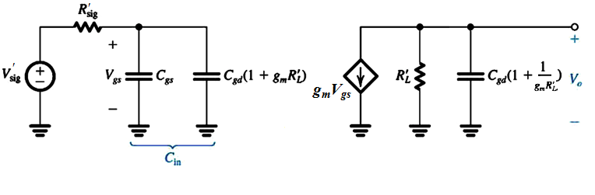
Miller’s Approximation in CS/CE
+C_{L}
The input circuit and the output circuit are low-pass
RC circuits
What is the pole frequency for a simple RC circuit?

Slide 36
Miller’s Approximation in CS/CE
+C_{L}
Input circuit pole at 1/(R’_{sig} C_{in})
Output circuit pole at 1/(R’_{L} C_{out})
Usually input circuit determines high frequency response

Slide 37
Miller’s Approximation in CS/CE
+C_{L}
Input circuit pole at ω_{in} = 1/(R’_{sig} C_{in})
Output circuit pole at ω_{out} = 1/(R’_{L} C_{out})
If input pole is not much smaller than output pole

Slide 38
Open-Circuit Time Constants
  Instead of finding A(s) to get ω_{Η}, we’d like to determine ω_{H} directly from the circuit

Slide 39

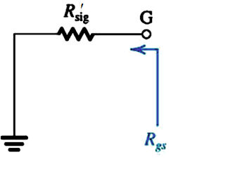
Find using OCTC

Slide 40
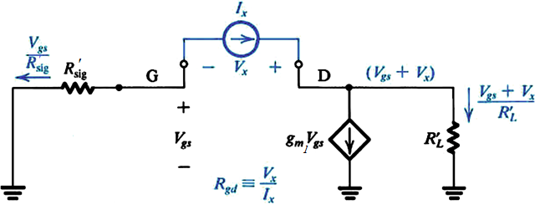

Slide 41
Frequently-used resistance calculation

Slide 42
Find using OCTC (cont’d)

Slide 43
Open-Circuit Time Constants (cont’d)
Numberical Example: Find
  Given:
  Solution:
OCTC allows us to determine the circuit component(s) that limit the value of ω_{H}

Slide 44
Open-Circuit Time Constants (cont’d)

Slide 45
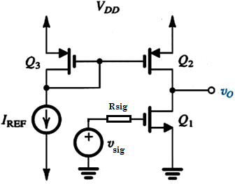
  Example 1: CMOS Common-Source Amp
  Find f_{H} using:
    Miller’s approximation
    Open-circuit time constants (OCTC)
    Transfer function

Slide 46
  Example 1: CMOS Common-Source Amp

Slide 47
  Example 1: CMOS Common-Source Amp

Slide 48
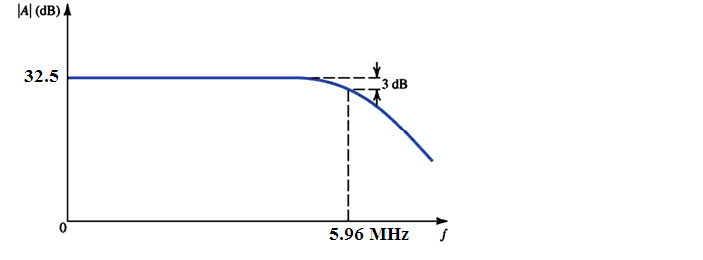
  Example 1: CMOS Common-Source Amp

Slide 49
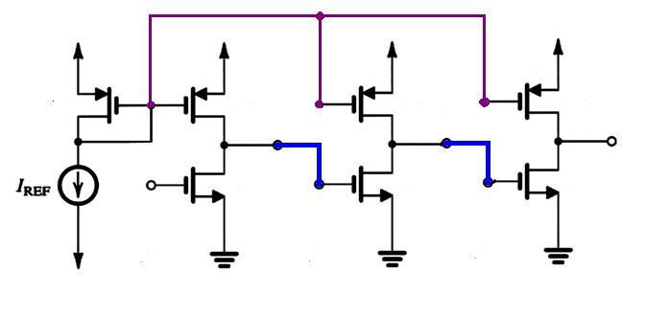
  Example 2: CMOS Common-Source Cascade
  What is the overall low-frequency gain if the per-stage gain is –42?
  What is the 3-dB frequency if the per-stage 3-dB f_{H} is 6 MHz?

Slide 50
Solution

Slide 51
Example 3: Common-Emitter Amplifier
Find the 3-dB frequency
f_{H} using Miller’s approximation
Assume that the input circuit
determines the value of f_{H}

Slide 52
Solution

