Slide 1
Chapter 2
The Relational Model

Slide 2
Objectives
History of the relational data model
What a data model is and its uses.
Terminology of the relational model.
How tables are used to represent data.
Properties of database relations.
How to identify candidate, primary, and foreign keys.
Meaning of entity integrity and referential integrity.
That SQL and QBE are the two most widely used relational languages.

Slide 3
What is a Data Model
Integrated collection of concepts for describing data, relationships between data, and constraints on the data used by an organization.
Has three components:
a structural part;
a manipulative part;
a set of integrity rules.

Slide 4
RM Terminology
Relation: table with columns and rows.
Attribute: named column of a relation.
Domain: set of allowable values for one or more attributes.
Tuple: a record of a relation.
Relational Database - collection of normalized relations with distinct relation names.

Slide 5
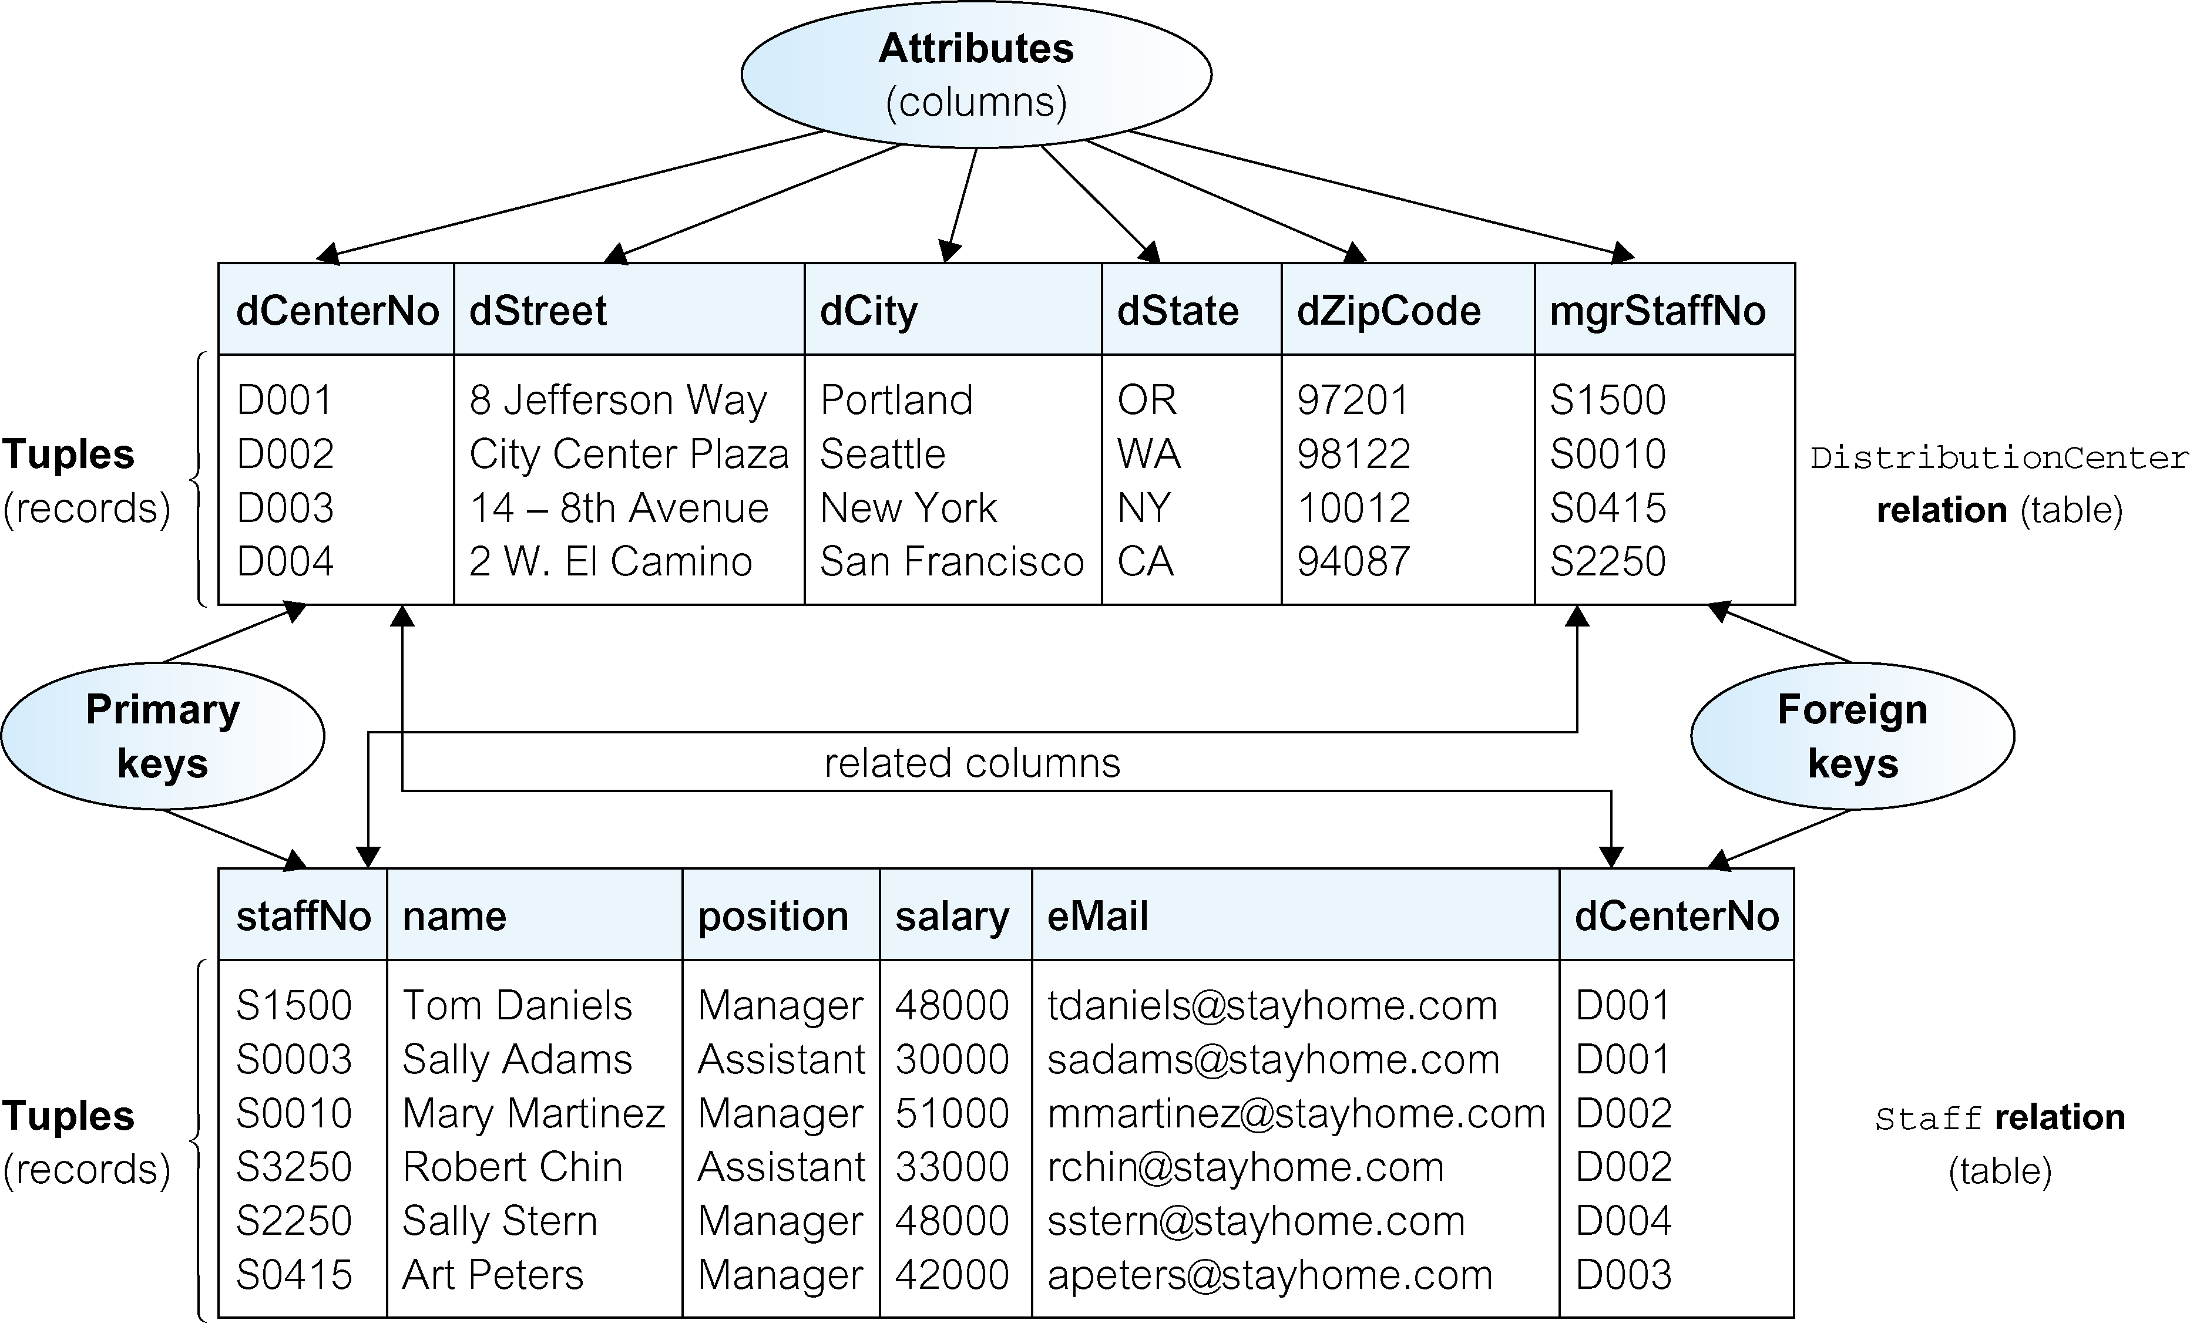
Instances of DistributionCenter and Staff relations

Slide 6
Domains for some attributes of distributionCenter and staff relations

Slide 7
Properties of Relational Tables
Table name is distinct from all other table names in the database.
Each cell of table contains exactly one atomic (single) value.
Each column has a distinct name.
Values of a column are all from the same domain.
Each record is distinct; there are no duplicate records.
Order of columns has no significance.
Order of records has no significance, theoretically.

Slide 8
Relational Keys
Superkey
A column, or a set of columns, that uniquely identifies a record within a table.
Candidate Key
A superkey that contains only the minimum number of columns necessary for unique identification.
In each record, values of the candidate key uniquely identify that record (uniqueness).
No proper subset of the candidate key has the uniqueness property (irreducibility).

Slide 9
Relational Keys
Composite Key
A key consists of more than one column
Primary Key
The candidate key that is selected to identify records uniquely within table.
Alternate Keys
Candidate keys that are not selected to be primary key.
Foreign Key
Column, or set of columns, within one table that matches the candidate key of some (possibly the same) table.

Slide 10
Key Constraints and Constraints on NULL Values (cont’d.)

Slide 11
Relational Integrity
Nulls
Represents value for a column that is currently unknown or not applicable for record.
Deals with incomplete or exceptional data.
Represents the absence of a value and is not the same as zero or spaces, which are values.

Slide 12
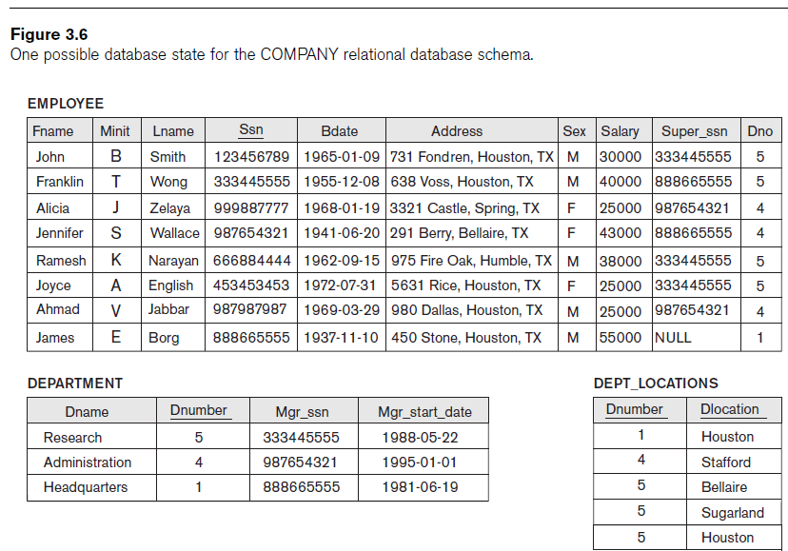

Slide 13
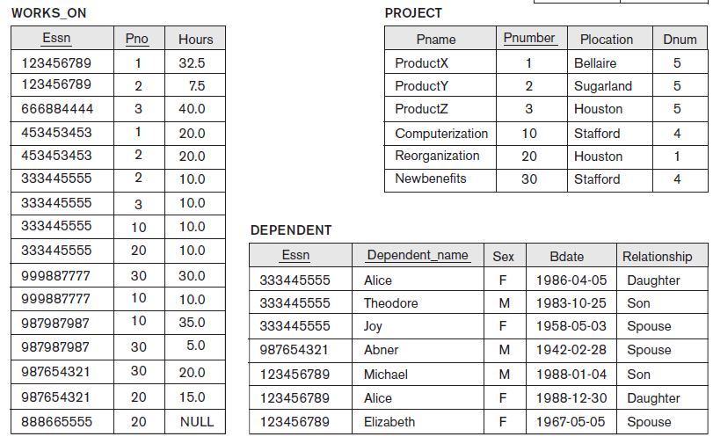

Slide 14
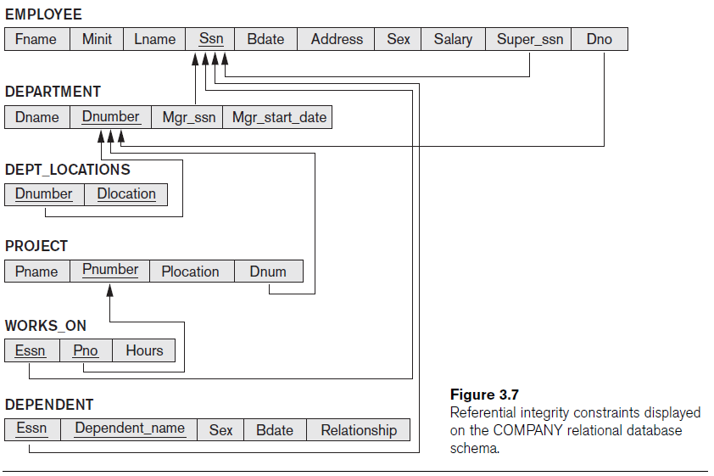

Slide 15
Relational Integrity
Entity Integrity
In a base table, no column of a primary key can be null.
Referential Integrity
If a foreign key exists in a table, either foreign key value must match a candidate key value of some record in its home table or foreign key value must be wholly null.
Integrity Constraints
Rules that define or constrain some aspect of the data used by the organization.

Slide 16
Relational Languages
Two main languages are SQL (Structured Query Language and QBE (Query By Example)

