Slide 1
Chapter 1
Introduction to Databases

Slide 2
Objectives
Common uses of database systems.
Meaning of the term database.
Meaning of the term Database Management System (DBMS).
Components of the DBMS environment.
Typical functions of a DBMS.
Advantages/disadvantages of DBMSs.

Slide 3
Examples of Database Systems
Purchases from the supermarket
Purchases using your credit card
Booking a holiday at the travel agents
Using the local library
Renting a DVD
Using the Internet

Slide 4
Data and Information
Data is raw (unprocessed) facts that have some relevancy to an individual or organization.
Information is data that has been processed or given some structure that brings meaning to an individual or organization.

Slide 5
Database
Shared collection of logically related data (and a description of this data), designed to meet the information needs of an organization.

Slide 6
DBMS
A software system that enables users to define, create, and maintain the database and that provides controlled access to this database.

Slide 7
Database Application/System
Database Application
A computer program that interacts with the database by issuing an appropriate request (typically an SQL statements) to the DBMS.
Database System
The collection of database applications that interact with the database along with the DBMS and the database itself.

Slide 8
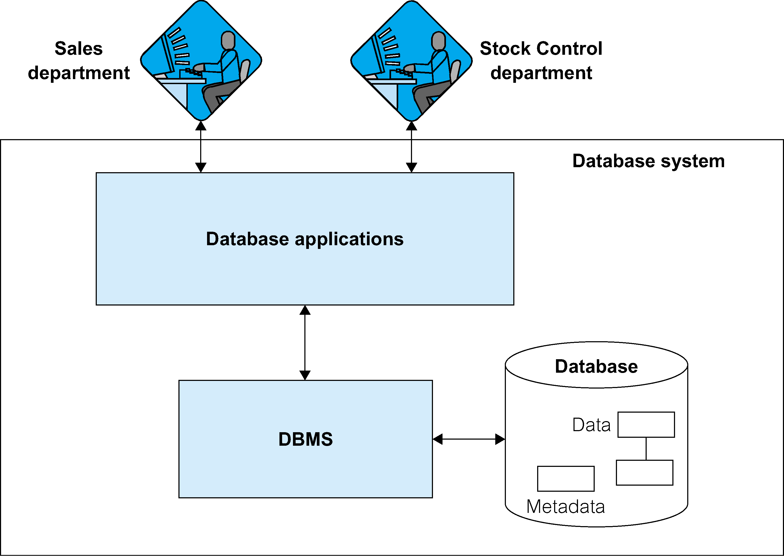
Sales and Stock Control Departments

Slide 9
Views
Allows each user to have his or her own view of the database.
A view is essentially some subset of the database.
Benefits include:
Provides a level of security.
Provides a mechanism to customize the appearance of the database.
Presents a consistent, unchanging picture of the structure of the database, even if the underlying database is changed.

Slide 10
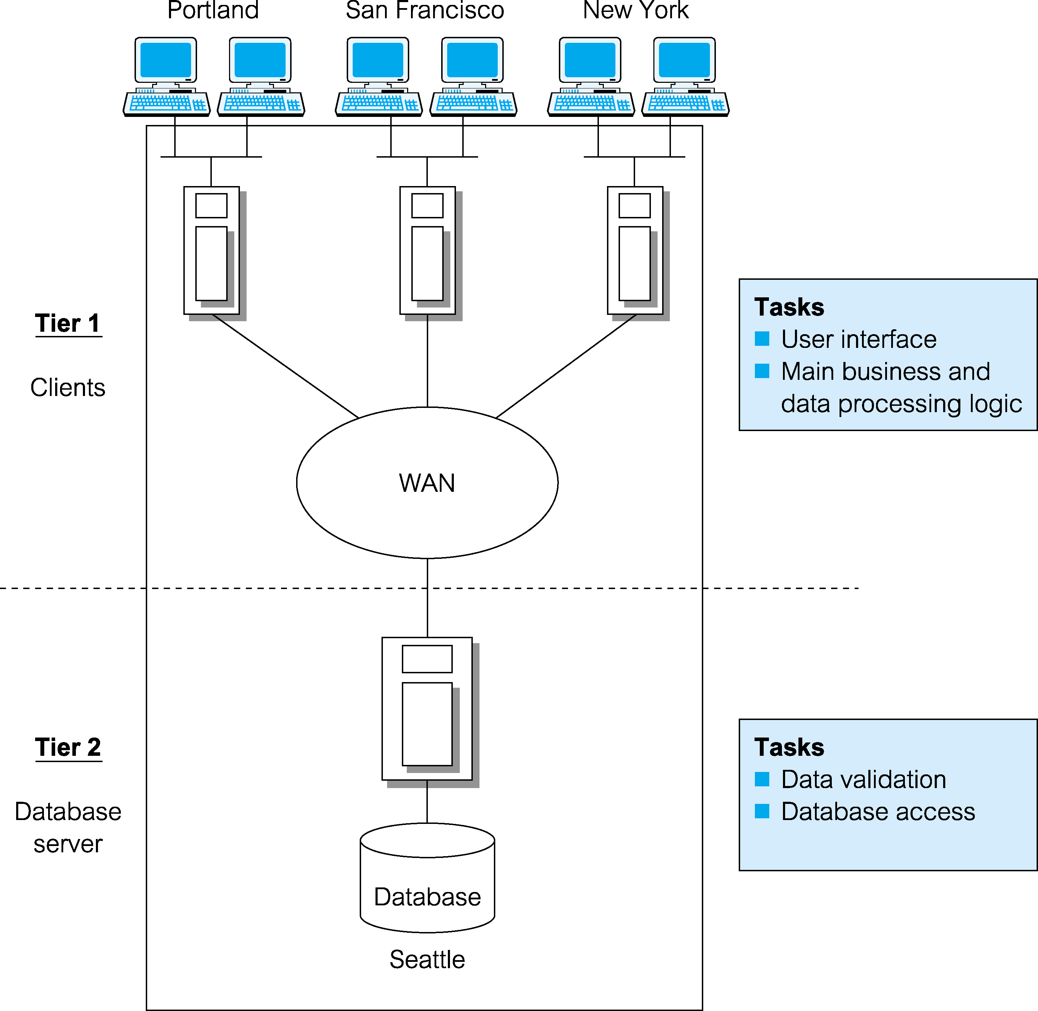
DBMS Architecture

Slide 11
Components of DBMS Environment
Hardware
Can range from a PC to a network of computers.
Software
DBMS, operating system, network software (if necessary) and also the application programs.
Data
Used by the organization and a description of this data called the schema.

Slide 12
Components of DBMS Environment
Procedures
Instructions and rules that should be applied to the design and use of the database and DBMS.
People
Includes database designers, DBAs, application programmers, and end-users.

Slide 13
Two-Tier Client-Server
Client manages main business and data processing logic and user interface.
Server manages and controls access to database.

Slide 14
Two-Tier C-S Configuration

Slide 15
Three-Tier C-S Architecture
Client side presented two problems preventing true scalability:
‘Fat’ client, requiring considerable resources on client’s computer to run effectively.
Significant client side administration overhead.
By 1995, three layers proposed, each potentially running on a different platform.

Slide 16
Three-Tier C-S Architecture
User interface layer – runs on client.
Business logic and data processing layer – middle tier runs on a server (application server).
DBMS – stores data required by the middle tier. This tier may be on a separate server (database server).

Slide 17
Three-Tier C-S Architecture
Advantages:
‘Thin’ client, requiring less expensive hardware.
Application maintenance centralized.
Easier to modify or replace one tier without affecting others.
Separating business logic from database functions makes it easier to implement load balancing.
Maps quite naturally to Web environment.

Slide 18
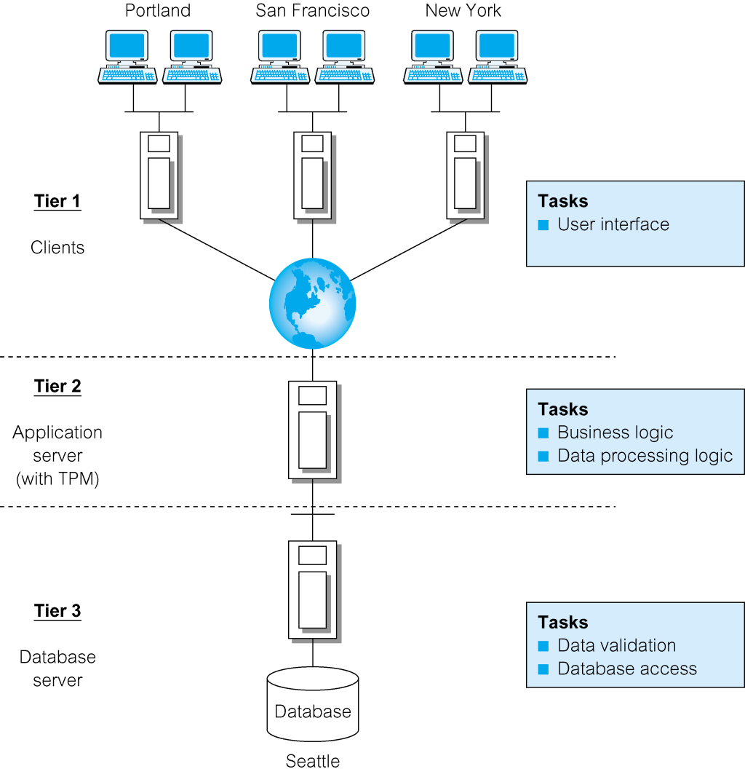
Three-Tier C-S Configuration

Slide 19
Database Design
The structure of the database is determined during the database design.
A system must be data-driven to satisfy an organization’s information needs.
A well designed database produces a system that provides the correct information for the decision-making process to succeed.
A complete methodology is presented for database design.

Slide 20
Historical Perspective
File-Based Systems are a collection of application programs that perform services for the end users (e.g. reports).
Each program defines and manages its own data.

Slide 21
Limitations of File-Based Systems
Separation and isolation of data
Each program maintains its own set of data.
Users of one program may be unaware of potentially useful data held by other programs.
Duplication of data
Same data is held by different programs.
Wasted space and potentially different values and/or different formats for the same item.

Slide 22
Limitations of File-Based Approach
Data dependence
File structure is defined in the program code.
Incompatible file formats
Programs are written in different languages, and so cannot easily access each other’s files.
Fixed Queries/Proliferation of application programs
Programs are written to satisfy particular functions.
Any new requirement needs a new program.

Slide 23
DBMS Development
Arose because:
Definition of data was embedded in application programs, rather than being stored separately and independently.
No control over access and manipulation of data beyond that imposed by application programs.
Result:
The database and Database Management System (DBMS).

Slide 24
DBMS Development
First-generation
Hierarchical and Network
Second generation
Relational
Third generation
Object-Relational
Object-Oriented

Slide 25
Functions of a DBMS
Data storage, retrieval, and update.
A user-accessible catalog.
Transaction support.
Concurrency control services.
Recovery services.
Authorization services.
Support for data communication.
Integrity services.
Services to promote data independence.
Utility services.

Slide 26
Advantages of DBMSs
Control of data redundancy
Data consistency
Sharing of data
Improved data integrity
Improved maintenance through data independence.

Slide 27
Disadvantages of DBMSs
Complexity
Cost of DBMS
Cost of conversion
Performance
Higher impact of a failure

