Slide 1
Exam II-solution
4 problems

Slide 2
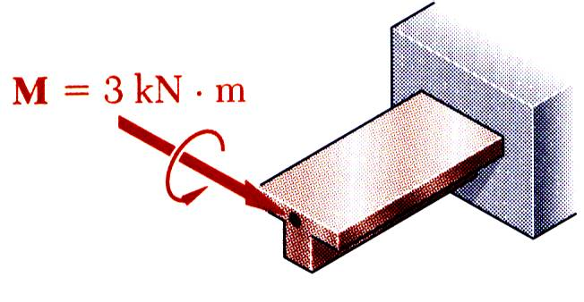
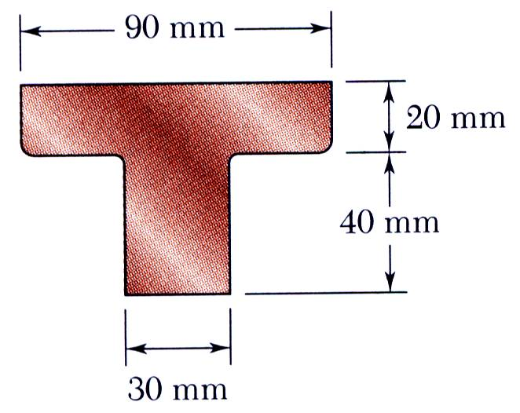
SOLUTION:
Based on the cross section geometry, calculate the location of the section centroid and moment of inertia.
Apply the elastic flexural formula to find the maximum tensile and compressive stresses.
A cast-iron machine part is acted upon by a 3 kN-m couple. Knowing E = 165 GPa and neglecting the effects of fillets, determine (a) the maximum tensile and compressive stresses, (b) the radius of curvature.
Calculate the curvature

Slide 3
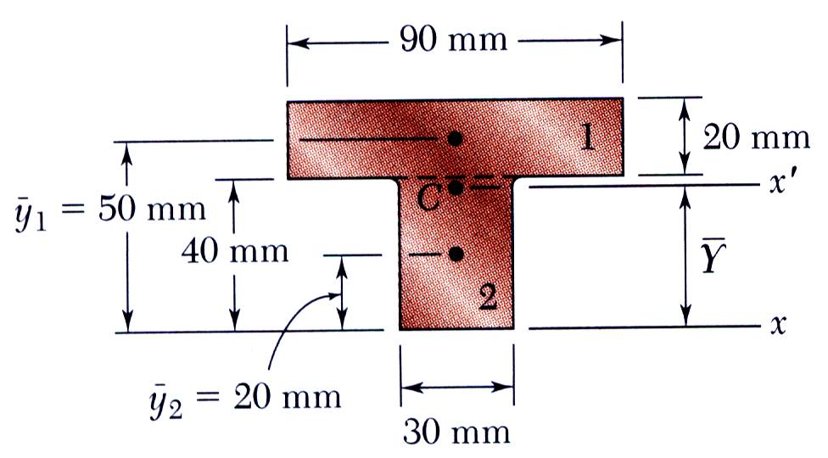
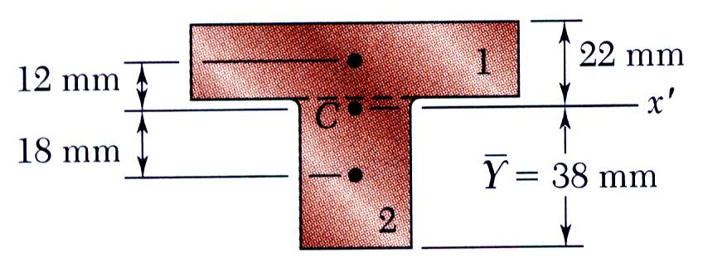
SOLUTION:
Based on the cross section geometry, calculate the location of the section centroid and moment of inertia.

Slide 4
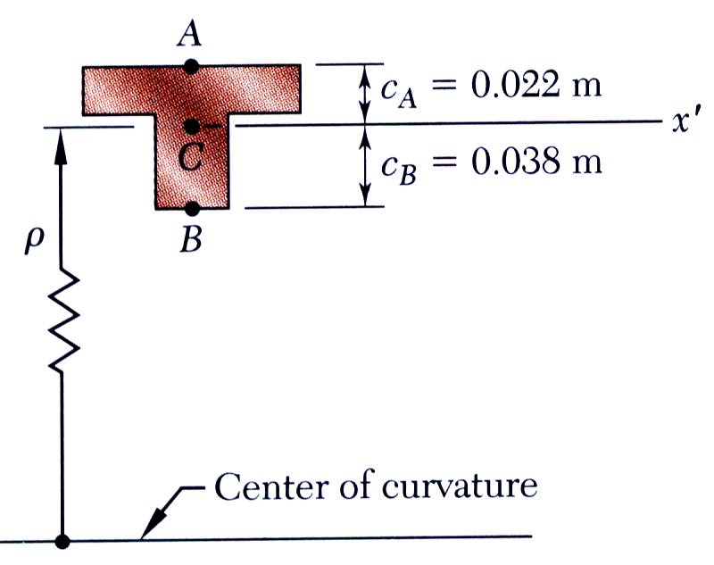
Apply the elastic flexural formula to find the maximum tensile and compressive stresses.
Calculate the curvature

Slide 5
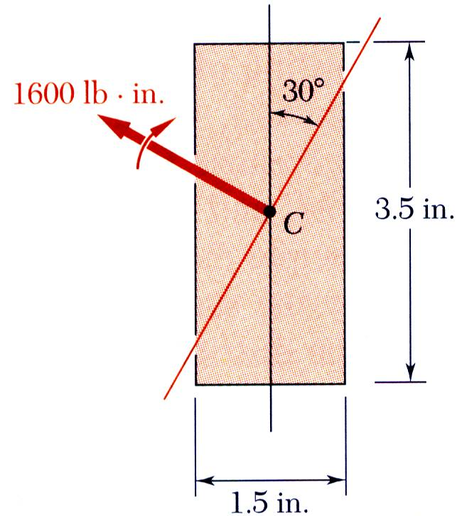
SOLUTION:
Resolve the couple vector into components along the principle centroidal axes and calculate the corresponding maximum stresses.
Combine the stresses from the component stress distributions.
A 1600 lb-in couple is applied to a rectangular wooden beam in a plane forming an angle of 30 deg. with the vertical. Determine (a) the maximum stress in the beam, (b) the angle that the neutral axis forms with the horizontal plane.
Determine the angle of the neutral axis.

Slide 6
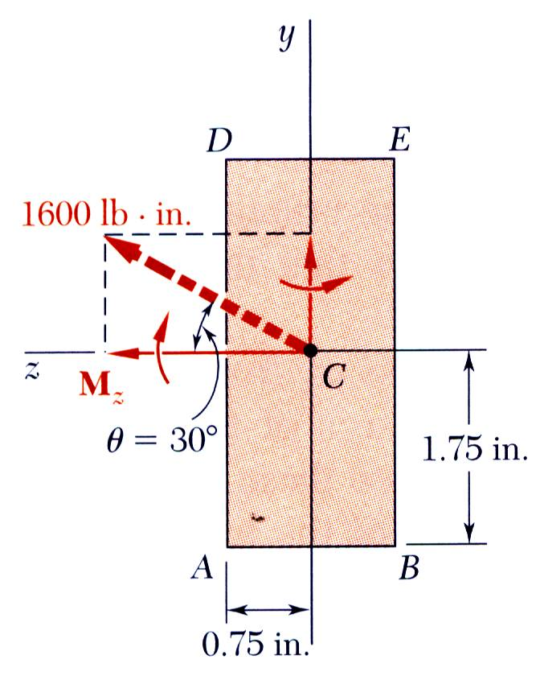
Resolve the couple vector into components and calculate the corresponding maximum stresses.
The largest tensile stress due to the combined loading occurs at A.

Slide 7
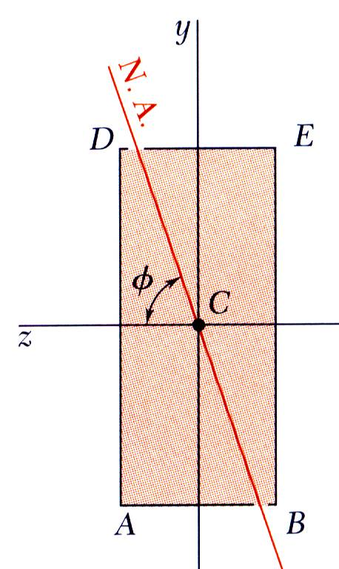
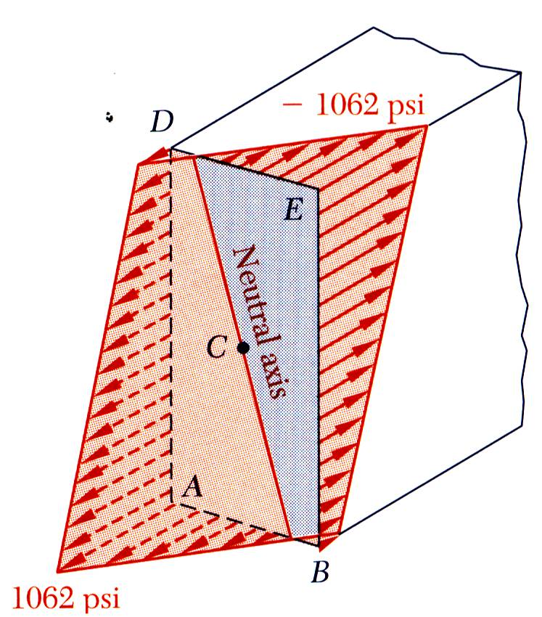
Determine the angle of the neutral axis.

Slide 8
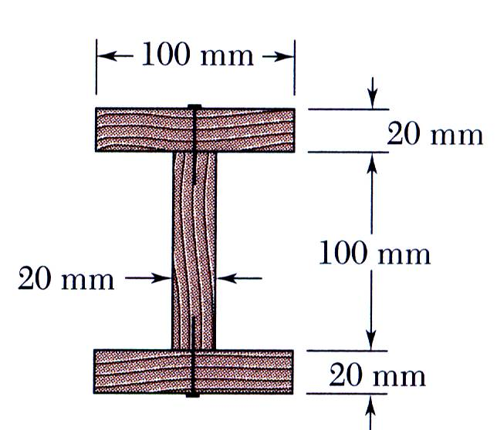
SOLUTION:
Determine the horizontal force per unit length or shear flow q on the lower surface of the upper plank.
Calculate the corresponding shear force in each nail.
A beam is made of three planks, nailed together. Knowing that the spacing between nails is 25 mm and that the vertical shear in the beam is V = 500 N, determine the shear force in each nail.

Slide 9
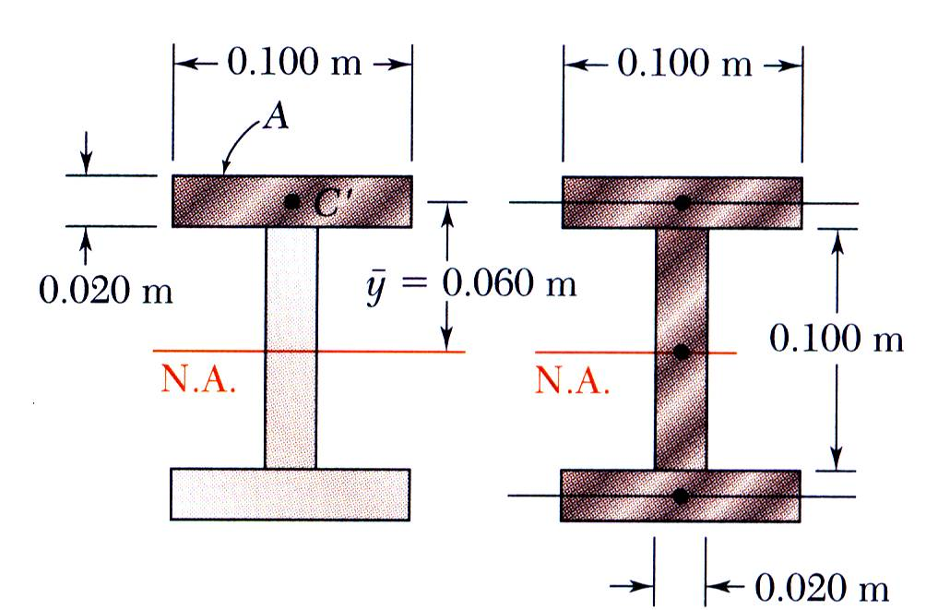
SOLUTION:
Determine the horizontal force per unit length or shear flow q on the lower surface of the upper plank.
Calculate the corresponding shear force in each nail for a nail spacing of 25 mm.

