Slide 1
Diabetes
Prepared by: Nadia jradi Masri, m.D

Slide 2
Definition
A group of metabolic diseases in which a person has high blood sugar because:
The body does not produce enough insulin
or
The receptor cells do not respond to the produced insulin

Slide 4
Pancreas

Slide 5
Diabetes- types
Type I: 10% of cases
Type II: Most common type
Gestational Diabetes: during pregnancy

Slide 6
DM I
-Diagnosed in childhood
-Cause is controversial (could be immune mediated)

Slide 7
DM I

Slide 8
Diabetes Mellitus Type 2

Slide 9
Diabetes mellitus Type II
Causes:
An interaction between genetic predisposition &
lifestyle factors
Life time risk of developping DMII is 5-10 x higher in 1st degree relatives (sister/Brother/son/Daughter) of a person with DMII compared to a person with no family history of DM II
The main risk factors are a diet rich in refined sugars, obesity and lack of physical exercise

Slide 10
Gestational Diabetes
Affects 4% of pregnancies
The cause is unknown
Many complications can happen to the baby
It usually goes away after delivery

Slide 11
Diabetes- symptoms

Slide 13
Things to know..
Eating sweets or sugar does not cause diabetes
Sometimes an accident or an illness may reveal diabetes if it is already there, but they do not cause it
You cannot catch diabetes from somebody!

Slide 14
Diabetes Mellitus- Treatment
It is a chronic disease
Goal is to maintain normal blood glucose levels
Consists of: - dietary treatment
- Excercise
- Medications

Slide 15
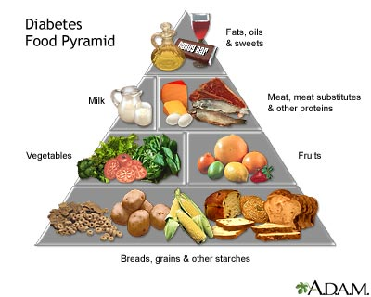
Diabetes Mellitus - treatment
Dietary management:
Use of artificial sweeteners (aspartame, saccharin..)
Low fat diet
Low sodium diet
High fiber diet
Avoid weight gain

Slide 16
Diabetes Mellitus I - Treatment
Insulin injections

Slide 17
Diabetes Mellitus I - Treatment
Insulin Pump

Slide 18
Diabetes Mellitus- treatment
Diabetes mellitus Type II:
Oral medications: increase sensitivity of peripheral tissues to insulin, or increase the secretion of insulin
Last resort: Insulin

Slide 19
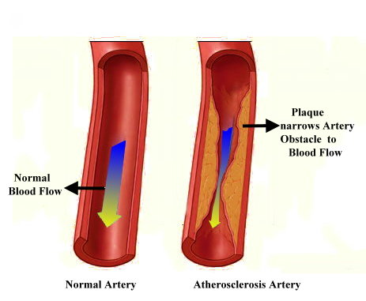
Diabetes mellitus - Complications
A. Vascular Complications- vasculopathy:
Coronary heart diseases
Stroke

Slide 20
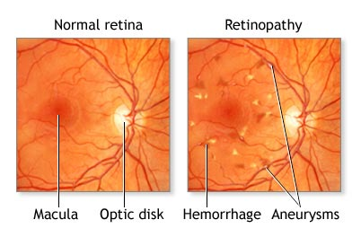
Diabetes mellitus - Complications
B. Retinopathy (Disease of the eyes)
can lead to blindness

Slide 21
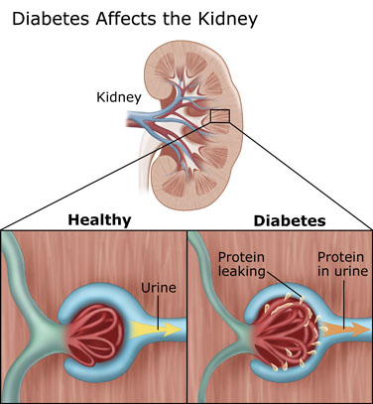
Diabetes mellitus - Complications
C. Nephropathy (Disease of the kidneys)
can lead to kidney failure and need for dialysis

Slide 22
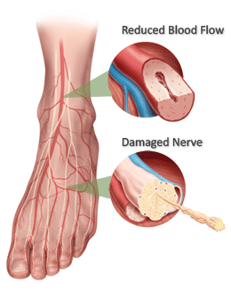
Diabetes mellitus - Complications
D. Neuropathy (Disease of the nervous system)
can lead to foot ulceration and possible amputation

Slide 23
Diabetic foot
Diabetes was responsible for 59% of limb amputations in Lebanon in 2007

Slide 24
Diabetes Mellitus - Prognosis
Regular medical care, compliance with dietary and medical treatment are ESSENTIAL

Slide 25
Diabetes mellitus - Prognosis
Despite the risks associated, most people can live active lives and continue to enjoy the foods and activities they enjoyed before being diagnosed

Slide 26
In Lebanon
Almost 1 in 6 lebanese individuals suffer from diabetes
The latest data show that nearly a quarter of a million lebanese remain undiagnosed
Lebanon occupies the 22nd highest rate of diabetes in the world, ahead of many western countries
More than 95% of cases are due to modern lifestyles: Poor diet, lack of exercise and rising obesity

