Slide 1
Cancer
Prepared by Nadia Jradi masri, M.D

Slide 2
Cancer- Prevalence
The leading cause of death in the developed countries
The second leading cause of death in the developing countries
1 in every 3 persons in developed countries will have Ca vs. 1 in every 5 in developing countries
« WHO 2006 »

Slide 3
Cancer - Prevalence
Most common cancers in ADULTS:
Lung Cancer
Prostate Cancer
Breast Cancer
Colorectal Cancer
« National cancer institute-2010 »

Slide 4
Cancer - Prevalence
Most common Childhood cancers:
Leukemias
Brain tumors
Lymphomas

Slide 5
Cancer- history
Hippocrates (460 BC) described several kinds of cancers, referring to them with the Greek word carcinos (crab or crayfish)
This name comes from the appearance of the cut surface of a solid malignant tumour, with "the veins stretched on all sides as the animal the crab has its feet, whence it derives its name".[

Slide 6
Definition of cancer

Slide 7
Cancer
A cancer is an abnormal growth of cells, usually derived from a single cell.
Cancerous (malignant) cells can develop from any tissue within the body.

Slide 8
Malignant transformation

Slide 9
Cancer- definition
Cancer cells have 3 important properties:
Uncontrolled growth
Invasion of adjacent structures
Spread to other organs of the body: Metastasis

Slide 10
Cancer - definition

Slide 11
Cancer
The term tumor refers to an abnormal growth or mass.
Tumors can be cancerous or noncancerous (benign)
Benign tumors:
No invasion of the surrounding structures: the mass of abnormal cells will remain enclosed
No spread to other organs: No Metastases

Slide 12
Cancer types

Slide 13
Cancer types
Cancerous tissues can be divided into :
Those of the blood :leukemias and lymphomas
“solid” tumors, often termed cancer. Cancers can be carcinomas or sarcomas.

Slide 14
Leukemias and lympkomas
Leukemias and lymphomas are cancers of the blood and blood-forming tissues and cells of the immune system.
They often harm the body by crowding out normal blood cells in the bone marrow and bloodstream, so that normal functioning cells are gradually replaced by cancerous blood cells.
They expand lymph nodes, producing large masses in the armpit, groin, abdomen, or chest

Slide 15
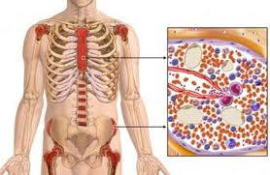
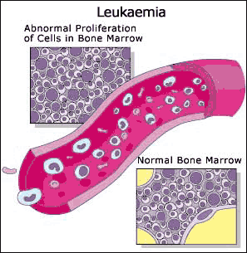
Leukemias

Slide 16
Lymphoma

Slide 17
Carcinomas and sarcomas
Carcinoma
Sarcoma
Examples: cancer of the skin, lung, colon, stomach, breast, prostate, and thyroid gland.
Typically, carcinomas occur more often in older than in younger people.
Examples: cancer of muscle and bone cancer.
Typically, sarcomas occur more often in younger than in older people.

Slide 18
Cancer causes

Slide 19
Cancer- causes
Cancer is the result of an interplay between genetic and enviromental factors

Slide 20
Genetic causes

Slide 21
Cancer- genetic causes
Many families have tendancy to develop some kinds of cancer: Breast Ca, Lung Ca, Colon Ca
Not implicated in all forms of Cancer
Only 5-10% of cancers are entirely hereditary
An extra or abnormal chromosome may increase the risk of cancer. For example, people with Down syndrome, who have three instead of the usual two copies of chromosome 21, have a 12 to 20 times higher risk of developing acute leukemia.

Slide 22
Cancer and Genes
The two major categories of genes involved with cancer are:
Oncogenes are mutated forms of genes that in their normal state regulate cell growth. If they become overactive and signal cells to divide when these cells should not, cancer may develop. The mutation of oncogenes is not entirely understood, but many enviromental factors may contribute,
Tumor suppressor genes normally suppress the development of cancers by coding for proteins that repair damaged DNA and suppress growth. Cancer is more likely when DNA damage impairs tumor suppressor gene function, allowing affected cells to divide continuously.

Slide 23
Enviromental factors

Slide 24
Cancer- Enviromental factors
Enviromental factors can CAUSE or ENHANCE abnormalities in the genetic material of the cell
Chemicals
Radiation
Viruses
Others

Slide 25
Cancer- Enviromental factors
Enviromental factors can CAUSE or ENHANCE abnormalities in the genetic material of the cell
Chemicals
Radiation
Infections
Others

Slide 26
Cancer- Enviromental factors
Enviromental factors linked to cancers formation are called « carcinogens »
These include:
Tobacco smoke
Alcohol; linked to liver cancer
Benzene: linked to leukemia
Asbestos : linked to Lung Cancer
Pesticides: leukemias and lymohomas
The time between exposure to the chemicals and development of the cancer may be many years.

Slide 27
Tobacco smoke
Contains over fifty known carcinogens
Responsible for 90% of cases of lung cancer
Linked with many cancers as: Larynx, mouth, esophagus, bladder, pancreas, kidneys
Resposible for 1 in 3 of all Cancer deaths in the developed world

Slide 28
Tobacco smoke

Slide 29
Cancer- Enviromental factors
Enviromental factors can CAUSE or ENHANCE abnormalities in the genetic material of the cell
Chemicals
Radiation
Viruses
Others

Slide 30
Cancer – Radiation
Sources include:
Medical instruments: X-Rays, CT scans
Sun UV rays linked with skin cancer
Radioactive radiation
No evidence that microwave radiation can cause Cancer

Slide 31
Cancer- Enviromental factors
Enviromental factors can CAUSE or ENHANCE abnormalities in the genetic material of the cell
Chemicals
Radiation
Infections
Others

Slide 32
Cancer - Infections
HPV linked with cervical cancer (vaccine available)
Hepatitis B virus linked with liver cancer( vaccine available)
EBV linked with lymphoma ( No available vaccine)
H-pylori (that typically cause peptic ulcer): stomach cancer

Slide 33
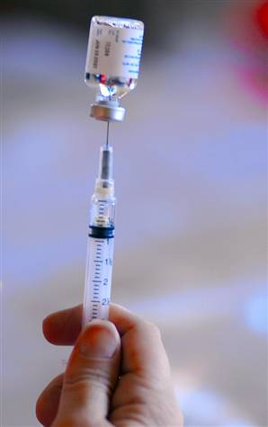
HPV vaccine

Slide 34
HPV vaccine- 2012 recommendations
Recommended for all males and females (sexually active) starting the age 0f 9 years

Slide 35
Cancer- Enviromental factors
Enviromental factors can CAUSE or ENHANCE abnormalities in the genetic material of the cell
Chemicals
Radiation
Viruses
Others: obesity, Lack of physical activity

Slide 36
Cancer and diet
A diet high in fat has been linked to an increased risk of colon, breast, and possibly prostate cancer.
People who drink large amounts of alcohol are at much higher risk of developing esophageal and liver cancer.
A diet high in smoked and pickled foods or in barbecued meats increases the risk of developing stomach cancer

Slide 37
Role of age
Most cancers are more common in older people.
In the United States, more than 60% of cancers occur in people older than 65.
The increased cancer rate is probably due to:
increased and prolonged exposure to carcinogens
weakening of the body's immune system.

Slide 38
Diagnosis of Cancer

Slide 39
Warning signs of cancer
Weight loss
Fatigue
Night sweats
Loss of appetite
New, persistent pain
Recurrent nausea or vomiting
Blood in urine
Blood in stool (either visible or detectable by special tests)
A recent change in bowel habits (constipation or diarrhea)
Recurrent fever
Chronic cough
Changes in the size or color of a mole or changes in a skin ulcer that does not heal
Enlarged lymph nodes

Slide 40
Warning signs of Cancer
Fortunately, most of these symptoms are usually caused by far less serious conditions.
Nonetheless, the development of any of the warning signs of cancer should not be ignored.

Slide 41
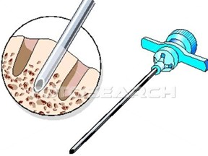
Cancer - Diagnosis
Diagnosis is suspected on the basis of symptoms, radiologic findings
Definitive diagnosis requires the microscopic examination of a biopsy specimen

Slide 42
Treatment

Slide 43
Cancer - Treatment
One or a combination of the following:
Surgery: remove the cancer cells
Radiation at high doses
Chemotherapy: treatment protocols

Slide 44
Radiotherapy
Radiation is a form of intense energy generated by a device
Radiation preferentially kills cells that divide rapidly and cells that have difficulty repairing their DNA (nuclear material): cancer cells
Some normal cells will be affected resulting in side effects.
Not all cancer cells are sensitive to radiation

Slide 45
Chemotherapy
Chemotherapy involves the use of drugs to destroy cancer cells.
Although an ideal drug would destroy cancer cells without harming normal cells, most drugs are not that selective: affecting rapidly growing normal cells such as those in the bone marrow and those lining the mouth and intestine, hair; causing side effects.
One new approach to limiting side effects and increasing effectiveness uses a variety of "molecularly targeted" drugs
Not all cancers respond to chemotherapy

Slide 46
Treatment outcome
Remission: Absence of all evidence of a cancer after treatment.
Cure: A cure means that all evidence of cancer disappears and does not return over a long period of observation. With some forms of cancer, doctors consider people cured if they remain disease-free for 5 years or longer. With other forms, a longer period is required.
Recurrence (relapse): Cancerous cells return after treatment, either in the primary location or as metastases (spread).

Slide 47
Cancer -prognosis
Cancer has a reputation as a deadly disease
Survival rates vary DRAMATICALLY depending on the type and stage of Cancer
For e.g: Childhood leukemias cure rate can approach 90%

Slide 48
Cancer - Prognosis
Earlier treatment is associated with better outcome
Importance of screening

Slide 49
Cancer - Screening
Screening is detection of cancer after it has formed but before any noticeable symptoms appear

Slide 50
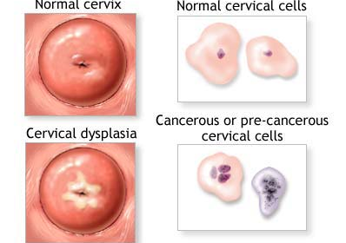
PAP smear: recommended in all sexually active females for early detection of cervical cancer
Cancer Screening

Slide 51
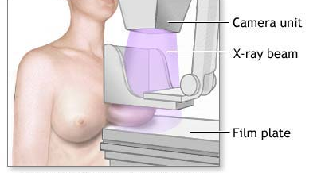
Mammography: recommended in all females above 40 years, every 2 years for early detection of breast Cancer
Cancer Screening

Slide 52
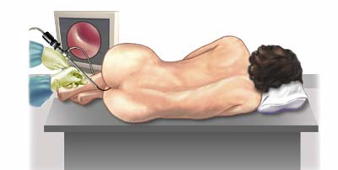
The US Preventive Services Task Force recommends screening for colorectal cancer using fecal occult blood testing, sigmoidoscopy, or colonoscopy, in adults, beginning at age 50 years and continuing until age 75 years.[
Cancer Screening

Slide 53
According to the U.S. Preventive Services Task Force(USPSTF), there is insufficient evidence to recommend for or against screening for: - lung cancer: chest Xray not routinely done -skin cancer -prostate cancer: blood tests PSA level not routinely done
Cancer Screening

Slide 55
Thank You

